Slide 1
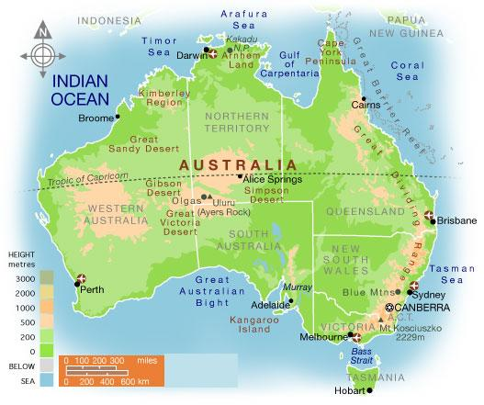
Australia

Slide 2
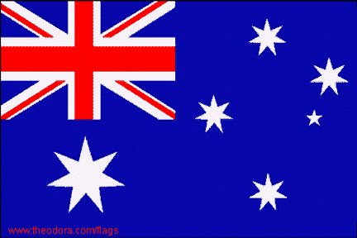
Flag
The Australian flag pictures a large seven-pointed star known as the Commonwealth Star. The Commonwealth Star depicts one point for each of the six original states and the territories of Australia. The other is a representation of the Southern Cross constellation.

Slide 3
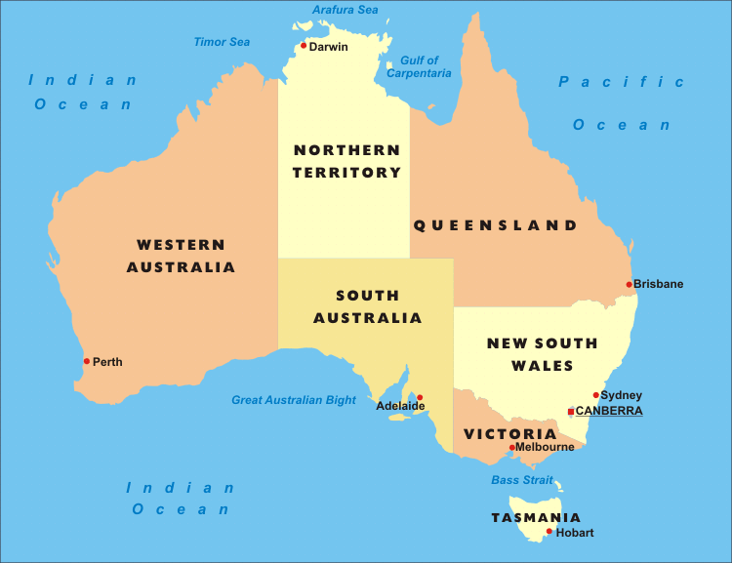
6 States and 1 territory

Slide 4
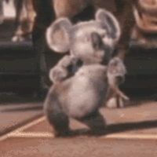
Facts:
Size: 2,967,909 mi² world's smallest continent, but it is the sixth-largest country
National Capital: Canberra, other major cities: Sydney, Brisbane, Perth, Melbourne, Adelaide, Darwin
Climate: arid to semi arid, tropical in north, temperate in south and east
Special Landforms/Waters: Great Barrier Reef, Ayers Rock, plateau, outback, bush, Great Victoria Desert
Arable land: 6%

Slide 5
Facts:
Nationality: Australian
Population: 22,507,617 Birth Rate: 12 Death Rate: 7
Life Expectancy: Total: 82 Literacy Rate: 99%
Ethnic Groups: white 92% (90% have European ancestry mostly British), Asian 7%, aborigines and other 1%
Religion: Christian 64% (Catholic 25%, Protestant 26%), Buddhist 2%, Muslim 2%, unspecified 11%, other 2%, none 19%
Language: English 79%, Chinese 3%, Italian 2%, Greek 1%, Arabic 1%, Vietnamese 1%, other 8%, unspecified 5%
Government Type: Parliamentary Democracy (constitutional monarchy) with a prime minister and head of state (Queen of England)

Slide 6
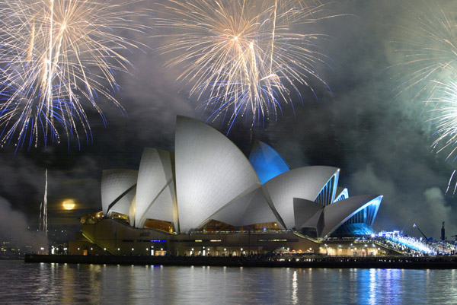
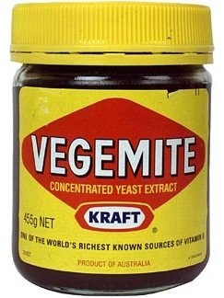
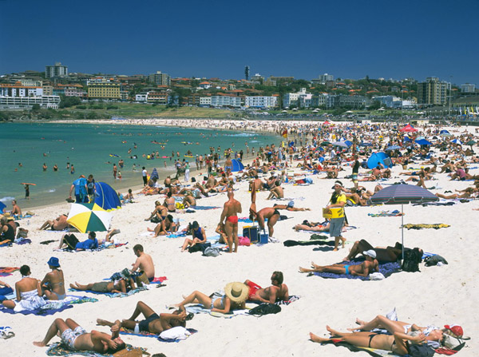
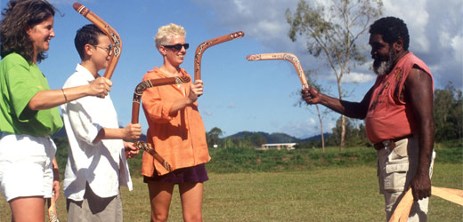
Culture

Slide 7
Talking “Strine”
I was with my mate Barry and his mum and dad. We were on our way back from summer hols on the Gold Coast. We’d stopped to get some petrol, and Barry’s dad had the bonnet up to check the oil. Barry opened the boot to get some tucker because he was hungry. Then in drove this huge lorry with a mob of cattle inside. It was a fair dinkum sight! Barry and I went to natter with the ringer who was driving. He said he was taking the cattle to Melbourne from a station in the outback. The mob had just been mustered last week. Poor bloke, he’d had to make a long diversion because the road had been washed out in a flood. “Boy, you sure got the rough end of the pineapple!” I said. “I’m glad she’s right now.”

Slide 8
Talking “Strine”
I was with my friend Barry and his mom and dad. We were on our way back from summer vacation on the Gold Coast. We’d stopped to get some gas, and Barry’s dad had the hood up to check the oil. Barry opened the trunk to get some food because he was hungry. Then in drove this huge truck with a herd of cattle inside. It was quite a sight! Barry and I went to talk with the cowboy who was driving. He said he was taking the cattle to Melbourne from a ranch in the country. The herd had just been rounded up last week. Poor guy, he’d had to make a long detour because the road had been washed out in a flood. “Boy, you sure got the bad deal!” I said. “I’m glad everything’s okay now.”

Slide 9
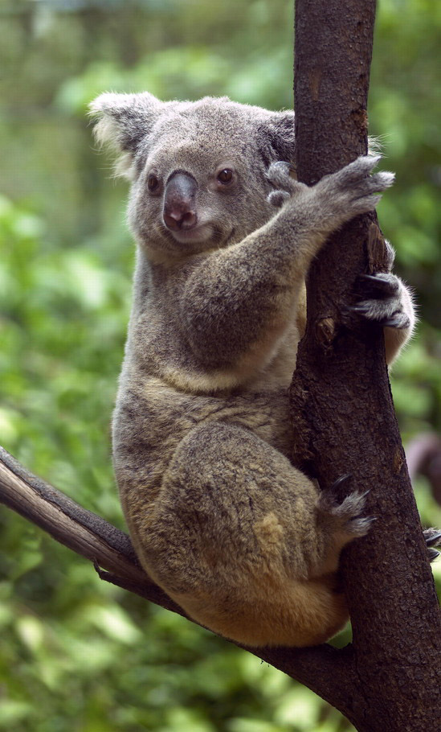
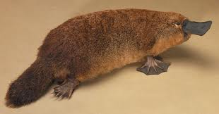
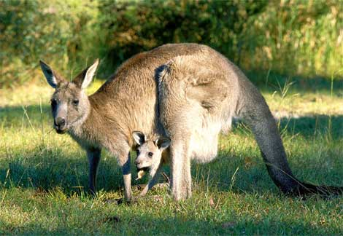
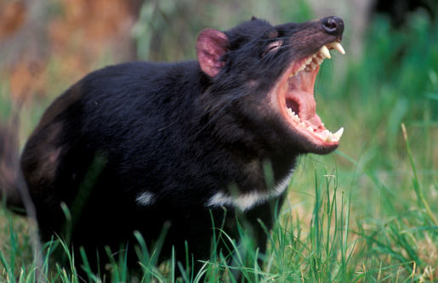
Endemic and Marsupials

Slide 10
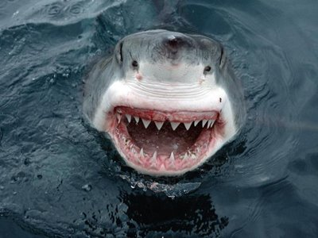
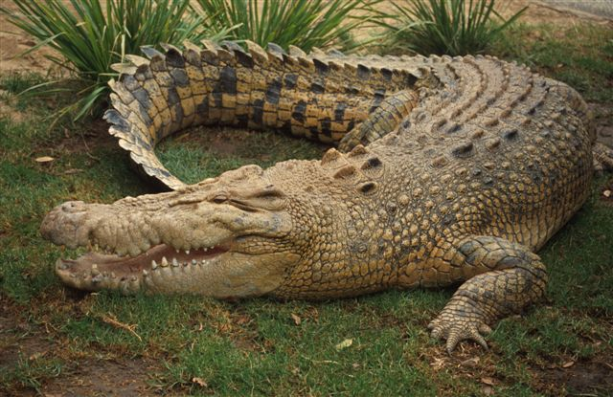
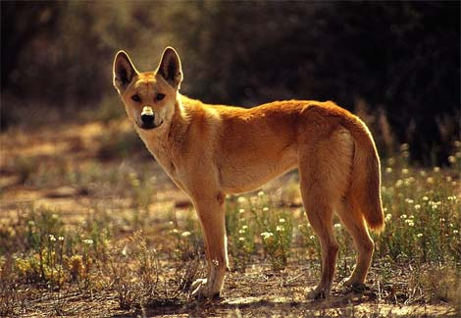
Other animals

Slide 11
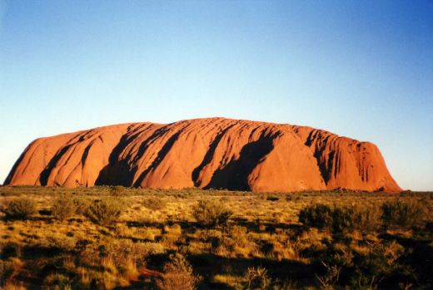
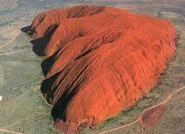
Ayers Rock
Ayers Rock
is located in the middle of Australia
1141 feet high,
2.2 miles long
1.2 miles wide
5.8 miles around the base
Research suggests that Aborigines have lived in the area for at least 10,000 years.
In 1950 Ayers Rock was made a national park.

Slide 12
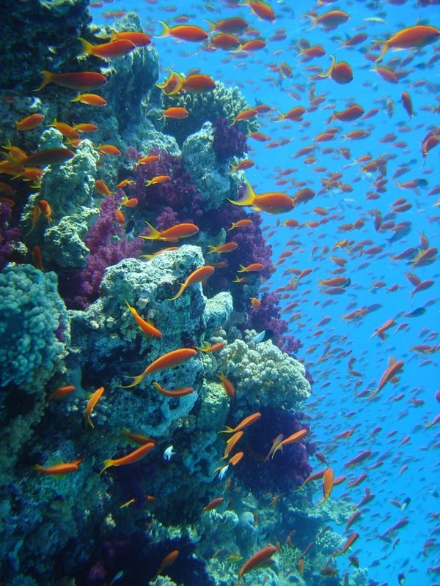
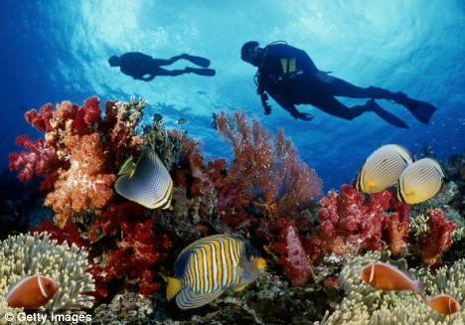
Great Barrier Reef
The Great Barrier Reef is the world's largest coral reef (Coral reefs are limestone formations produced by living organisms, found in shallow, tropical marine waters.) system. The reef is located in the Coral Sea, off the coast of Queensland in northeast Australia.
The Great Barrier Reef is threatened by increased shipping, climate change and tourist.
Great Barrier Reef

Slide 13
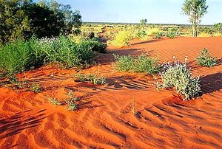
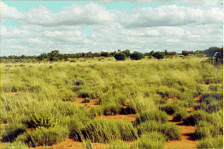
Great Victoria Desert
The Great Victoria Desert in Australia is the third largest desert in the world.
The rainfall range is 8-10” a year.
The days in summer are hot, anything between 90 and 105°F.
The nights can be freezing. Frosts is common.

Slide 14
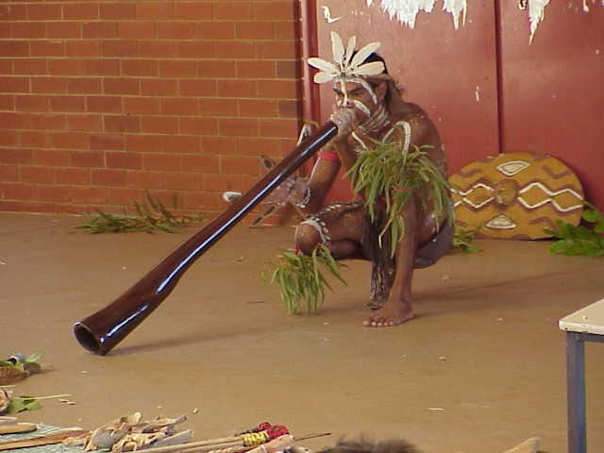
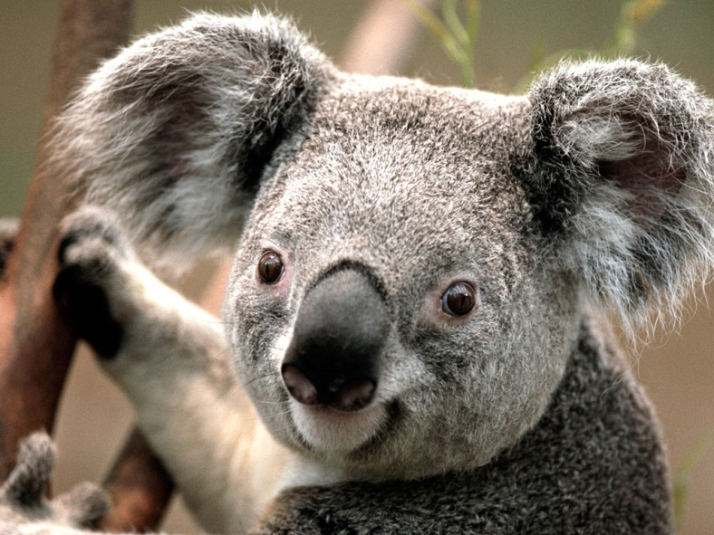
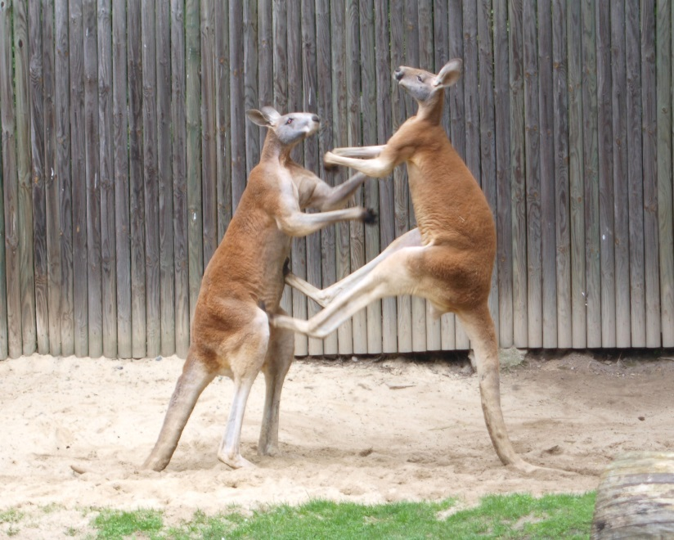
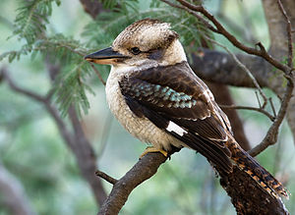
You tube
Didgeridoo
Kicking Kangaroo
Baby in a pouch
Koala Fight
Kookaburra

Slide 15
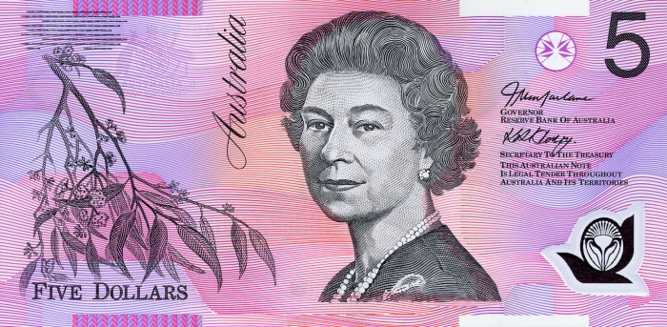
Facts:
Economy: Per capita Income: $43,100, Capitalism, Mixed economy
Natural Resources: coal (Australia is the world's largest exporter of coal), metals, diamonds, petroleum
Agriculture: 4%, Industry: 28%, Service: 69%
Agr. products: wheat, barley, sugarcane, fruits; cattle, sheep, poultry
Industries: one of the world’s top producers of wool
Money: Australian dollar (1.03-$1)
A lot of trade with China, why?

Slide 16
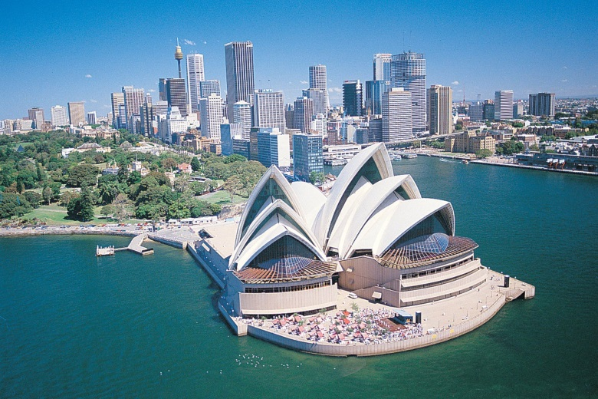
Human/Environment Interaction:
89% urbanization: population concentrated along the eastern and southeastern coasts because of climate is better at the coast
soil erosion from overgrazing, industrial development, and poor farming practices
desertification; clearing for agricultural purposes threatens the natural habitat of many unique animal and plant species

Slide 17
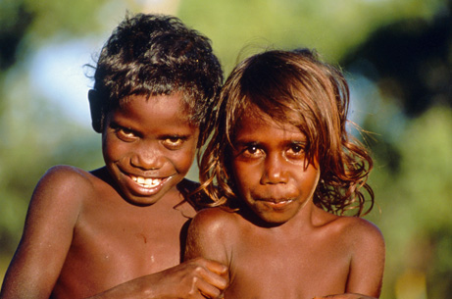
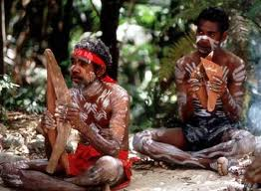
Aborigines
The Aborigines are believed to have arrived in Australia about 40,000 BC during an ice age when Australia was connected to Asia by a land bridge. Tasmania was cut off from Australia when the last ice age ended and sea level rose.

Slide 18
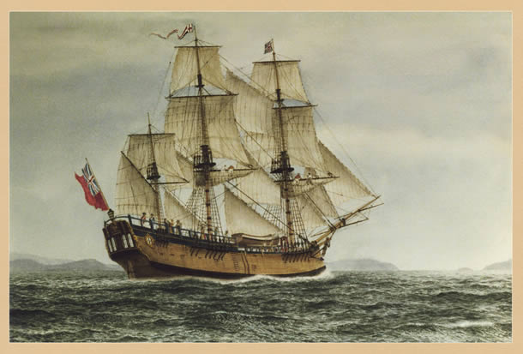
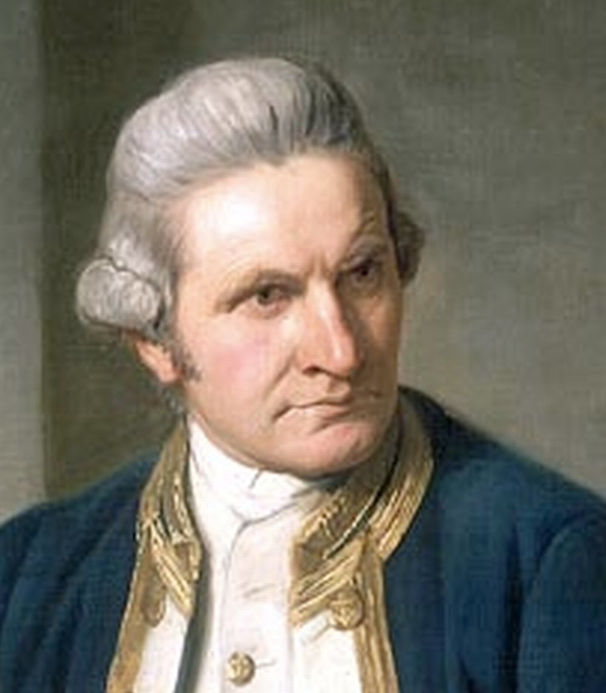
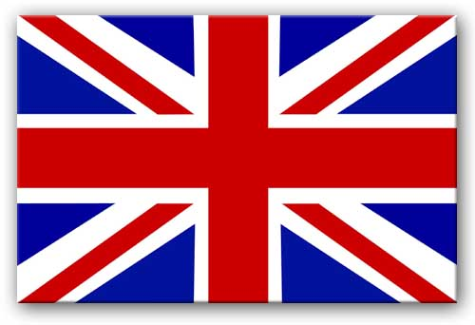
Colonizing
Until the American War of Independence, Britain had sent prisoners to America. American independence ended the practice and the British prisons were full, so they had to find another location.
CRIMES: Stealing money, stealing clothing, stealing food, stealing paper, stealing plants, stealing fish from the river, assault, receiving stolen goods, having more than one wife
In 1770 Captain James Cook arrived on his ship the Endeavour. He claimed the whole of Australia for Britain.

Slide 19
Penal Colony
The Fleet consisted mainly of convicts with officers to guard them. There were many more men than women - around four men for every woman - and this caused problems in the settlement for many years.
In spite of the problems such as: lack of agricultural knowledge and poor soil, the settlement grew.
At first convicts worked on government land for provisions but starting 1793 those who behaved well were freed and given grants of land.
Having a penal colony may not have been the sole motive for founding a colony in Australia. The British established a naval base in the Pacific. They also used Australia as a source of timber.

Slide 20
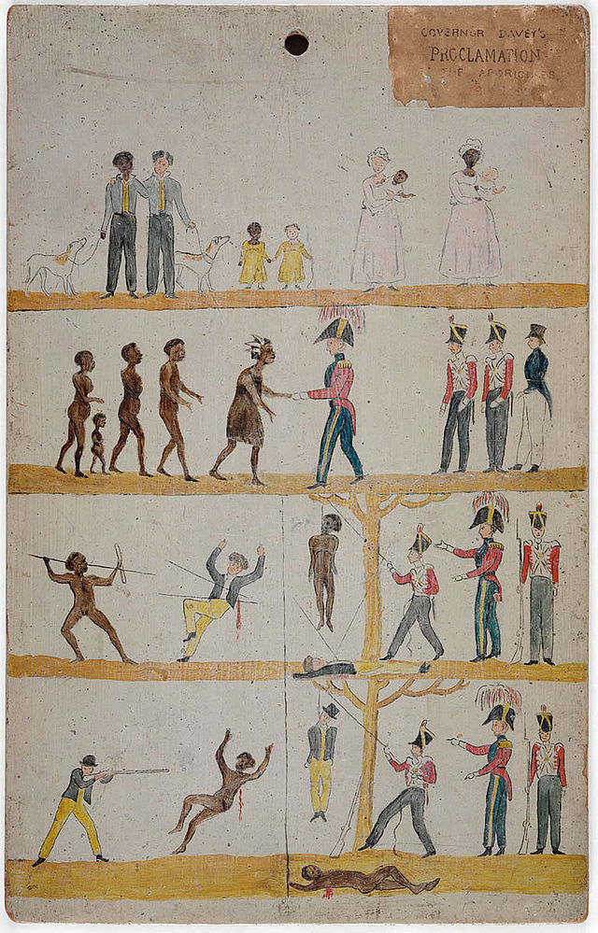
Black War
1828-1832: European diseases such as smallpox, influenza and measles devastated the Aborigines. The Europeans began to drive the Aborigines off their land. As the Whites took more and more of the Aborigines hunting land for sheep, tension grew and violence flared.
Aborigines sometimes attacked settlers and took sheep. In retaliation Europeans sometimes massacred Aborigines. This led to the “Black War”. The Aborigines used 'hit and run' raids and parties of Europeans went out to kill Aborigines.

Slide 21
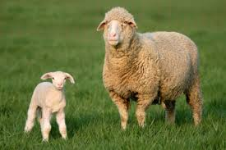
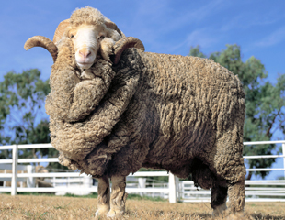
Sheep
In 1797 Merino sheep were brought to Australia. The number of sheep in Australia quickly boomed. There was a huge demand for their wool in England. By 1820 there 100,000 sheep in Australia. By 1830 the figure had reached 1 million. By 1850 there were 13 million sheep in New South Wales.

Slide 22
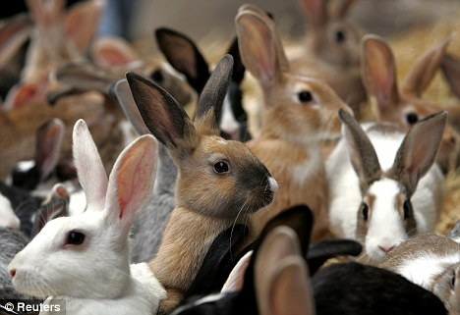
Wild Hares
In the 1800s rabbits were introduced to Australia for hunting by releasing 24 wild rabbits by Thomas Austin on his property. While living in England, Austin had been an avid hunter. Upon arriving in Australia, which had no native rabbit population, Austin asked his nephew in England to send him the rabbits.
The population has grown from the 24 to 3.5 million.
They had no natural enemies, so they multiplied quickly. They have been responsible for soil erosion (by eating the vegetation and by the burrowing in the ground). They kill crops and also cause problems for the native animals because their food sources are disappearing. $206 million dollars damage to agricultural properties every year.

Slide 23
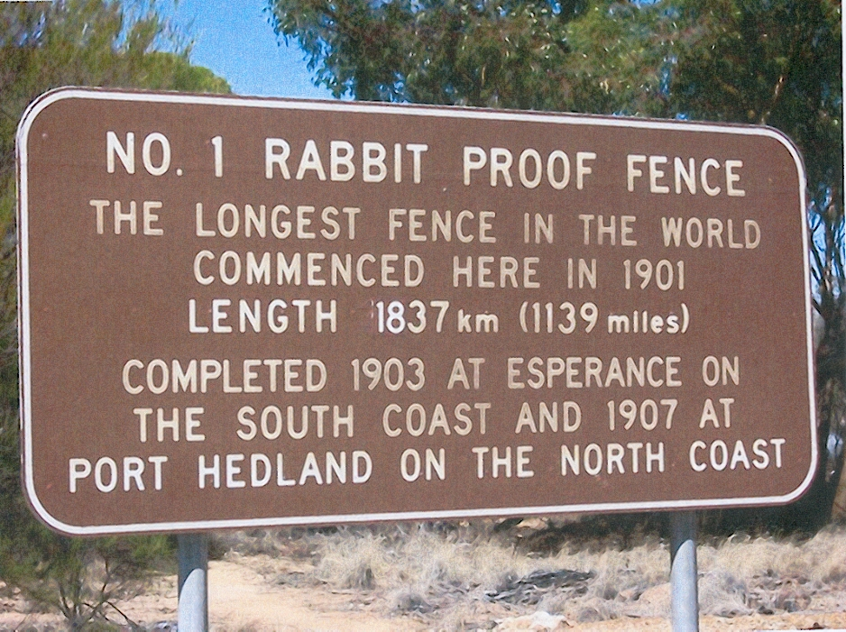
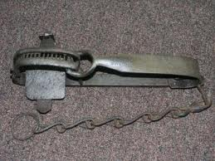
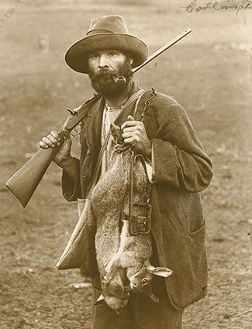
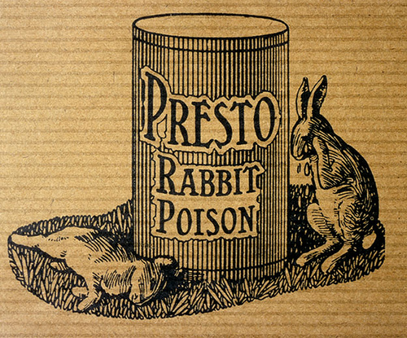

Slide 24
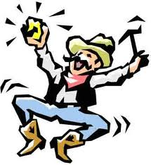
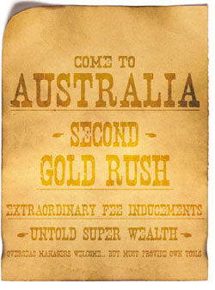
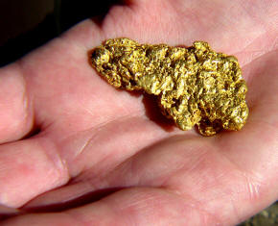
GOLD
In 1851 gold was found. This marked the beginning of the Australian gold rush. The total population went from 430,000 in 1851 to 1.7 million in 1871.
Because so many people were travelling to and from the goldfields, the 1850s also saw the construction of the first railway and the operation of the first telegraphs.

