Slide 1
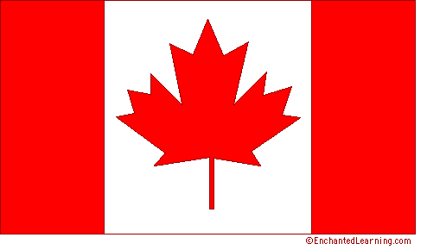
Canada
This is Canada

Slide 2
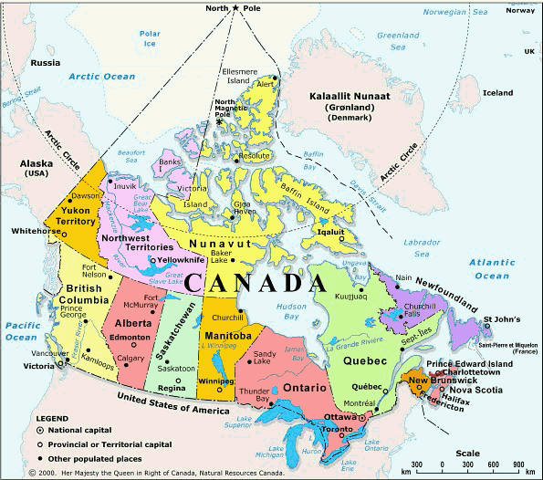
Canada

Slide 3
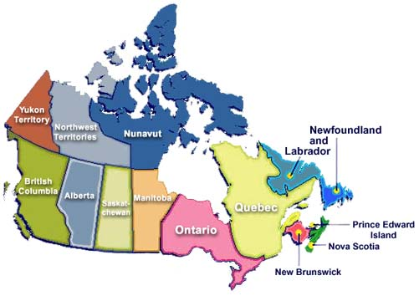
10 provinces and 3 territories: Alberta, British Columbia, Manitoba, New Brunswick, Newfoundland and Labrador, Nova Scotia, Ontario, Prince Edward Island, Quebec, Saskatchewan, Nunavut, Northwest Territories, Yukon Territory

Slide 4
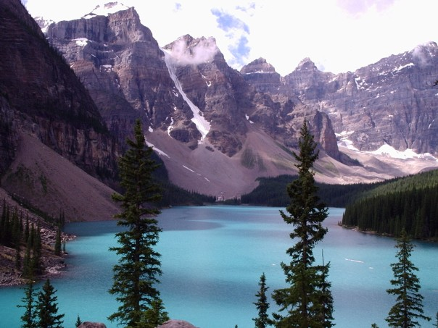
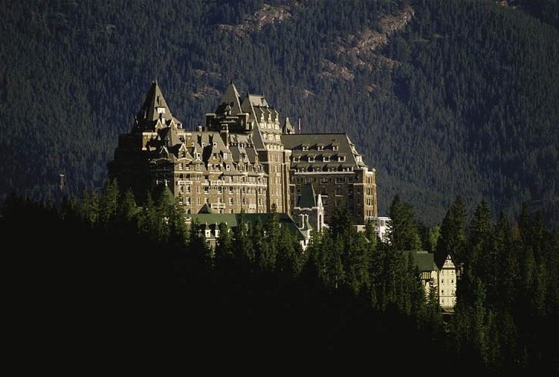
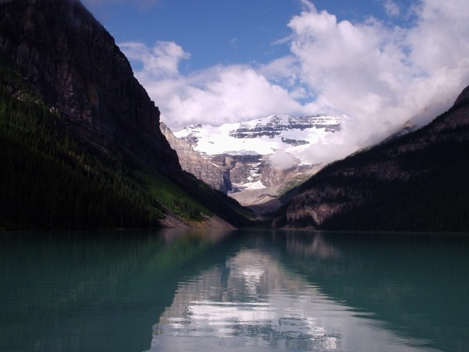
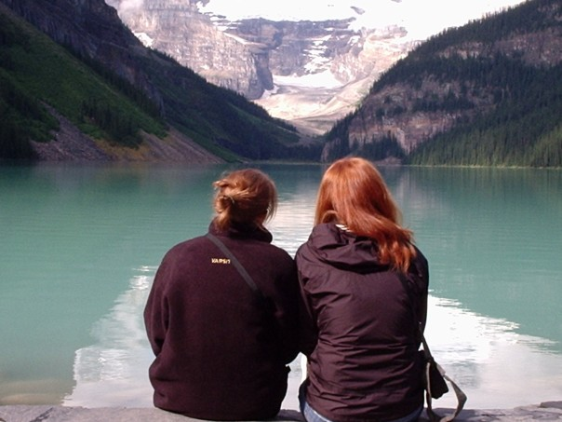
ALBERTA

Slide 5
Canada
Size: 3,855,103mi² slightly larger than USA (#2 in the world behind Russia)
Capital: Ottawa (national capital), other major cities: Vancouver, Calgary, Winnipeg, Toronto, Montreal
Climate: from temperate in south to subarctic and arctic in north, tundra (a large, flat, treeless Arctic region in which the subsoil is permanently frozen (permafrost)
Special Landforms/Waters: Rocky Mountains, Niagara Falls, St Lawrence River, Canadian Shield, Great Lakes
Arable land: 5%
Population: 34,030,589 (small compared to amount of land) Birth Rate: 10 Death Rate: 8
Life Expectancy: Total: 81, Males: 79, Females: 84

Slide 6
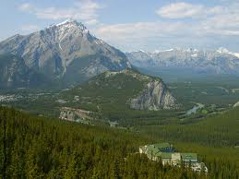
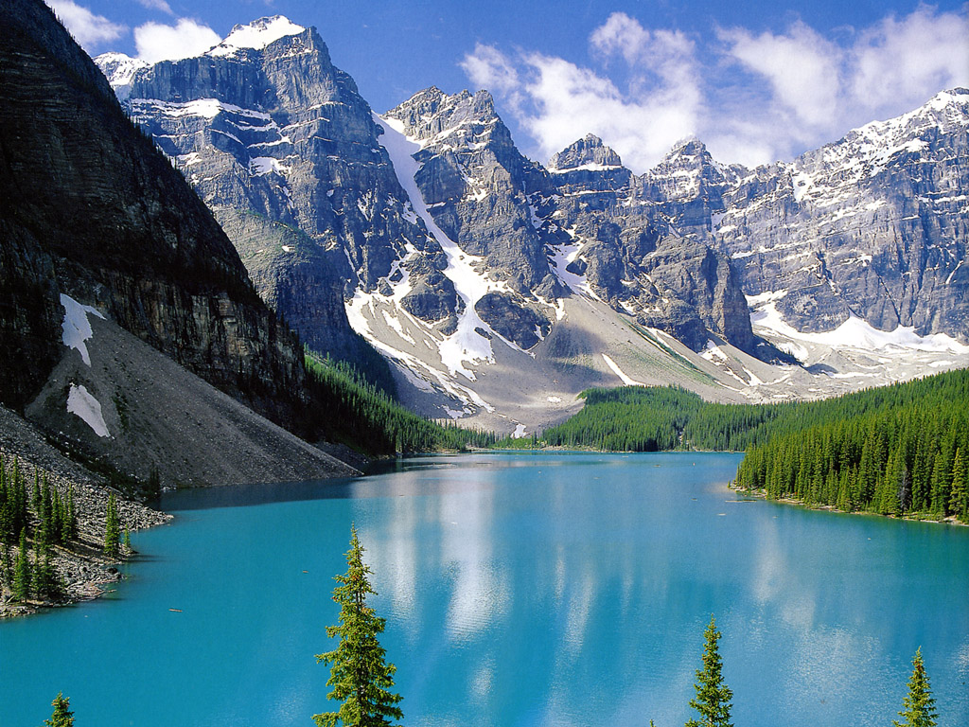
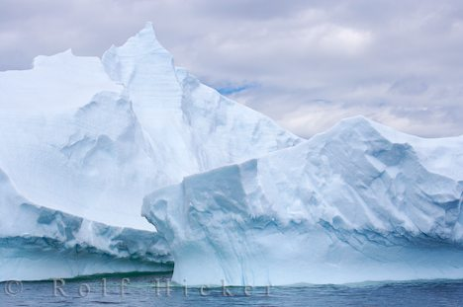
Climate
North America's lowest recorded temperature was -81.4 degrees Fahrenheit at Snag, Yukon Territory, on February 3, 1947.

Slide 7
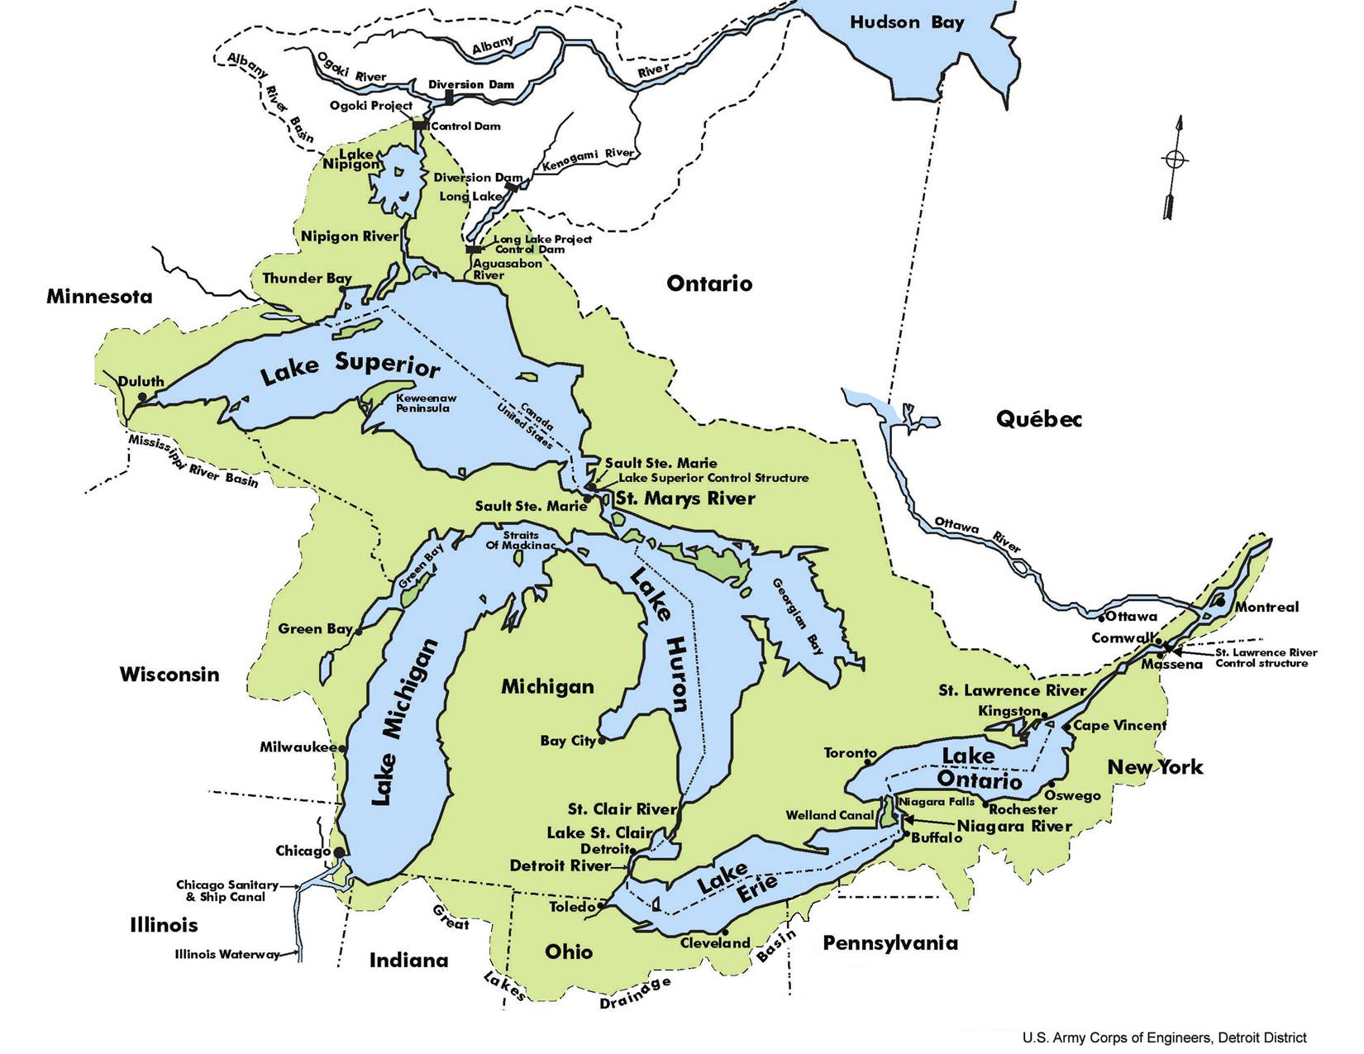
GREAT LAKES (HOMES): Huron, Ontario, Michigan, Erie, Superior

Slide 8
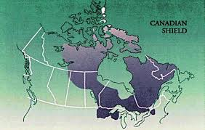
Canadian Shield
The Canadian Shield is an area of valuable mineral resources (gold, silver, copper, lead, iron, etc) that surround the Hudson Bay.
Approximately 1.5 million people make their living mining in the Canadian Shield.
People are concerned about the effects of extraction (the process of removing natural resources so that they can be used to meet human needs)on the Canadian Shield. The blasting and digging changes the environment and puts new pollutants in the air.

Slide 9
Facts:
Nationality: Canadian
Ethnic Groups: United Kingdom 28%, French 23%, other European 15%, Native American 2%, other 6%, mixed 26%
Religion: Christian 70% (Catholic 2/1 Protestant) , Muslim 2%, other 12%, none 16%
Language: English (official) 59%, French (official) 22%, other 19%, (many are Bilingual)
Literacy Rate: 99%
Government Type: a parliamentary democracy with a constitutional monarchy
Prime Minister (Head of Government) and President (Head of State) who is the representative of England’s Queen
Provinces are administrative divisions of a country with their own governments (like states).
Territories have a bit less power than the provinces. They still have representation in the federal government, but don't have local governments. One of the biggest difference is that the provinces get to vote on changes to the constitution but the territories do not.

Slide 10
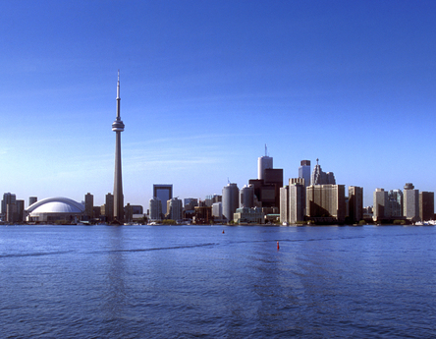
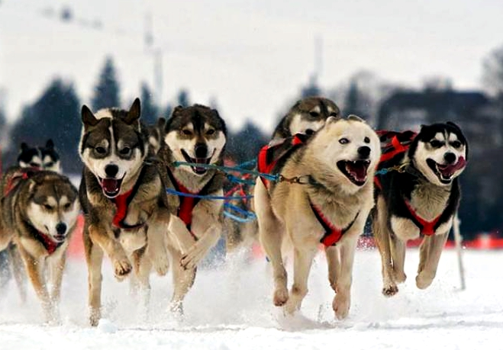
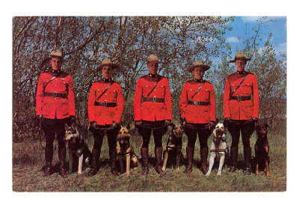
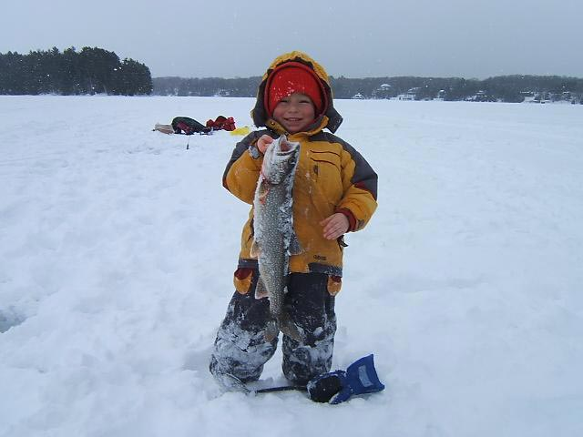
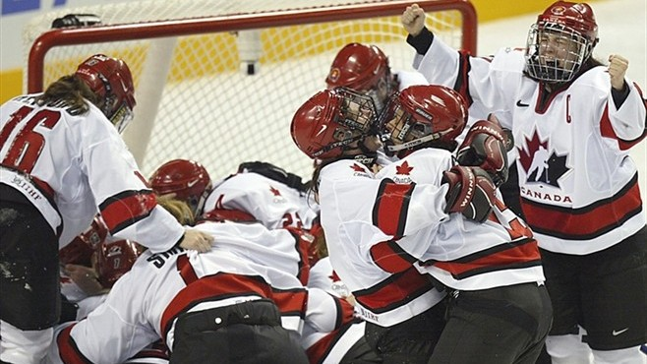
Culture

Slide 11
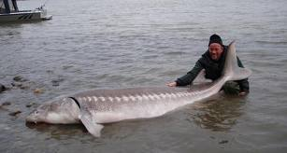
Facts:
Economy: Per capita Income: $42,300, Capitalism, mixed economy
Natural Resources: (Minerals and metals are a major natural resource), fish, timber, wildlife, coal, petroleum, natural gas, hydroelectric
Agriculture: 2%, Industry: 20%, Service: 78%
Most of the industry is in the Ontario and Quebec area because of access to St. Lawrence River.
Agr. products: wheat, barley, tobacco, fruits, vegetables; dairy products; forest products
Fishing and timber cutting are a major industry
Money: Canadian dollar (1.10/$1)
Poverty Rate: 15%
Member of NAFTA
USA buys 80-85% of Canada’s exports

Slide 12
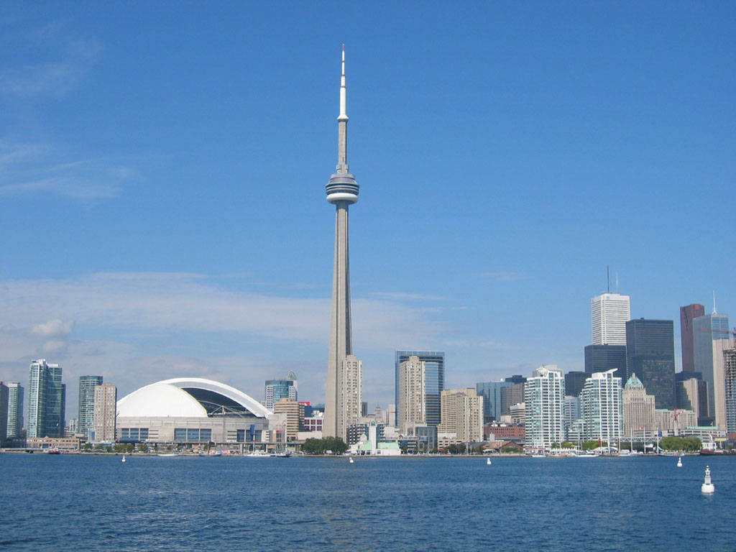
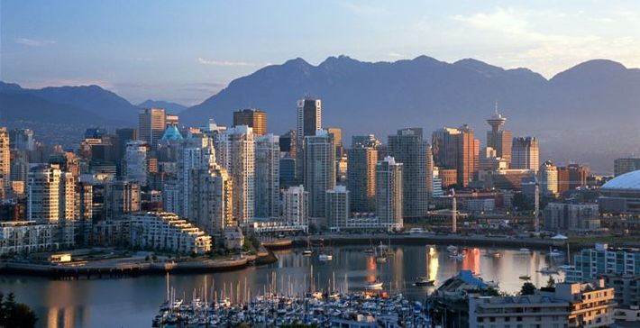
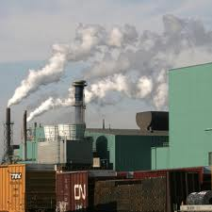
Movement and Human/Environment Interaction:
89% urbanization
75-90% live within 100 miles of USA/Canada border, why?
The majority of the French-Canadians live in Quebec
Air pollution
Acid Rain

Slide 13
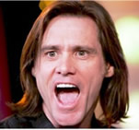
Other Facts:
Quebec sovereignty movement: Separatist want Quebec to become a separate country because they feel they are very different. They follow many of the French traditions, unlike others parts of the country that followed English ways. (Secede)
The border between the United States and Canada is the longest unprotected, land border in the world (approximately 3900 miles on the lower 48 states).
Canada has the longest coastline of any country in the world at 151,600 miles
Hockey and lacrosse are the national sports.

Slide 14
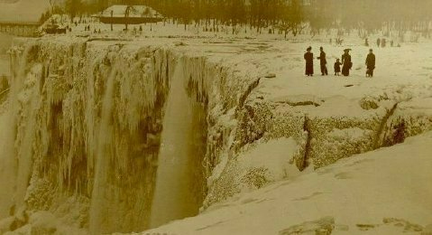
Niagara Falls

Slide 15
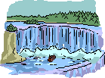
Niagara Falls Facts:
The word "Niagara" is derived from the Iroquois Indian word "Onguiaahra" meaning "the strait"
The flow was halted over both falls on March 30, 1848 due to an ice jam in the upper river.
Five daredevils lost their lives trying to conquer Niagara in some container.
The first person to go over the Falls in a barrel and survive was a 63 year old female schoolteacher.

Slide 16
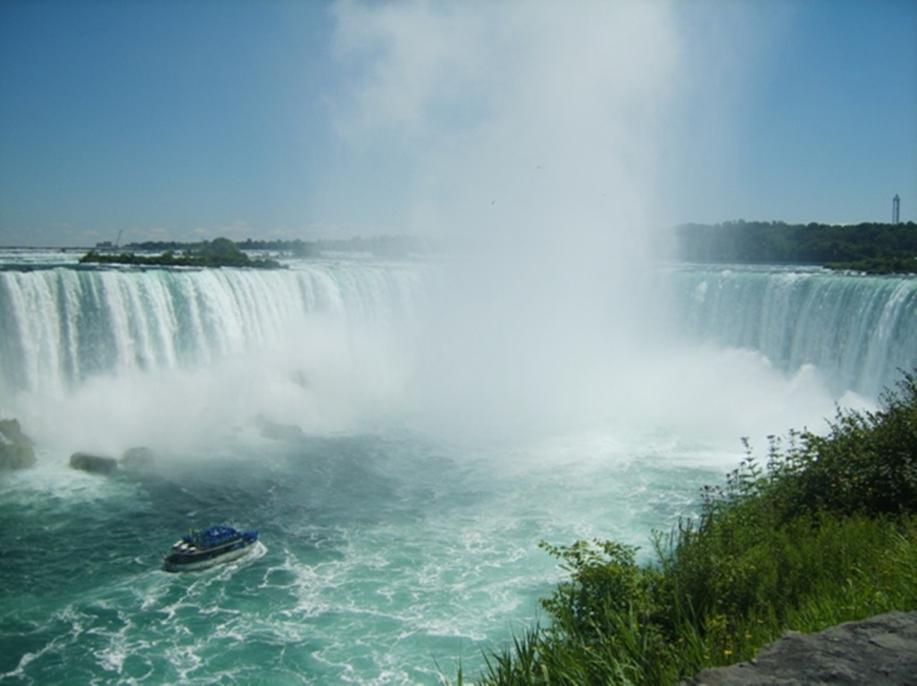
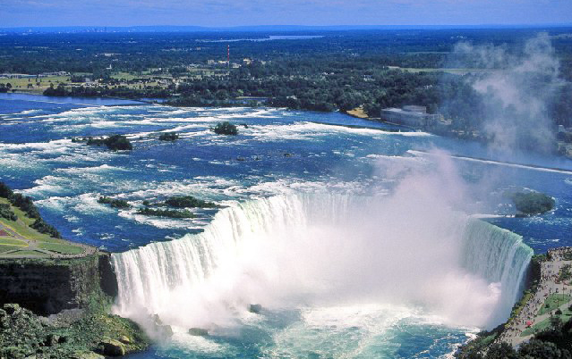
Niagara Falls
Series of Falls
Sits on the border of USA and Canada
1060 ft long
176 ft high
150,000 gallons per second
Niagara Falls

Slide 17
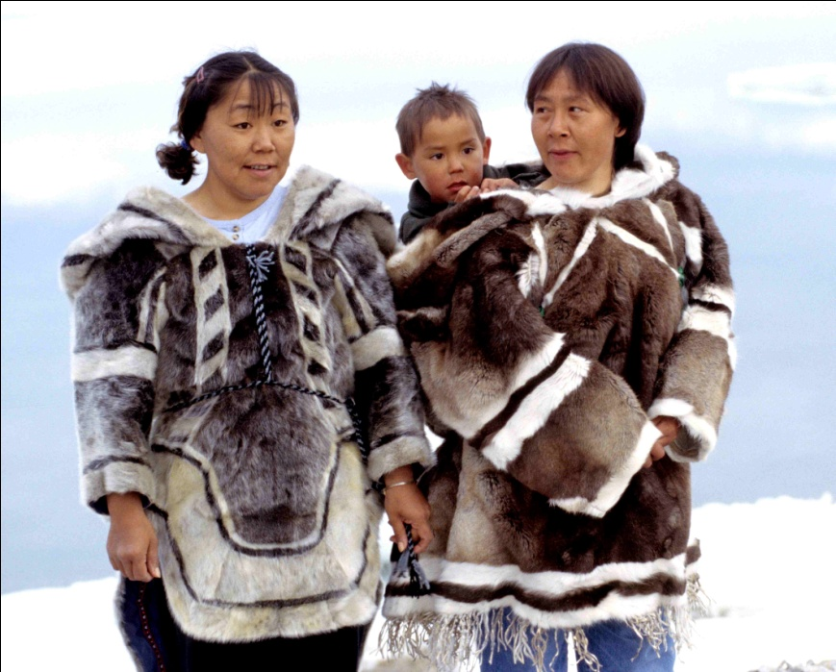
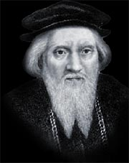
History
Man migrated from Asia across the Bering Strait possibly around 40,000 BC following their herds.
In the north the Inuit (Eskimos – means eater of raw meat) lived by hunting seals, walruses and whales. They also hunted caribou, deer, bear, fish and beaver.
The first Europeans to reach Canada were the Vikings, but did not stay due to problems with the natives.
In 1497 the English king Henry VII sent an Italian named Jean Cabot on an expedition across the Atlantic to Newfoundland.

Slide 18
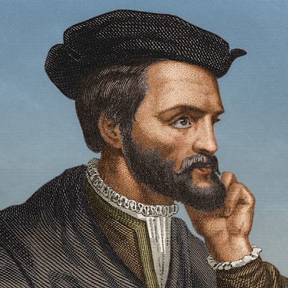
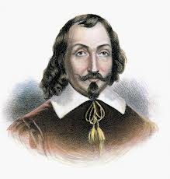
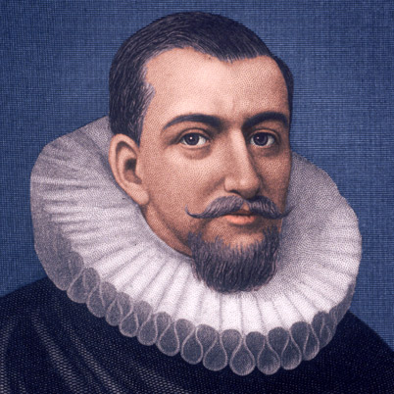
Then in 1534 a Frenchman named Jacques Cartier sailed into the St Lawrence River, which he named after one of the saints of the Catholic church.
Cartier meets a tribe who uses the word “kanata” for village. Later the word becomes Canada.
1603 Samuel de Champlain, a Frenchman, made the first permanent settlement, Quebec.
The English were also interested in Canada. In 1610 Henry Hudson discovered Hudson Bay.

Slide 19
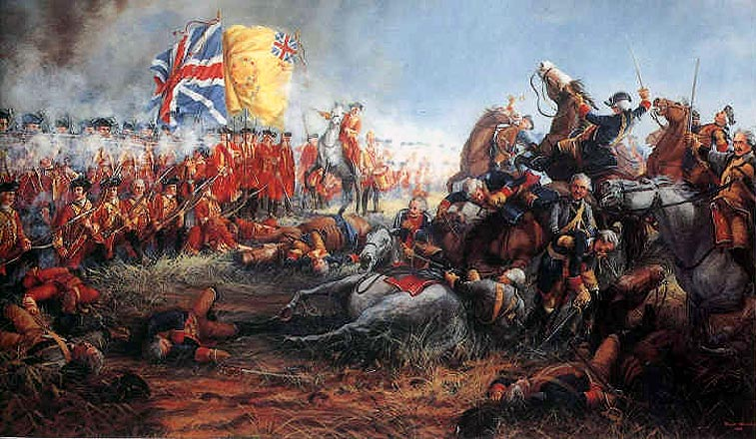
During the Seven Years War (1756-1763) the Britain and France fought in Europe. At the same time they fought the French and Indian War in North America. In 1763 the French lost and were forced to sign the Treaty of Paris. France had to give all their territories, including Canada to Britain.
The British were then left with the problem of how to deal with the French Canadians. They decided to allow the French Canadians to practice their own traditions. The French Canadians were also allowed to keep French civil law alongside British criminal law.

Slide 20
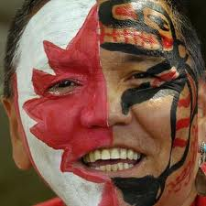
In 1818, the 49th Parallel was set as the main border between Canada and the US.
The Klondike Gold Rush, also called the Yukon Gold Rush, was a migration by an estimated 100,000 prospectors to the Klondike region of the Yukon in north-western Canada between 1896 and 1899.
British North America Act (BNA Act) united the colonies of Canada in 1867. It became a parliamentary democratic government. Canada was the first country to gain its independence through legislation, rather than revolution from Britain. Britain agreed to Canada’s independence as long as they promise to keep “ties” to England.
In 1999, Northwestern Territories was divided into two and a new territory called Nunavut was created. The Inuit was given the area Nunavut (means “our land”) to govern independent of the remaining section of Canada.

