Slide 1
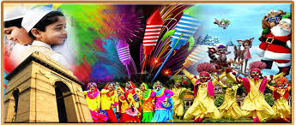
Culture
The attitudes, customs and beliefs that distinguish one group from another

Slide 3
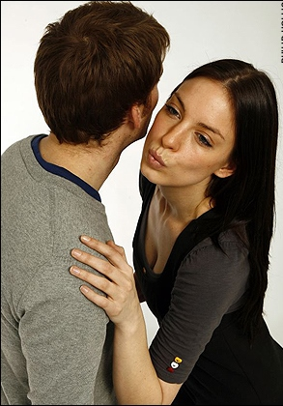
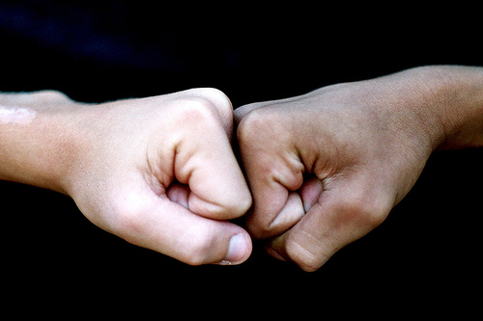
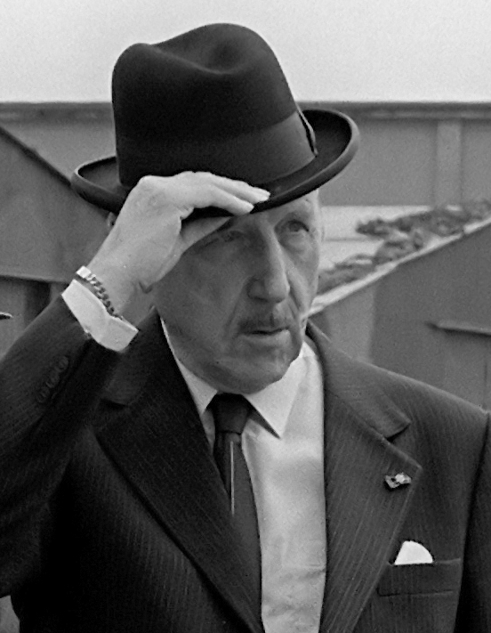
Forms of Greetings

Slide 4
COMMUNICATION
The exchanging of information or news.

Slide 5
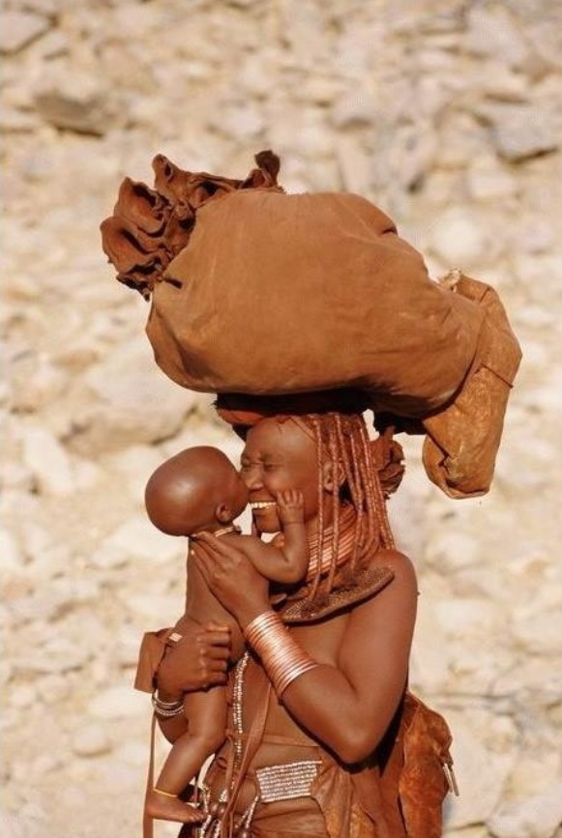
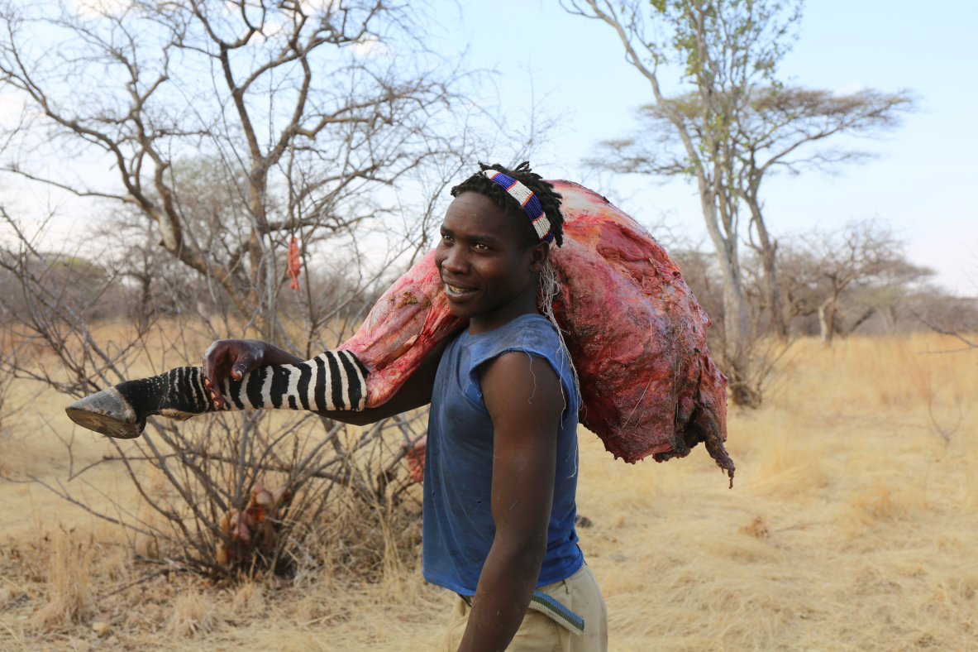
Roles
the function assumed or part played by a person or thing in a particular situation.

Slide 6
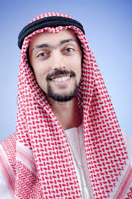
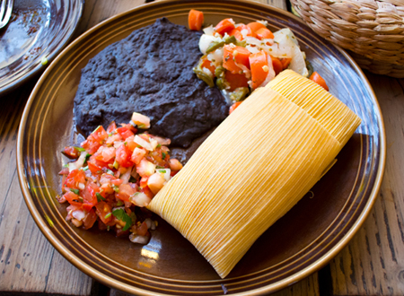
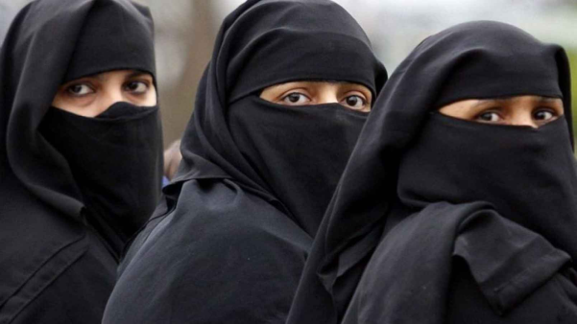
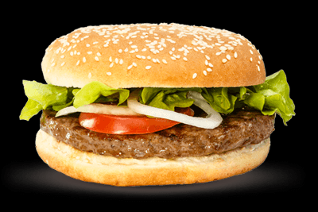
Examples of culture
Food
Music
Clothing
Language
Religion

Slide 7
Southern versus Northern Language
Britches Pants
Buggy Cart
Coke Soda or Pop
Cut Turn
Fixin About to
Gussied up Dressed
Mash Push
Reckon Think
Y’all All of you
Winder, idear, yellar Window, Idea, Yellow

Slide 8
Language Families
Romance Languages: the group of languages derived from Latin. Such as: French, Spanish, Italian, and Portuguese
Germanic Languages: a branch of the Indo-European family of languages mainly from Northern Europe. Such as: English, Dutch, Swedish, Danish
Slavic Languages: a branch of the Indo-European family of languages mainly from Eastern Europe. Such as: Russian, Polish, Bulgarian
Learn a Language

