Slide 1
Culture of Latin America

Slide 2
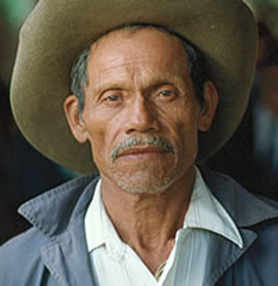
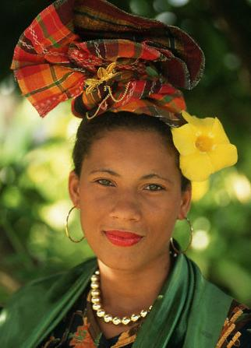
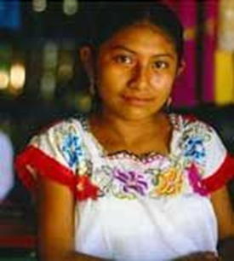
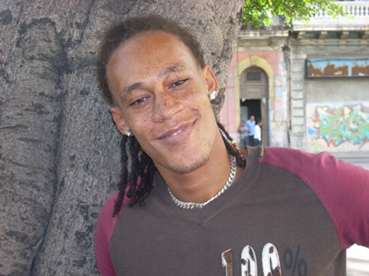
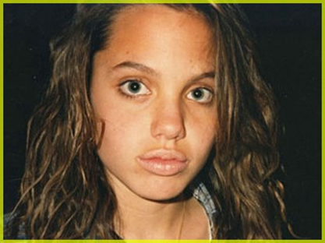
Latin America
Nationality: Indigenous
Ethnic Groups:
Native “Amerindian
Mestizos (Native and European)
Mulattoes (African and European)
Whites
Creoles (an European born in the Caribbean)
Black
Other
Religion: Christian
Language: Spanish only 93% ( Mexico is largest Spanish-speaking country in the world), Brazil speaks Portuguese
Literacy Rate:
Mexico: 94% (students can drop out at age 14 and officially work)

Slide 3
Make Pie chart of ethnic groups
Mestizo 48%
White 25%
Amerindian 10%
Mulatto 7%
Black 6%
Other 4%

Slide 4
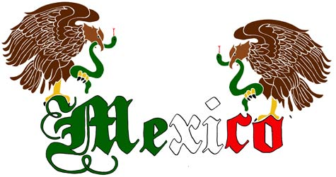
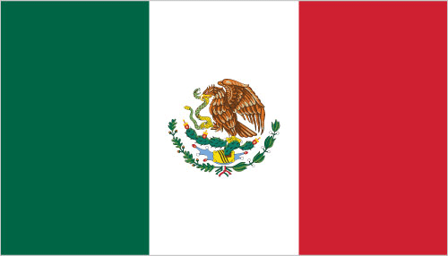
Size:761,600 mi²
Arable land: 13% (with irrigation)
Population: 119,713,203
Birth Rate: 19 Death Rate: 5
Life Expectancy: Total: 75,
Males: 73, Females: 78

Slide 5
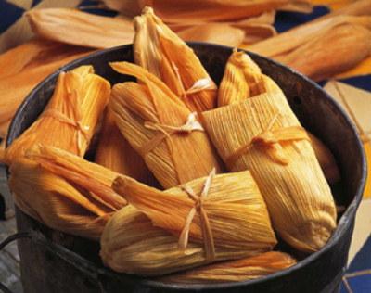
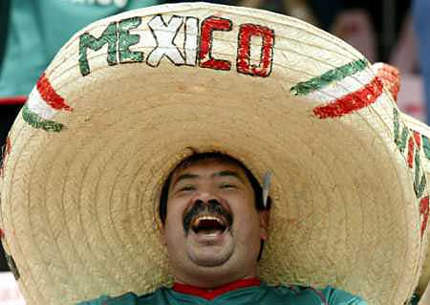
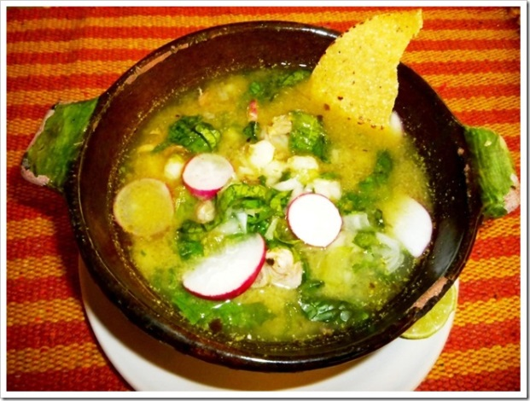
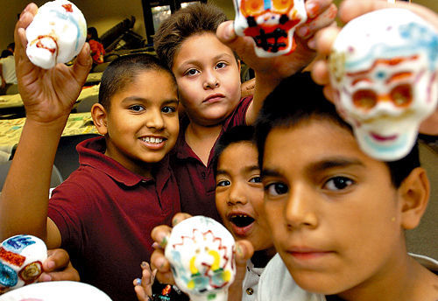
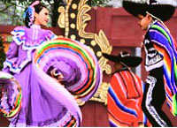
Mexico

Slide 6
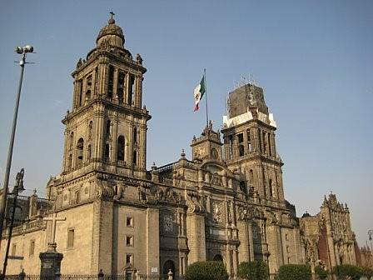
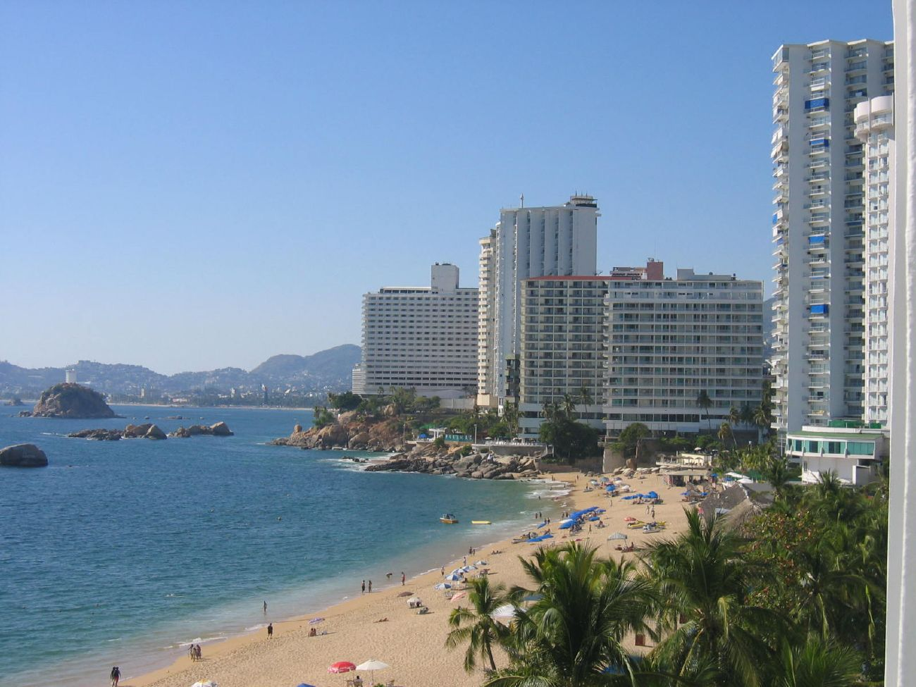
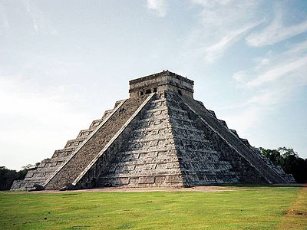
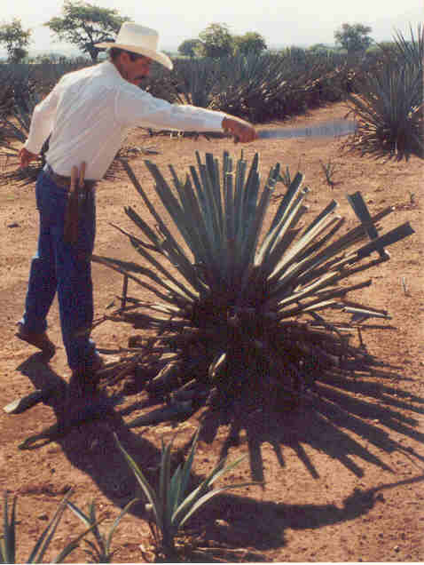

Slide 7
Central America
Size: 185,607 mi²,
More than 1000 miles North to South, 300 miles wide
Special Landforms/waters: entire area is an isthmus (small piece of land that connects two larger pieces of land), Panama Canal (not a strait)
Arable land: 12% (using irrigation)
Population: 41,829,265
Birth Rate: 23 Death Rate: 5
Life Expectancy: Total: 73 Males: 71, Females: 75

Slide 8
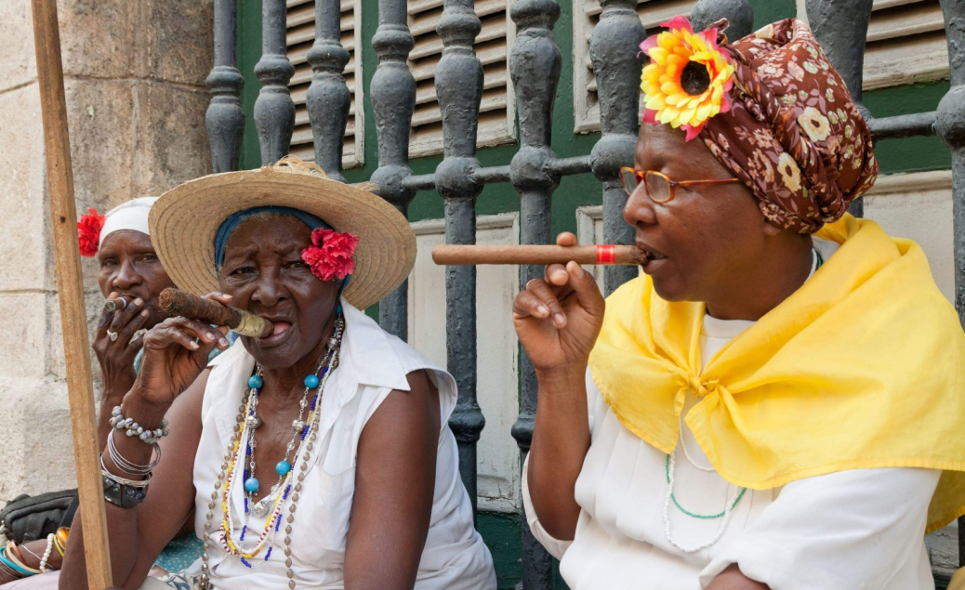
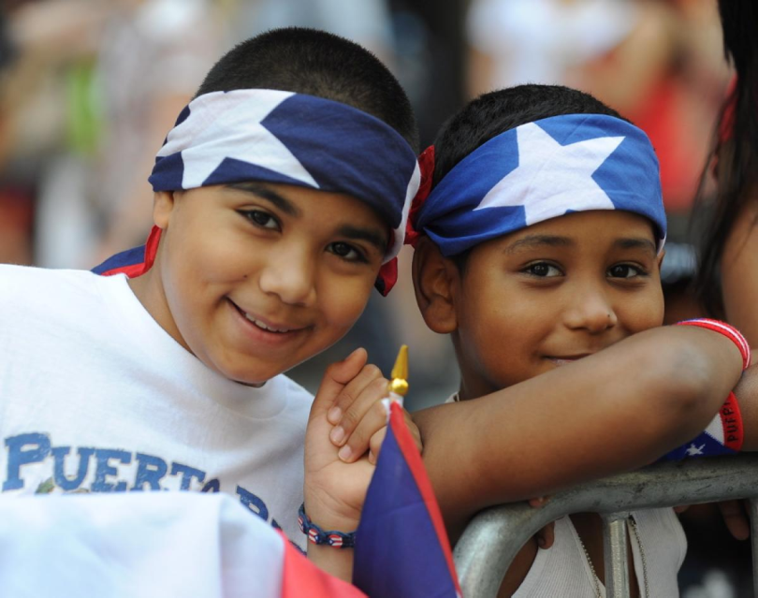
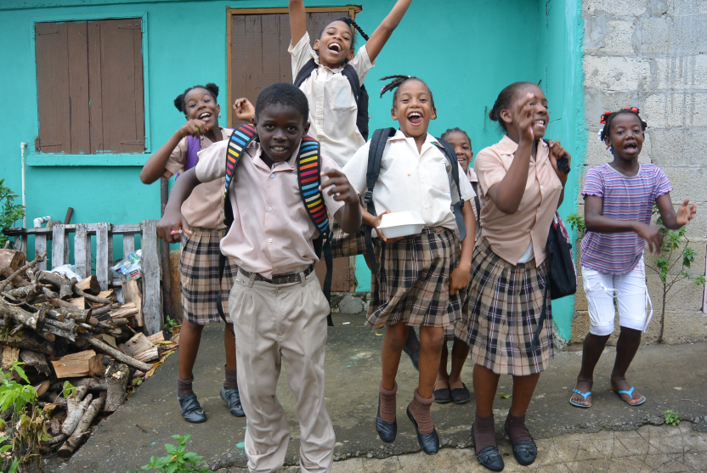
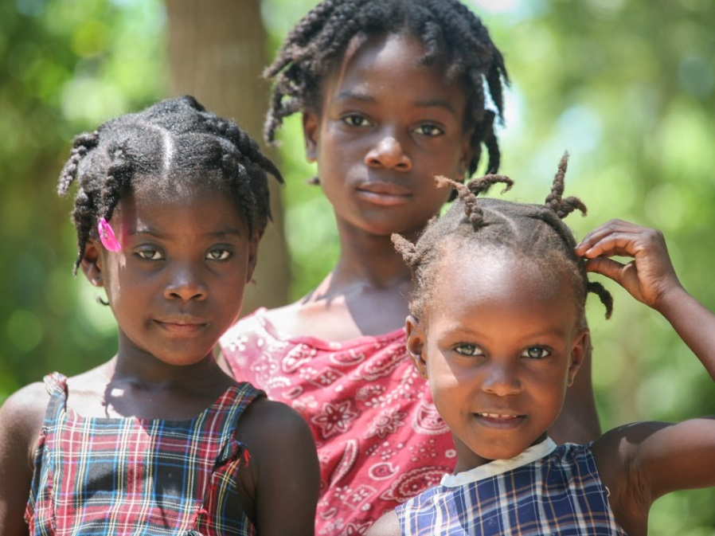
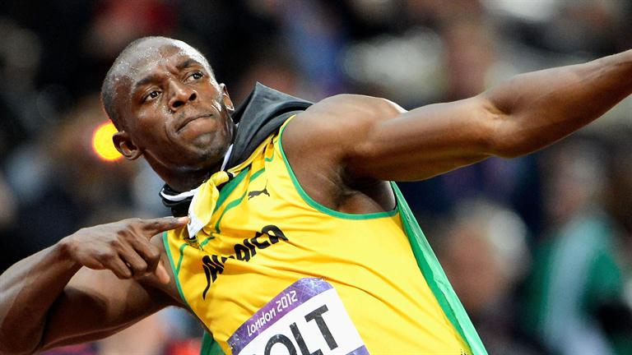
People of the Caribbean

Slide 9
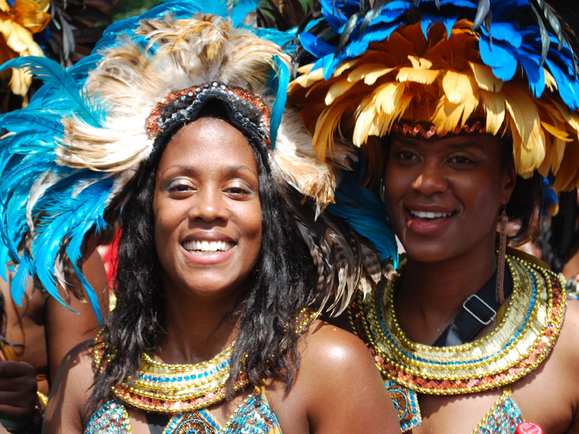
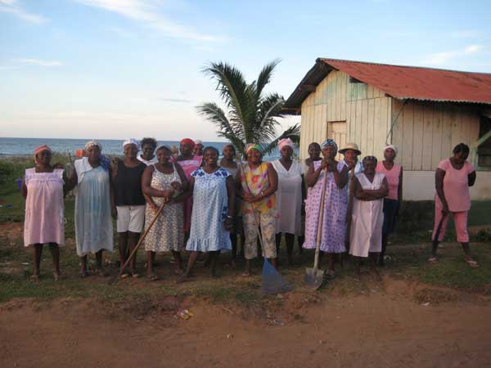
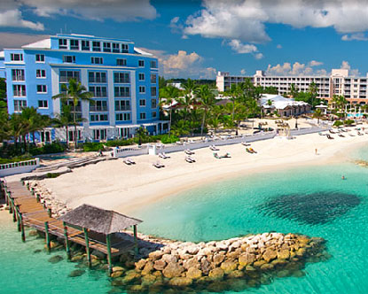
Caribbean

Slide 10
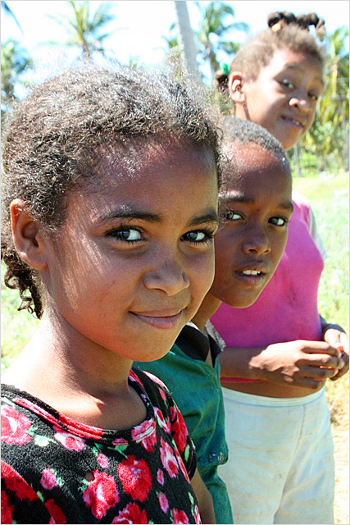
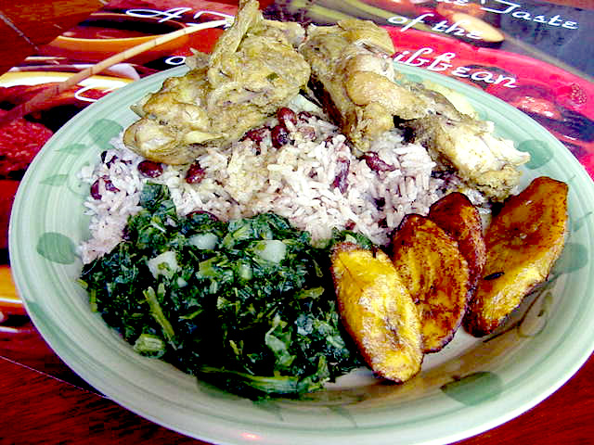
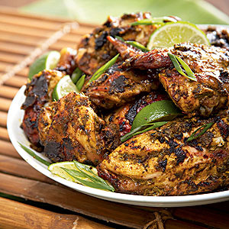
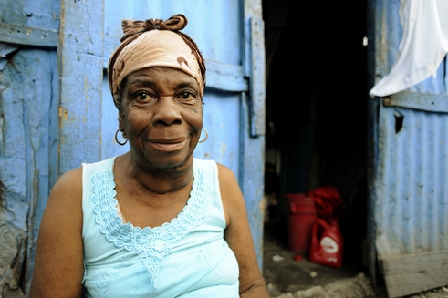

Slide 11
Facts of the Caribbean:
Archipelago: a group of islands
Made up of two groups of islands
Greater Antilles: Cuba, Jamaica, Haiti, Puerto Rico and Dominican Republic
Lesser Antilles: 700 smaller islands: Bahamas, Virgin Islands (includes the West Indies)
Islands cover 90,700 mi²
Bordering Waters: Gulf of Mexico, Caribbean Sea, Atlantic Ocean
Cuba is the largest island, Saba is the smallest (5 mi² and 2000 people)
Approximately 37,000,000 total population for all

Slide 12
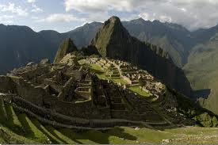
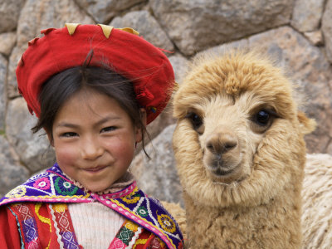
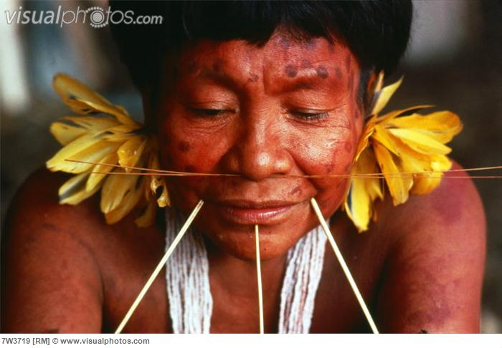
South America

Slide 13
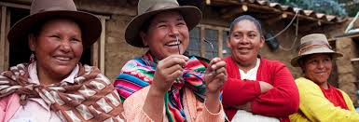
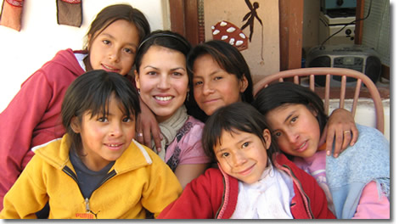
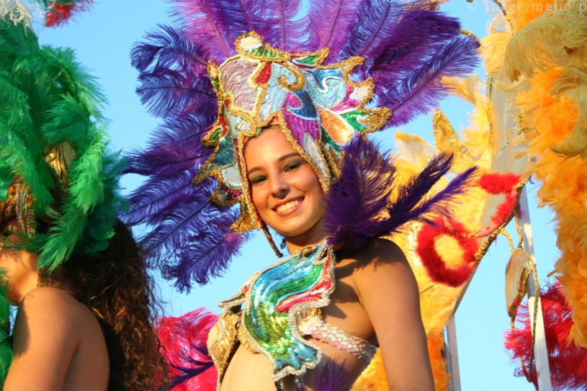
South America
Most people live within 200 miles of coast
Natives make up many areas around the Andes
Mestizos and Mulattos make up a major portion of the population
People of African ancestry can be found through out due to the slave trade.

