Slide 1
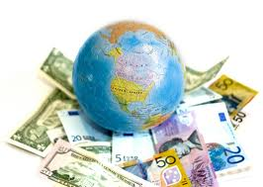
Economy

Slide 2
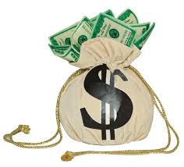
What is economics?
Economics is the study of the making, buying, and selling of goods or services.
The use of MONEY!

Slide 3
Early economics
“To trade without money” is called bartering.
Eventually people found they could not always trade because they did not have something the other person wanted. People started using currency, which was coins or paper money for trade.
  Forms: Cash/Coin, Credit Cards, Debit Cards, Checks
Currency Exchange: is changing one country's money into another country’s money

Slide 4
Economics today
Today there are 4 basic forms of economies.
  Traditional
  Market
  Command
  Mixed
Most countries fit somewhere on a “economic continuum”

Slide 5


Economic Continuum
Pure
Command
Pure
Market
Mixed Economy

Slide 6
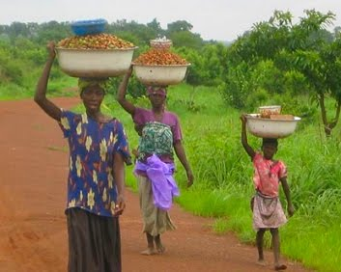
Traditional Economy
Definition: is when people's economic roles are the same as those of their parents and grandparents.
Tradition or customs decides what these people do for a living and how their work is performed.
Typically found in rural and poor countries or areas.

Slide 7
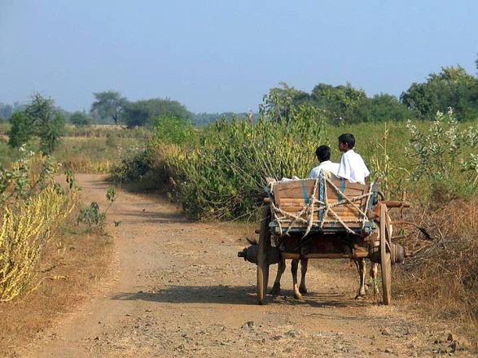
Traditional Economy
Disadvantage:
  No technology
  Little improvement or advancement
Advantage:
  Males and females roles are clearly defined

Slide 8

Market Economy
In a market economy, people make the decision of how much to charge (distributor or producer) and how much they are willing to pay (consumer) and not the government.

Slide 9
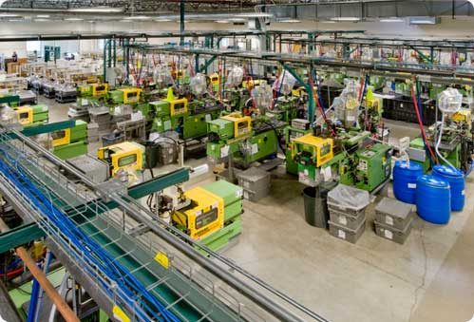
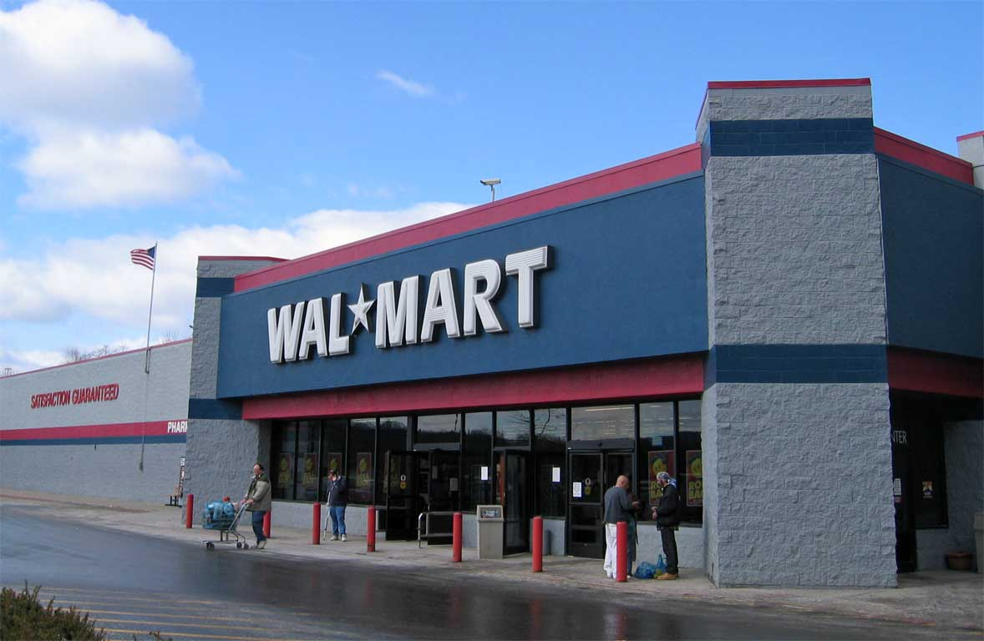

What are producers, distributor and consumers?
A producer (manufacturer) is anyone who makes or grows a good or performs a service.
A distributor (retailer) is anyone who sells or gives out a product or service.
A consumer is anyone who buys a good or a service.

Slide 10
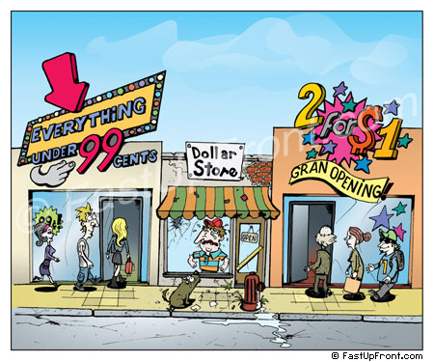
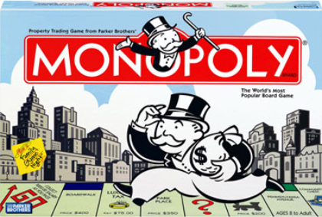
What is an competition?
Competition is the act or process of trying to get or win something. Companies make the effort to attract customers by offering the most favorable terms or prices.
Monopoly is having complete control over the entire supply of goods or services and it is illegal.

Slide 11


What is an entrepreneur?
An entrepreneur is a person who comes up with a product or service, or a better way to produce one. He found the resources, the money, and the time to produce a new product. He takes the risk.

Slide 12
Market Economy
Advantages:
  Easier to become wealthy
  Consumers have choices (competition)
  Business can charge any price
Disadvantage:
  There can be a clear difference between the wealthy and the poor
  People may not be able to afford necessities
  Easier to become poor

Slide 13
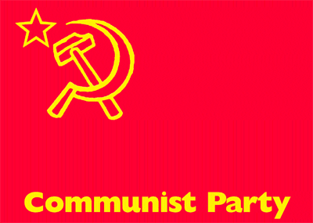
Command Economy
Definition: is when all aspects of the economy are planned and controlled by the government
No person may independently decide to open and run any kind of business. The government decides what goods and services are to be produced. And the government sells these goods and services.

Slide 14
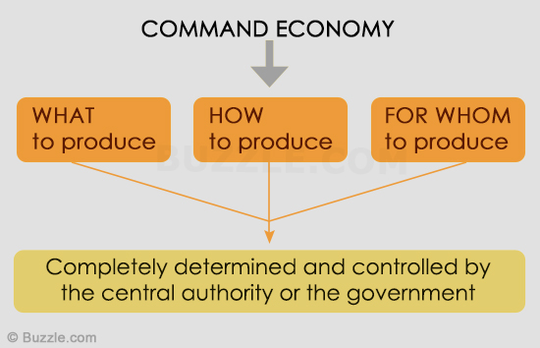
Command Economy
Advantages:
  Everyone equal, No economic classes
  Less crime
  Needs are met by the government
Disadvantage:
  Few choices, decisions are made by government based on what is best for majority
  No incentive to improve
  Little entrepreneurship

Slide 15
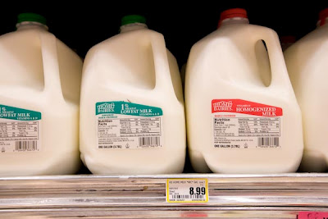

Mixed Economy
Definition: is when the economy is controlled by both individuals (market) and by the government (command).
The government takes care of people’s needs while individuals takes care of people’s wants.

Slide 16
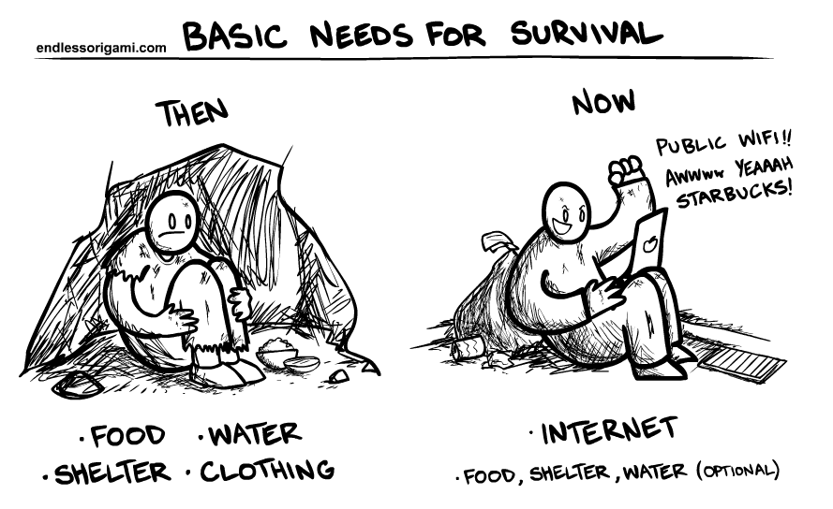
Mixed Economy
Advantages:
  Balance of needs and wants
  Government makes sure that people have the opportunity to receive basic needs
Disadvantage:
  Economic classes
  People must decide “how bad they need/want something”

Slide 17
Mixed Economy
MARKET (US) COMMAND
⬅==========*=============================➔
No country is not specifically one or the other. Most are a mixed. They fall somewhere between purely market and purely command.
Some are closer to one end than another, but no country is 100% command or market!
A country’s form of government directly affects the type economy.

Slide 18


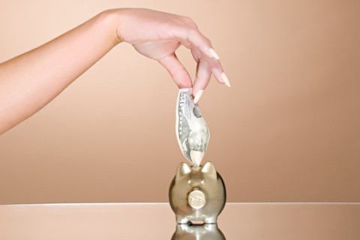
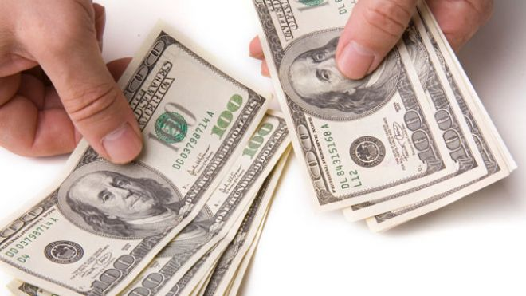
What is INTEREST?
Interest is the extra money you have to pay for borrowing money.
Interest is the extra money you earn for saving money.
You earn Interest when you place money in a savings account.
You pay Interest when borrow money. You must pay back what you borrow plus interest.

Slide 19
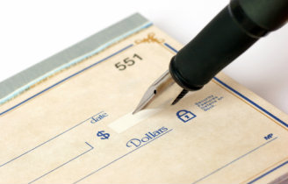
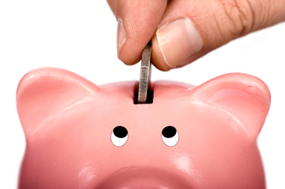
Checking Account versus Savings Account
Checking account is money you have and can be used anytime. A checking account may or may not earn interest.
Savings account is money you set back and intend on not using for a period of time. A saving account earns more interest because it isn’t used often. The longer it stays in the account the more it earns.

Slide 20
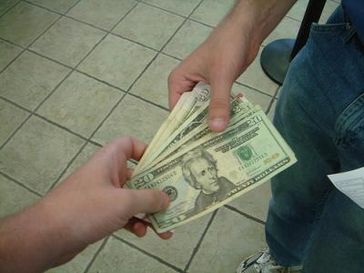
When is a good time to borrow money?

Slide 21

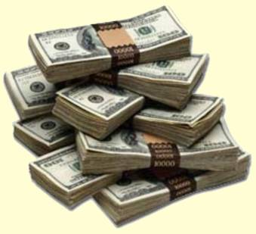
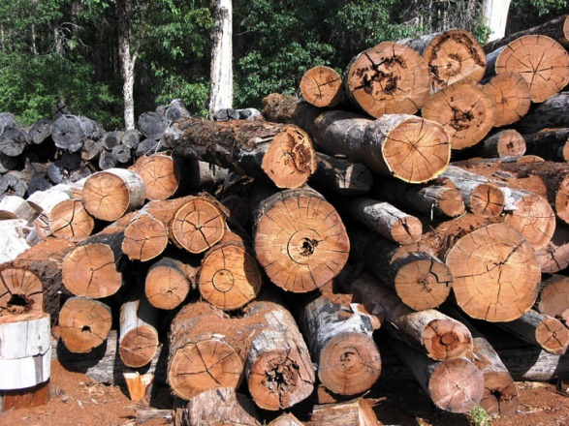
What are Productive Resources?
Capital Resources: man-made resources used in production; such as money, building, tools, etc.
Natural Resources: natural materials used in productions; such as water, trees, coal, gas, land, etc.
Human Resources: is the employees or anything that directly affects the employees; such as training

Slide 22

One affects the Other
Increasing capital helps a business.
When you improve the business, the GROSS DOMESTIC PRODUCT (GDP) improves.
GDP: the total value of goods produced and services provided in a country during one year.
Improving the GDP means more profit!

Slide 23
Economic terms
A Budget is an estimate of income and expenses for a set period of time.
A Profit is the gain after the expenses are subtracted from the amount received.
A Deficit is the loss after the expenses are subtracted from the amount received.
Scarcity means that there are lacking in quantity or number; not plentiful, and therefore, people must make choices.
Specialization is when an individual or a company specializes in doing one part of a task, and relies on others to complete the other parts. You do one thing very well instead of a lot of things just ok!

Slide 24
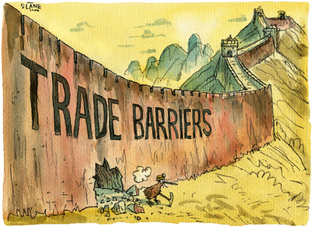
Trade Barriers
Trade barriers are things that prevent a country or business from trading freely.
Three Types:
  Economic
  Physical
  Political

Slide 25
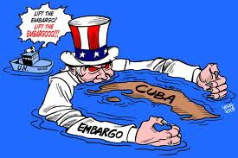
Economic Trade Barriers
Economic barriers are barriers that prevent people from trading with each other.
Embargo: an official ban on trade with a particular country
Sanctions: a threatened penalty for disobeying a law or rule.
Quota: a limited or fixed number or amount
Tariffs: a tax on imports

Slide 26
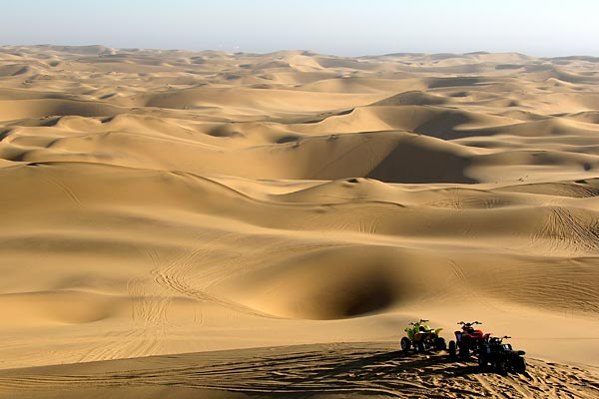
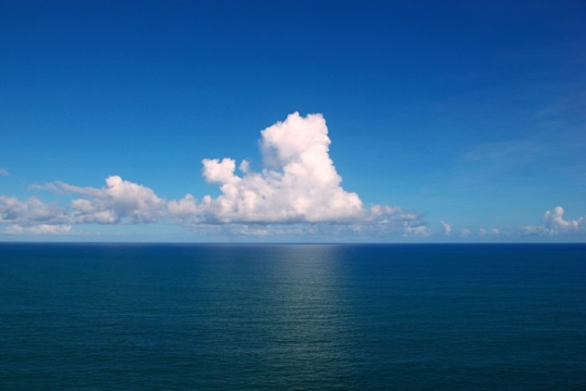
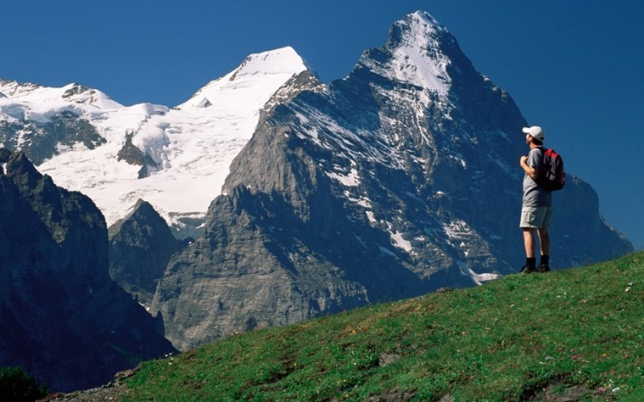
Physical Trade Barriers
Physical barriers are natural or man made physical barriers that prevent people from traveling
Mountains
Deserts
Large bodies of Water
Landlocked

Slide 27


Political Trade Barriers
Political barriers are the differences among people that prevent people from trading with each other.
Religious Differences
Government Types
Cultural Beliefs

Slide 28
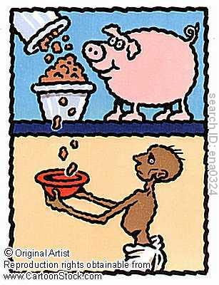
Developing Countries
(Low Standard of Living) vs
Developed Countries
(High standard of Living)
“In developing countries people die of starvation, in developed countries they die of overeating.”

Slide 29
Determining Development
To determine a country’s development, these statistics are usually considered by the United Nations
Per Capita Income/GDP (Gross Domestic Product)
Life Expectancy
Literacy Rate
Education
Healthcare System

Slide 30
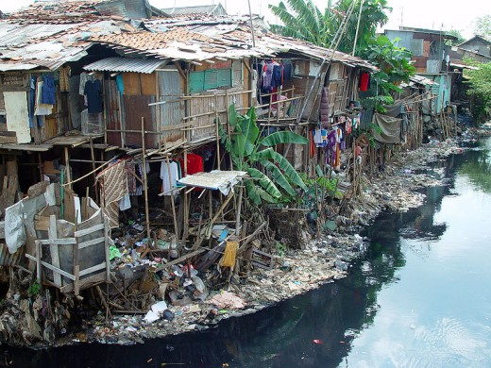
Developed vs. Developing
Developing Country (Rural areas)
  Little industry, low standard of
  living, low money value, bad
  heath care, little or unused able
  resources and low literacy rate
  -BUT-
  Unmanageable population, high
  poverty, high agriculture
  (subsistence farming), and high
  death rate

Slide 31
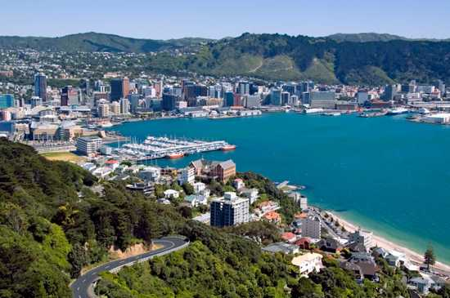
Developed vs. Developing
Developed Country (Urban areas)
  Much more industry, commercial
  farming, high standard of living,
  usually higher money value, good
  heath care, many or useable
  resources, high literacy rate, and
  higher income
  -BUT-
  Manageable population, lower
  poverty, and low death rate

