Slide 1
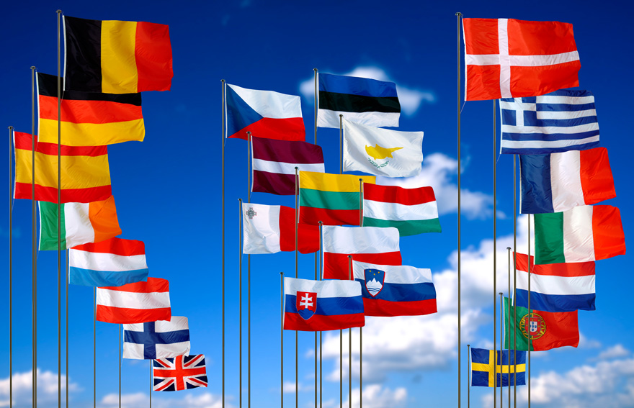
EUROPE

Slide 2
Youtube
The basics of Europe

Slide 3
Size Comparison of Europe to the United States
Notes:
Instructional Approach(s): The teacher should use the image to illustrate the size of Europe in comparison to the United States.

Slide 4
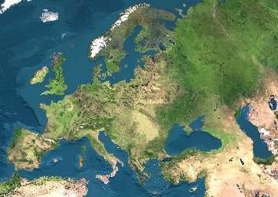
Satellite View of Europe
Notes:
Instructional Approach(s): The teacher should use the image to illustrate the continent of Europe. The teacher may want to ask the class or have students discuss together characteristics of Europe based on the map.

Slide 5
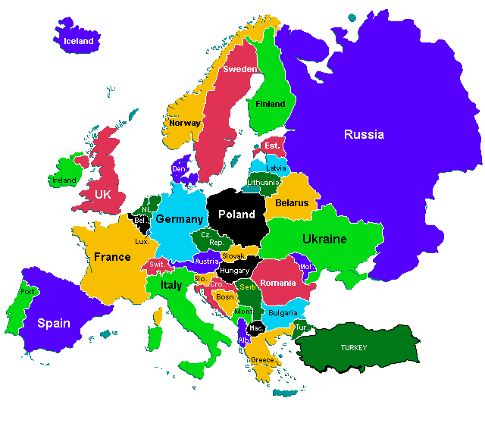
Countries of Europe
Countries to know:
United Kingdom
Russia
Ukraine
Poland
Germany
Belgium
Italy
France
Spain
Portugual

Slide 6
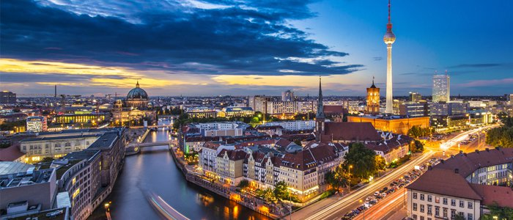
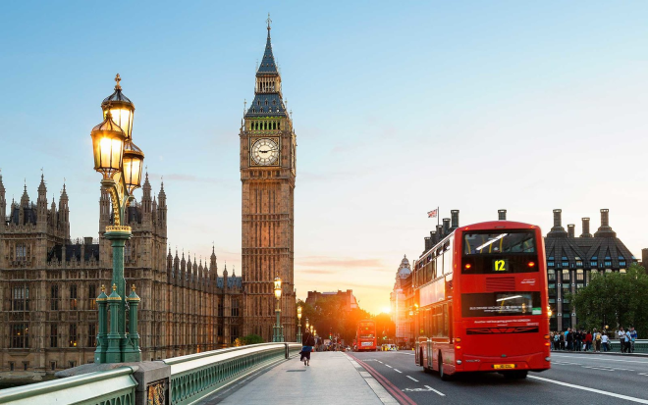
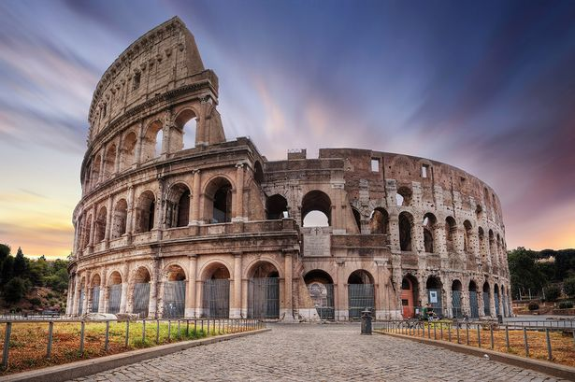
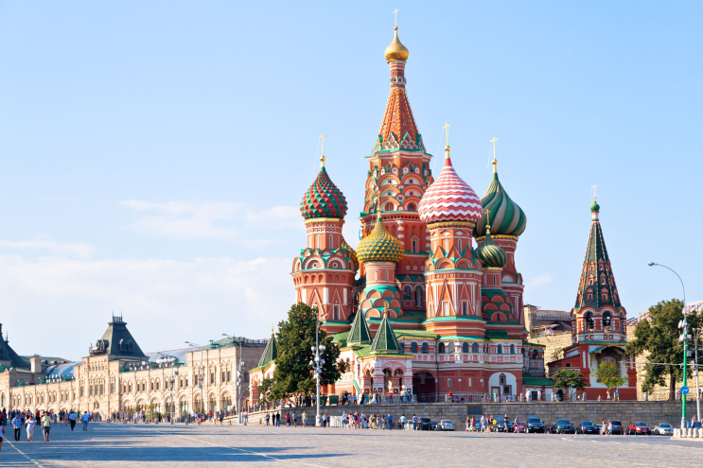
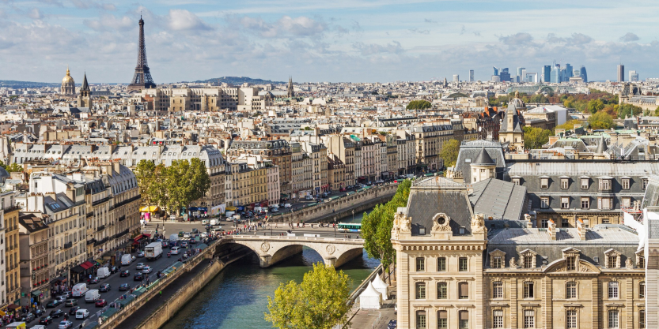
Major Capital Cities:
London, England
Rome, Italy
Berlin, Germany
Moscow, Russia
Paris, France

Slide 7
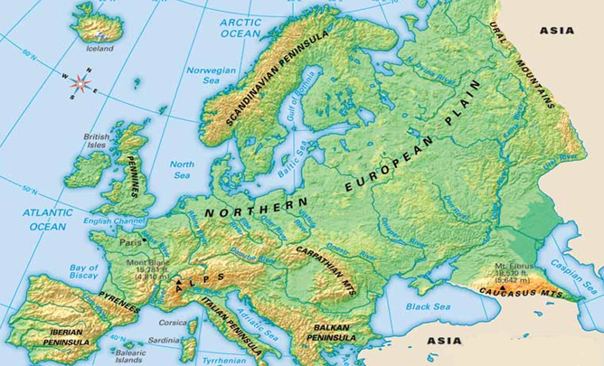

Slide 8
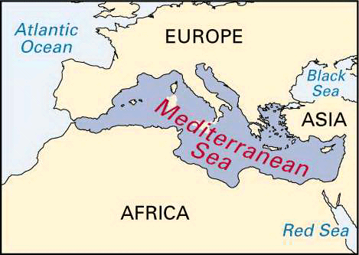
Notes:
Instructional Approach(s): The teacher should use the picture to illustrate the European physical feature.

Slide 9
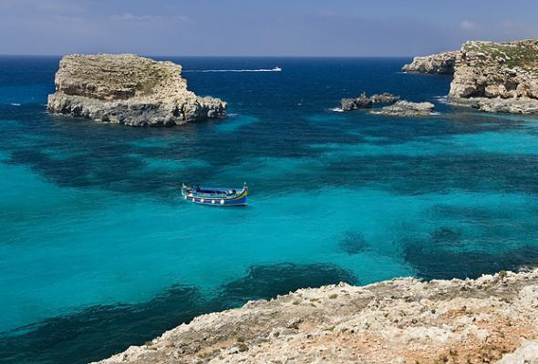
Notes:
Instructional Approach(s): The teacher should use the picture to illustrate the European physical feature.

Slide 10
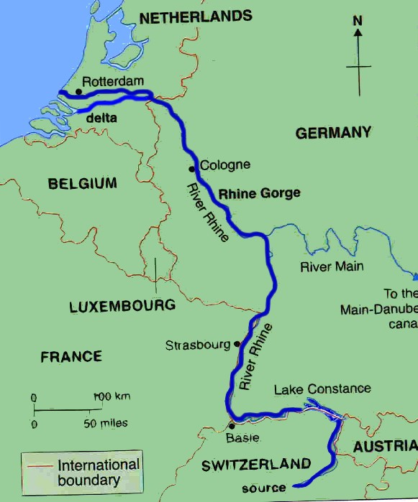
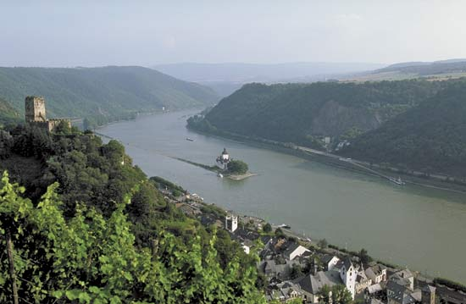
Rhine River
The Rhine is one of the longest and most important river in Europe. It runs north for over 766 mi from its source in the Swiss Alps (in Switzerland).
The Rhine flows through five countries -Switzerland, Austria, Germany, France and the Netherlands before flowing into the North Sea and is navigable.

Slide 11
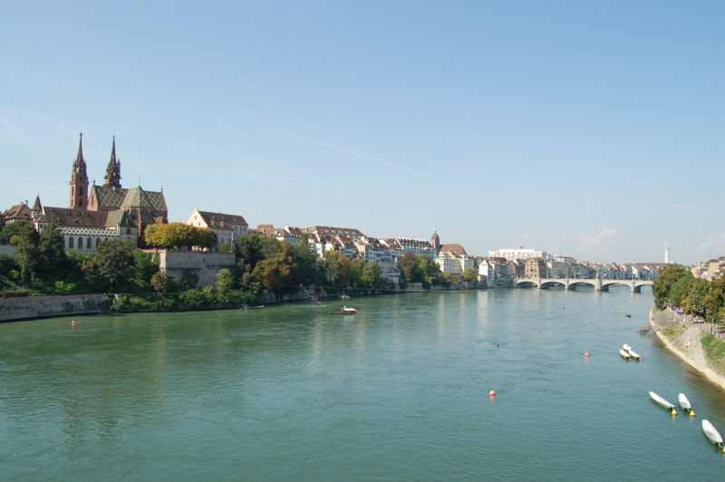
Notes:
Instructional Approach(s): The teacher should use the picture to illustrate the European physical feature.

Slide 12
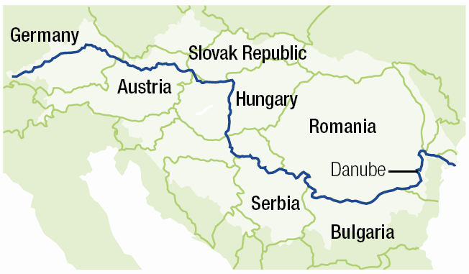
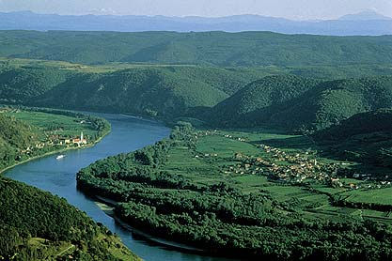
Danube River
Europe’s second longest river, the Danube River, flows for nearly 1,800 miles through some of eastern Europe's most populous and frequently visited cities.
Today the Danube supplies much of Europe with drinking water, power production, and irrigation for farmland.

Slide 13
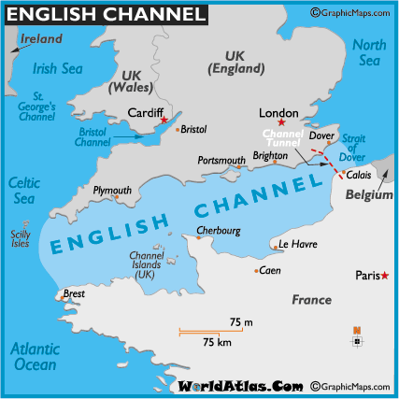
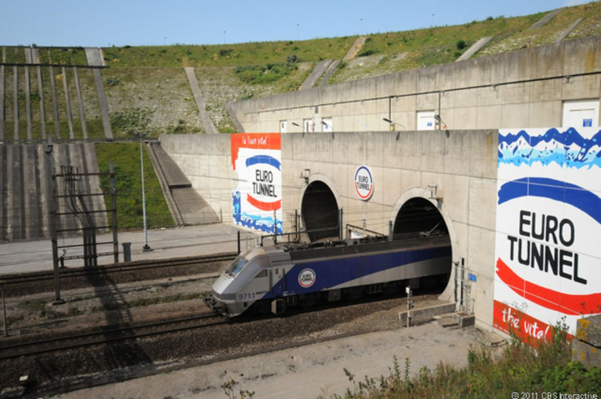
English Channel
The English Channel is a part of the Atlantic Ocean, and it separates the island of Britain from northern France and joins the North Sea to the Atlantic Ocean. It is today one of the busiest shipping lanes on the planet. It's approximately 350 miles long, and at its narrowest in the Strait of Dover.
The Chunnel (Channel Tunnel) passes under it.

Slide 14
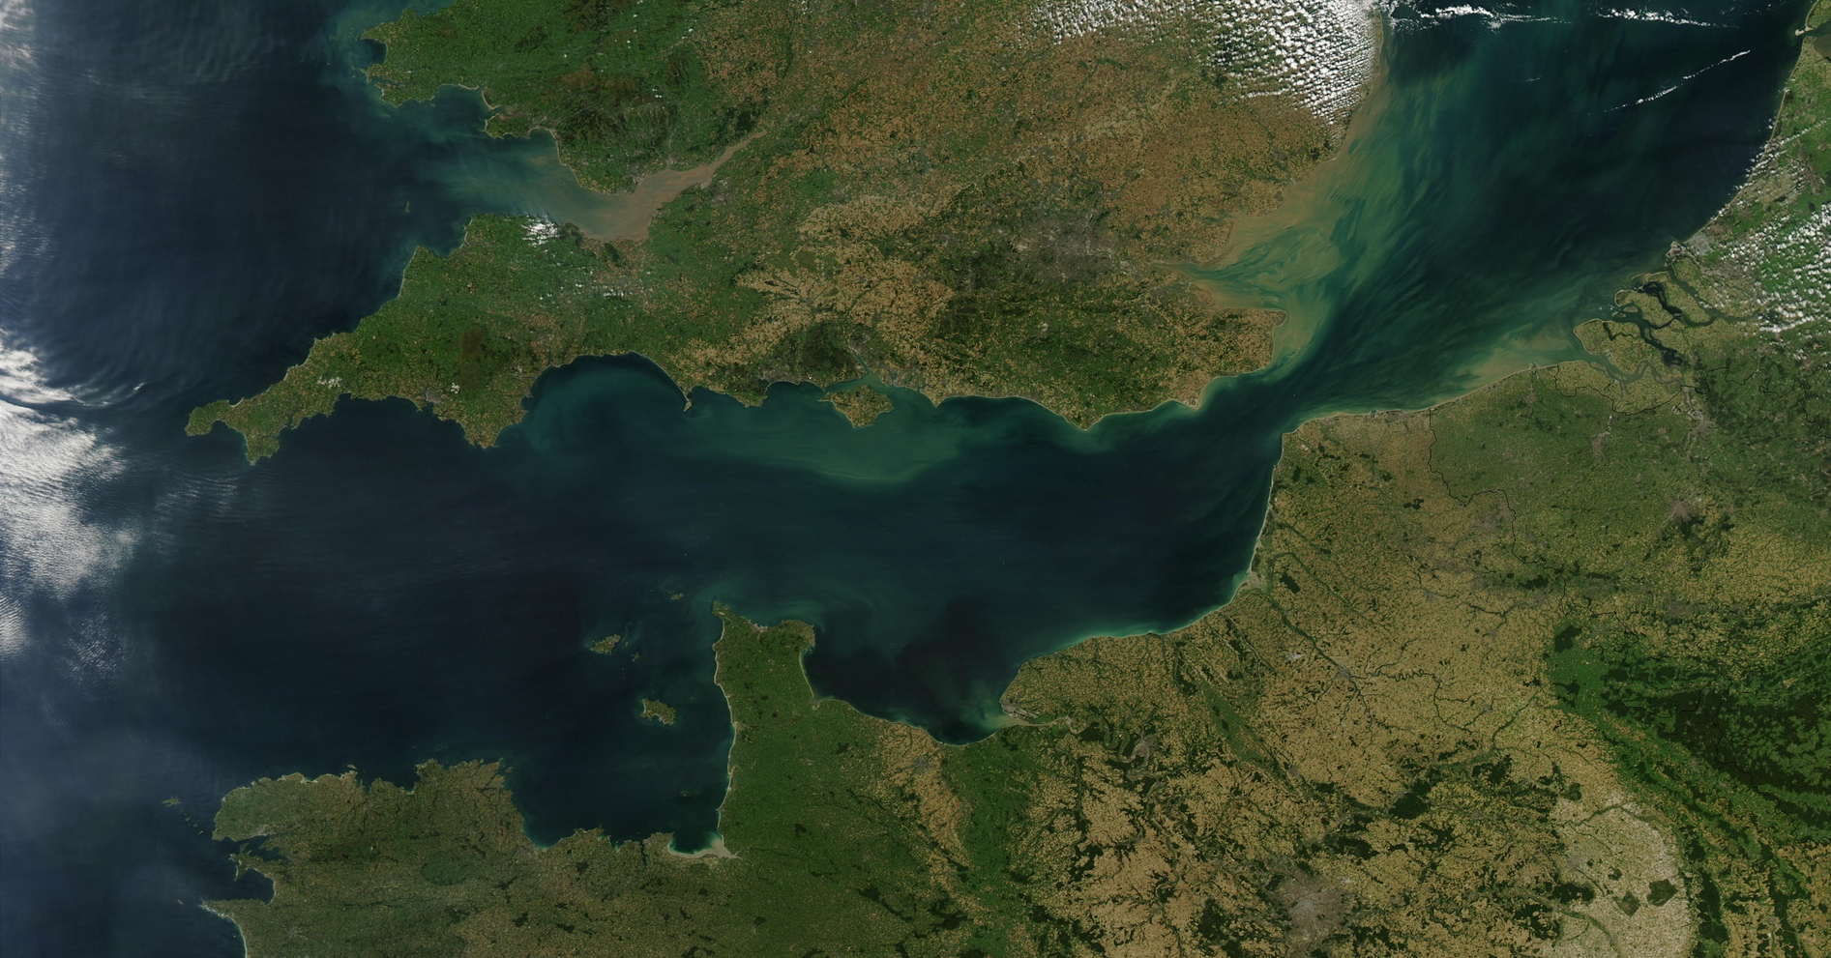
Notes:
Instructional Approach(s): The teacher should use the picture to illustrate the European physical feature.

Slide 15
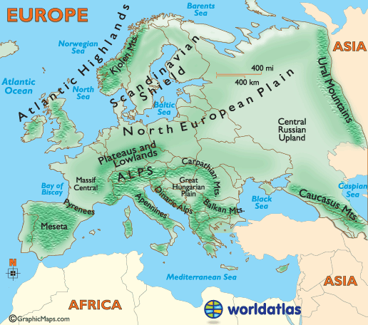
European Plain and Mountains
European Plain is the mainland of Europe
Mountains:
Alps
Ural
Pyrenees

Slide 16
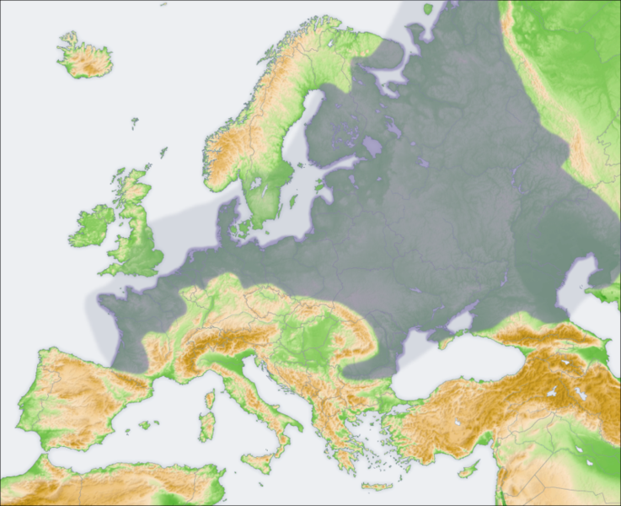
European Plain
Notes:
Instructional Approach(s): The teacher should use the picture to illustrate the European physical feature.

Slide 17
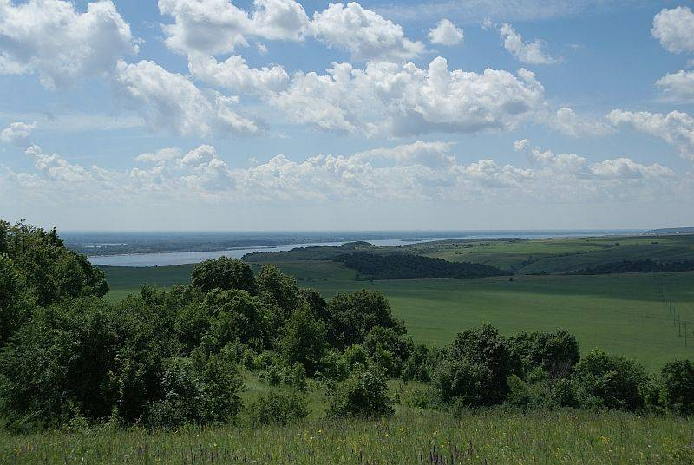
European Plain
It sweeps from the Pyrenees Mountains on the French-Spanish border across northern Europe to the Ural Mountains in Russia. In western Europe the plain is comparatively narrow, rarely exceeding 200 miles in width, but as it stretches eastward it broadens steadily until it reaches its greatest width in western Russia, where it extends more than 2,000 miles.
The terrain is flat or gently undulating.
The climate on the whole is characterized by marked seasonal changes, with cold winters and warm summers. The west has a maritime climate very favourable to agriculture. It has enough rain in all seasons to keep fields green. Summers are warm but not hot, and winters are cold but not freezing.

Slide 18
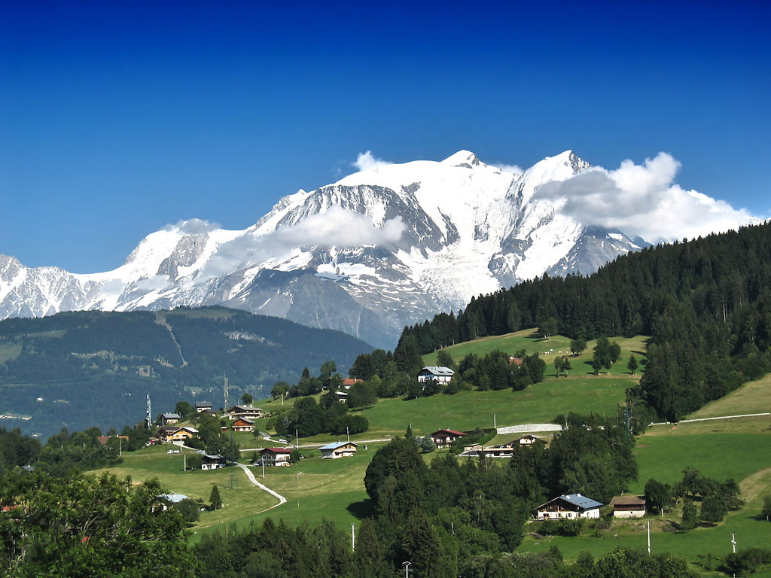
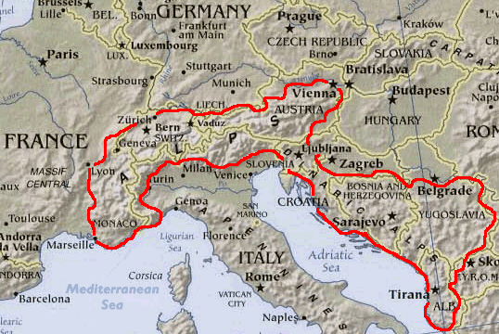
Alps
Mont Blanc
The Alps is the name for one of the highest mountain range of Europe.
The Alps are a mountain system located in south-central Europe, immediately north of the Mediterranean Sea. They extend for almost 700 miles in a crescent shape from the coastline of southern France into Switzerland, then through northern Italy and into Austria, and down through Slovenia, Croatia, Bosnia and Herzegovina, Serbia and Montenegro - then ending in Albania on the rugged coastline of the Adriatic Sea.
The highest point is Mont Blanc at 15,771 ft. (4,807m)

Slide 19
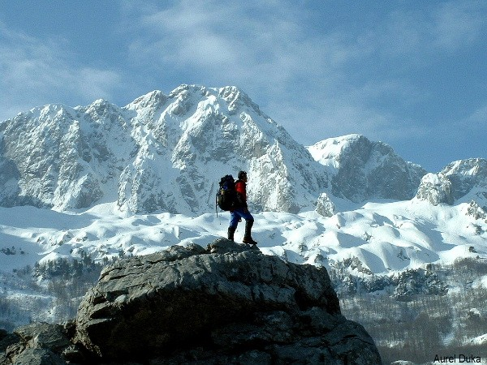
Notes:
Instructional Approach(s): The teacher should use the picture to illustrate the European physical feature.

Slide 20
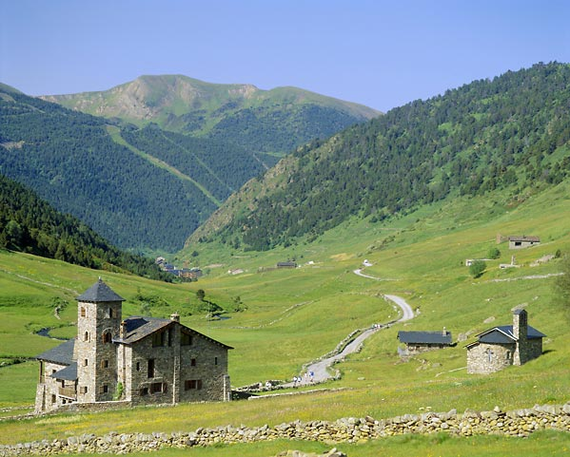
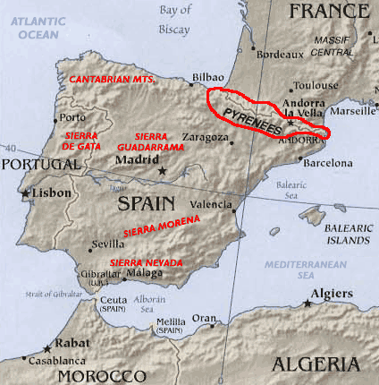
Pyrenees
The Pyrenees are a range of mountains in southwest Europe that form a natural border between France and Spain.
They separate the Iberian Peninsula from the rest of continental Europe, and extend for about 305 mi from the Bay of Biscay to the Mediterranean Sea.

Slide 21
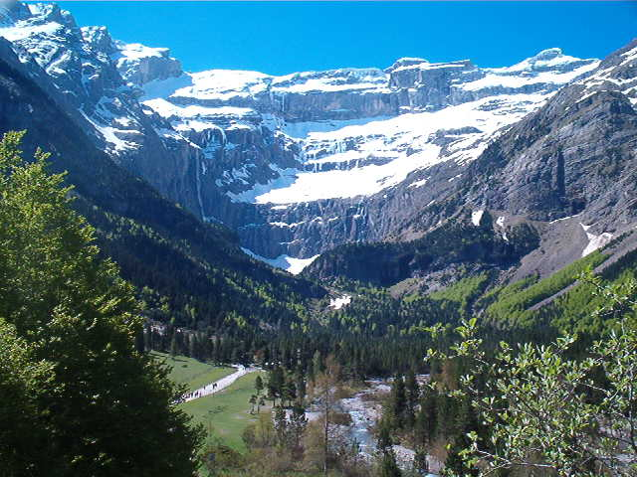
Notes:
Instructional Approach(s): The teacher should use the picture to illustrate the European physical feature.

Slide 22
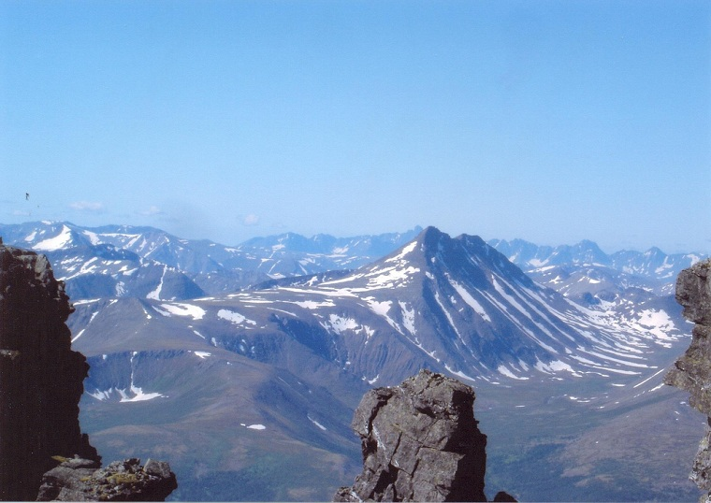
The Ural Mountains
The Ural Mountains are an ancient mountain range located at the extreme eastern limit of Europe. They are notably associated with the boundary between Europe and Asia.
A natural boundary between Europe and Asia The Urals are traditionally used to mark the easternmost boundary of Europe into Asia. West of the Urals lay the European prairies of Russia, while on the East spans Siberia for thousands of miles, up to the Pacific Ocean.
Climate impact The Urals act as a natural barrier to winds from the Atlantic. After blowing east from the ocean for thousands of miles through European central plains, those winds are stopped by the Urals. As a result, the region east of the Urals – Siberia – is in average colder and dryer.

Slide 23
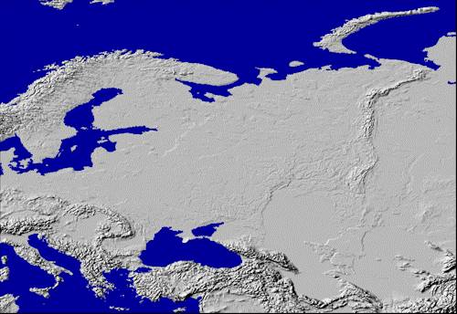
Ural Mountains: “The Great Divide”
1500 miles
It divides the European and Asian sections of Russia.

Slide 24
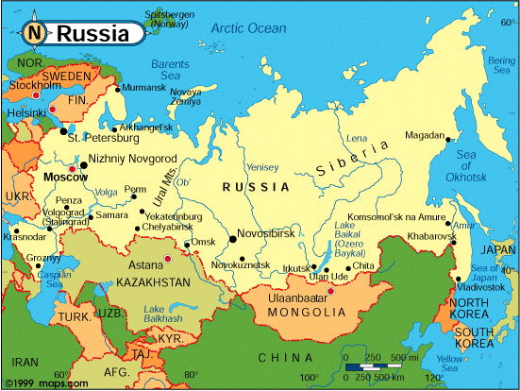
Ural Mountains

Slide 25
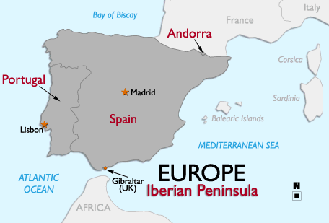
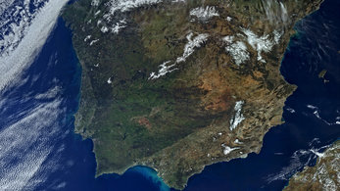
Iberian Peninsula
Iberian Peninsula is Spain and Portugal

Slide 26
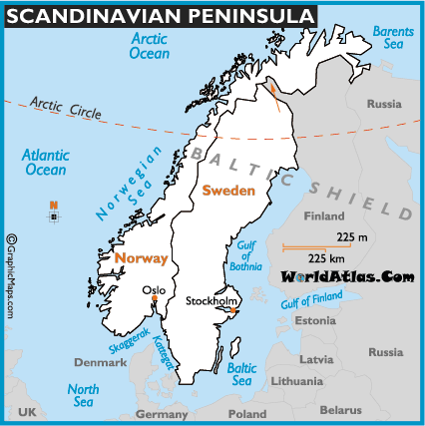
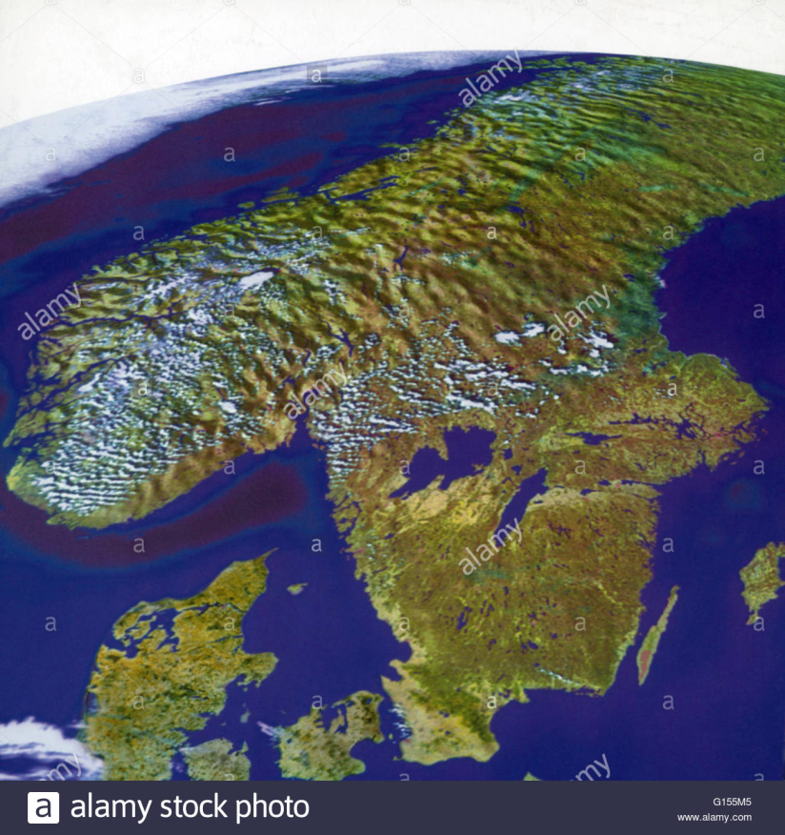
Scandinavian Peninsula
Scandinavian Peninsula is Norway and Sweden.

