Slide 1
Climates of Europe
Although Europe has different types of climatic conditions, most of the Europe climate remains temperate (mild, with cool summers and cold winters). Generally: Europe gets warmer towards the south
It gets drier towards the east
The wind blows in from the Atlantic Ocean stopping at the Ural Mountains.
Southern Europe has the Mediterranean climate (A climate with warm, wet winters and calm, hot, dry summers.), which appears in countries as: Portugal, Spain, France(south), and Italy. Tundra/Polar Climate: northern Europe. Countries: Norway, Sweden, Finland, Russia.

Slide 2
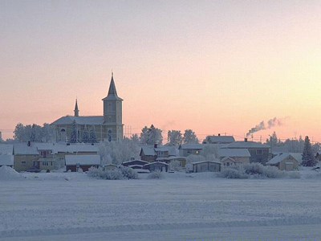
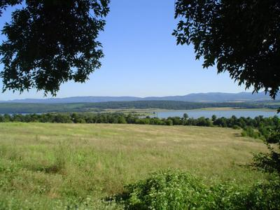
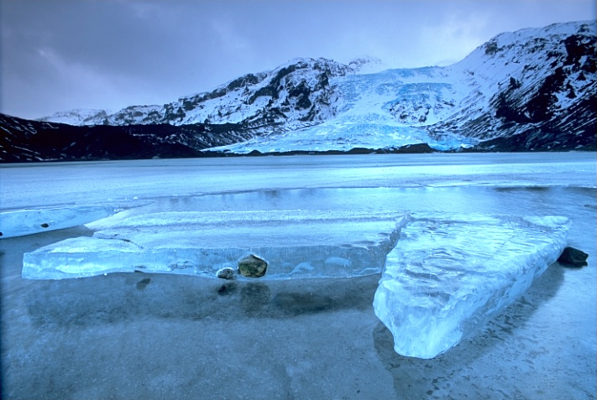
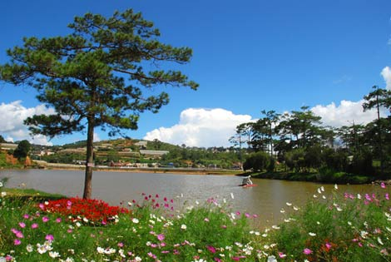
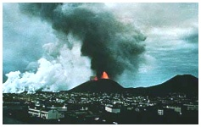
Geography
Climate is temperate to subarctic

Slide 3
European Facts:
Size:
Russia is the largest country 6,601,642 mi² (2x the USA)
Arable (land that is fertile) land:
Areas within the European Plain and along the Mediterranean Sea are the most arable.
Population:
Russia is the most populated country with Germany being 2nd
The majority of the countries Birth Rate and Death Rate are very close with Birth Rate being slightly higher. Russia is an exception. Their death rate is higher than the birth rate and their life expectancy is the lowest. WHY?

Slide 4
Other Facts of Southern Europe
Area deals with earthquakes, mudslides, flooding, volcanoes (Pompeii, Mt Etna)
Many peninsulas: Iberian, Scandinavian, Italy, and Greece.
Area is called Mediterranean Europe (means Middle of the land)

Slide 5
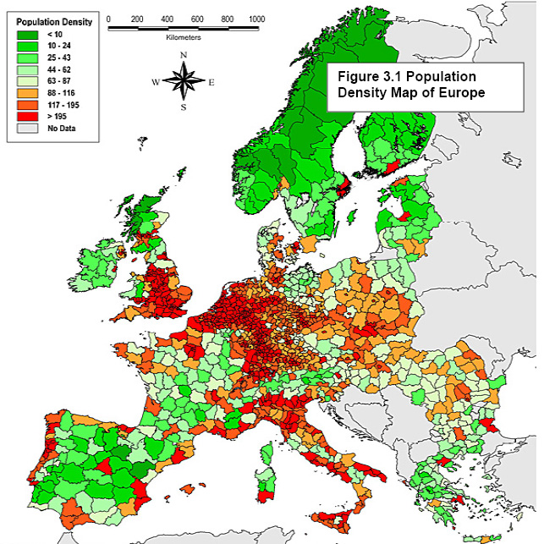
Where do the people live? Why?

Slide 6
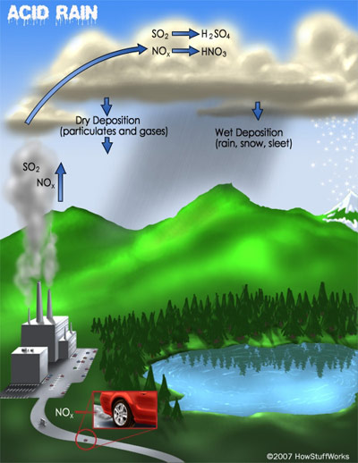
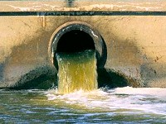
Environmental Issues:
acid rain
air pollution
water pollution due to animals waste or chemical fertilizers
Nuclear reactor meltdown

Slide 7
Acid Rain
What is it? is rain, snow, sleet, or other wet precipitation that is polluted by acids such as sulfuric acid and nitric acid
What are the causes?
A) Smoke from factories and power plants
B) Burning of fossil fuels
C) Exhaust from vehicles
Affects of the environment?
A) Damage statues, buildings, and bridges
B) Damage forests and soil
C) Pollutes rivers
D) Kills wildlife
Affects on Neighbors?
A) Air currents carries the acid rain to bordering countries
B) Water Currents carries the pollutants in the rivers
Solutions?
A) Stricter emission laws
B) Use cleaner fuels (water , wind and solar)
C) Filter smoke stacks from factories
Germany does not as many regulations /rules than other countries, so they allow more of the burning of coal and other fossil fuels

Slide 8
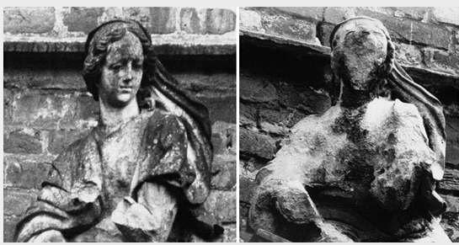
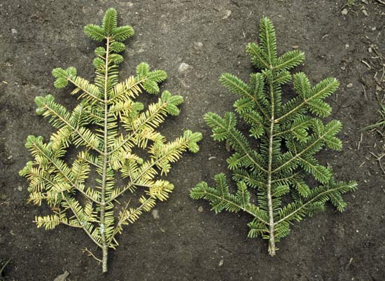

Slide 9
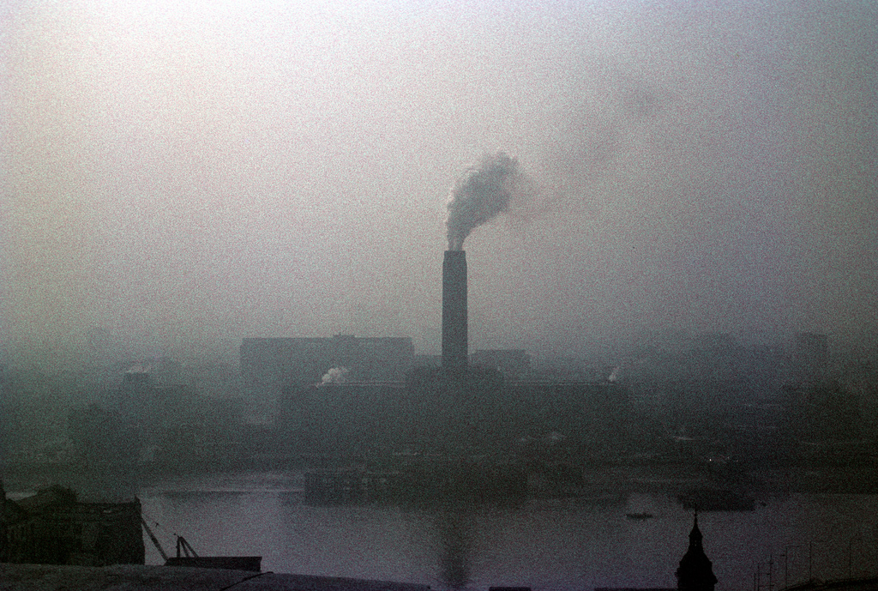
Air Pollution
Smog is a form of air pollution
first used in 1905 to describe the combination of smoke and thick fog that at times hung over London and other cities in the United Kingdom
It is particularly bad in the UK due to air current blowing towards the island

Slide 10
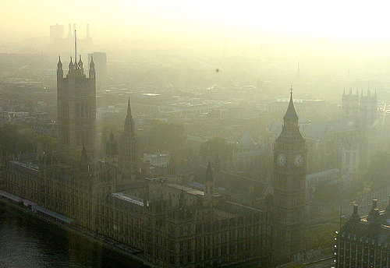

Slide 11
Air Pollution
What is it? Pollution caused by sunlight acting on gases from cars and factories What are the causes?
A) Smoke and sulfur dioxide from burning fossil fuels
B) Exhaust from vehicles
Affects of the environment?
A) Asthma and pneumonia
B) Smog
C) Discolors buildings
D) Kills wildlife
Affects on Neighbors?
A) Air currents carries the pollution to other countries
B) Causes acid rain
Solutions?
A) Stricter emission laws
B) Use cleaner fuels (water , wind and solar)
C) Government checks air quality
D) Citizens drive less

Slide 12
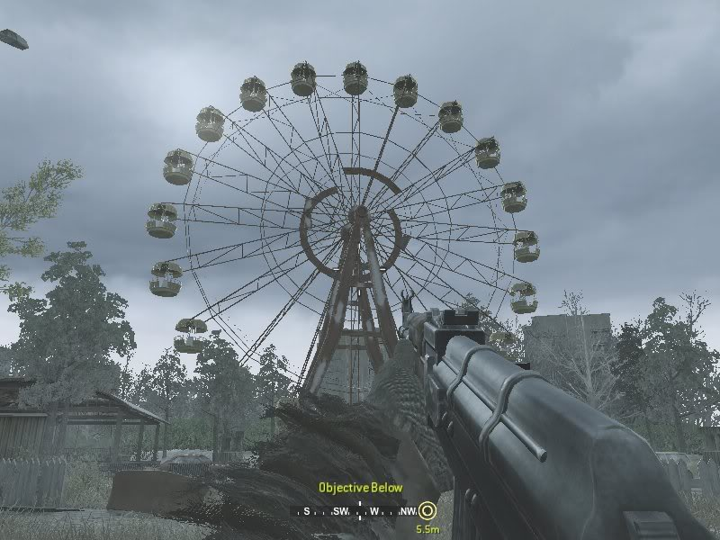
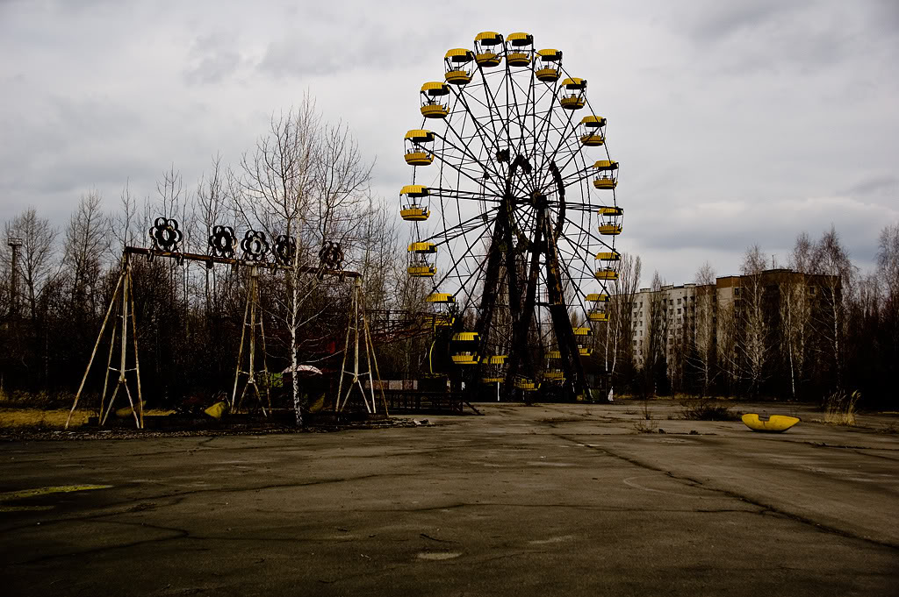
Call of Duty Modern Warfare

Slide 13
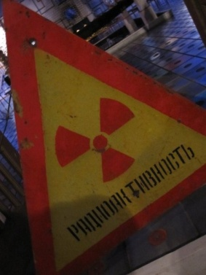
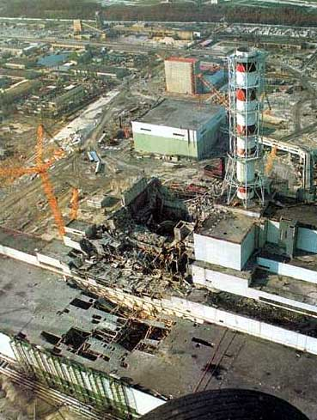
Chernobyl
In the early morning hours of April 26,1986, a testing error caused an explosion at the Chernobyl nuclear power station in northern Ukraine. During a radioactive fire that burned for 10 days, 190 tons of toxic materials were expelled into the atmosphere. The wind blew 70% of the radioactive material into the neighboring country of Belarus.
Chernobyl accident is equivalent to 500 nuclear bombs used in Hiroshima in 1945.

Slide 14
Chernobyl
Tribute to Chernobyl disaster - Sleeping Sun
Victims of Chernobyl disaster

Slide 15
Chernobyl
An estimated 17 million people were contaminated to some degree.
143,000 people have been evacuated from contaminated areas of Ukraine
600,000 people took part in the cleaning up of the disaster, 100,000 of which already died or are now handicapped
At the time of the accident, about 7 million people lived in contaminated territories, including 3 million children.
About 5.5 million people – including more than a million children – continue to live in contaminated zones.

Slide 16
Effects on People’s health, the Environment and Food
Birth Defects: Maternal exposure to radiation can cause severe organ and brain damage in an unborn child.
Genetic Mutations: Hereditary defects in Belarusian newborns increased in the years after the disaster.
Soil: Twenty-one percent of prime Belarusian farmland remains contaminated.
Groundwater: Radiation concentrated in sediments at the bottoms of lakes and ponds – the population continues to contaminate itself by fishing there.
Air: The air outside is generally safe.
Food: The food and water supply is continuously contaminated by rainfall and by the movement of radioactive dust. Mushrooms are severely contaminated in half the country but still collected and eaten.
Livestock such as cattle and goats accumulate radioactivity in their meat and milk.

Slide 17
Nuclear Radiation
What is it? Nuclear Power Station where a nuclear reactor exploded releasing tons of radiation into the environment
What are the causes?
A) Reactor was faulty and being misused
Affects of the environment?
A) Poisoned air, water, trees, and land
B) Causes cancer, mutations, deaths in people and wildlife
C) 30 miles area around plant abandoned, some areas still unlivable
Affects on Neighbors?
A) Radioactive material entered the air into northern Europe and Scandinavia
B) Belarus was affected physically and economically
Solutions?
A) Reactor was closed and encased on concrete

