Slide 1
European Economics

Slide 2
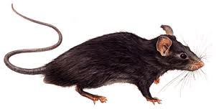
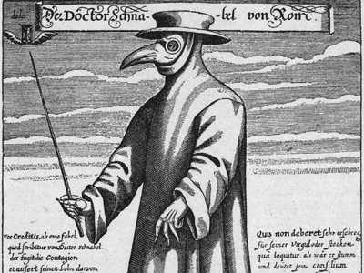
Bubonic Plague
In the early 1330s an outbreak of deadly bubonic plague occurred in China. The bubonic plague mainly affects rodents, but fleas can transmit the disease to people. Once people are infected, they infect others very rapidly. Plague causes fever and a painful swelling of the lymph glands called buboes, which is how it gets its name. The disease also causes spots on the skin that are red at first and then turn black.

Slide 3
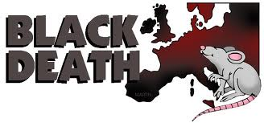
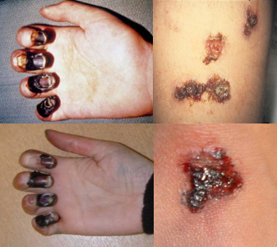
The plague had spread as far north as England, where people called it "The Black Death" because of the black spots it produced on the skin.
In winter the disease seemed to disappear, but only because fleas--which were now helping to carry it from person to person--are dormant then. Each spring, the plague attacked again, killing new victims. After five years 25 million people were dead--one-third of Europe's people.
The disease was only halted by the Great Fire of London in 1666 which killed the rats and fleas which carried the disease.
The disease led to the beginning of individual shop ownership and the start of the middle class.

Slide 4
Ring Around the Rosie
(Ring around the rosy) The symptoms of the plague included a rosy red rash in the shape of a ring on the skin.
(Pocket full of posies) Pockets and pouches were filled with sweet smelling flowers (or posies) which were carried because the people believed that the disease could be stopped by good smells.
The term (Ashes Ashes) refers to the cremation of the dead bodies!
(We all fall down) people died.

Slide 5
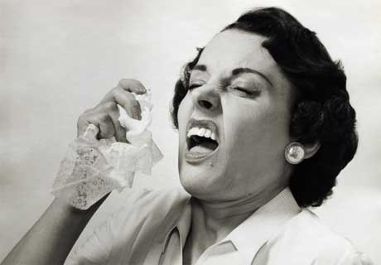
Saying “Bless You”
Considered a polite response to a sneeze, the phrase is attributed to Pope Gregory the Great, who said it to people who sneezed during the bubonic plague.

Slide 6
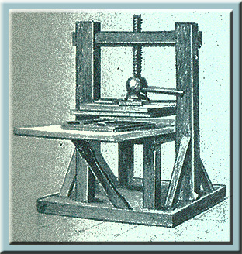
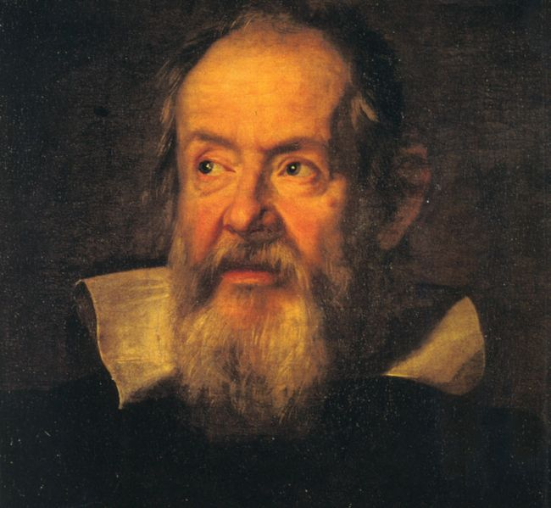
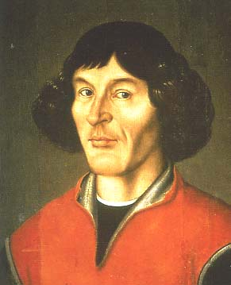
Economics in Europe after the dark ages
1300-1600 Renaissance (rebirth)
Europe saw a flowering of culture as the art, literature, and philosophy.
Copernicus (heliocentric sun centered)
Galileo: telescope, gravity (experiment)
Gutenberg Printing Press: made books less expensive, more people could afford them
made producing books quicker
people could read other things besides the Bible
helped pass on information correctly (written)
The printing press led to Martin Luther and the protestant reformation
Leonardo Da Vinci, Michelangelo, Raphael, Donatello

Slide 7
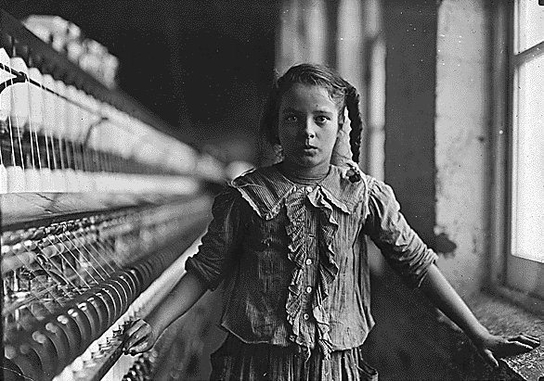
Industrial Revolution
The Industrial Revolution started in England around 1733 with the first cotton mill. As new inventions were being created, factories followed soon thereafter. Factory owners, needing cheap, unskilled labor, profited greatly by using children and women to run the machines. By the age of 6, many children were already working 14 hours a day in factories! These kids had no free time to do anything else and earned low wages. Some got sick and died because of the toxic fumes, while others were severely injured and sometimes killed working at the dangerous machines in factories. Industrial Revolution - Best Short Documentary

Slide 8
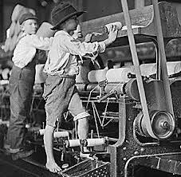
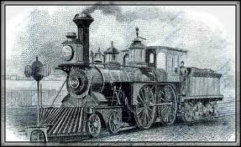
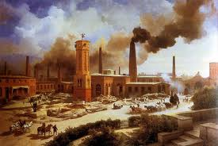
The Industrial Revolution introduced machines to textile manufacturing, printing, papermaking, and engineering industries. The most significant machines were steam engines and the machines used to make cloth.
Until the eighteenth century, transportation of goods was powered by humans or animals. Organic sources of fuel were wood, charcoal, or water power. Beginning in the eighteenth century, the Industrial Revolution began to rely on coal to produce the high temperatures needed to smelt iron. Eventually it also became a source of heat for the steam engine which would lead to the railroad.

Slide 9
Forms of economies
Today there are 4 basic forms of economies.
Traditional
Traditional economies still produce products and services that are a direct result of their beliefs, customs, traditions, religions, etc.
Market
Organizations run by the people determine how the economy runs, how supply is generated, what demands are necessary, etc.
Command
The economic system is controlled by a centralized power; often, a federal government
Mixed
A mixed economic system is just like it sounds (a combination of economic systems), but it refers to a mixture of a market and command.

Slide 10
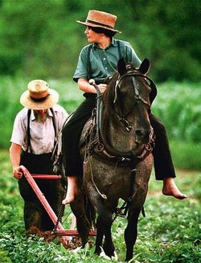
Traditional
Who decides what to produce? People follow their customs and make what their ancestors made
Who decides how to produce goods & services? People grow & make things the same way that their ancestors did
Who are the goods & services produced for? People in the village who need them

Slide 11
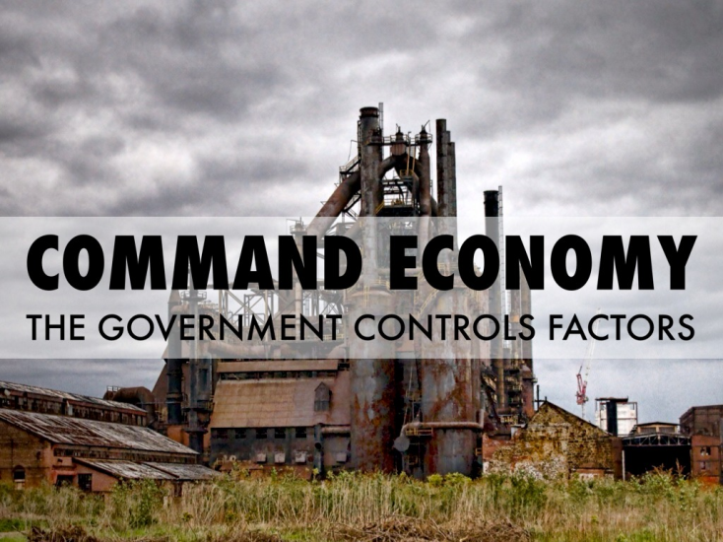
Command
Who decides what to produce? Government makes all economic decisions
Who decides how to produce goods and services? Government decides how to make goods/services
Who are the goods and services produced for? Whoever the government decides to give them to

Slide 12
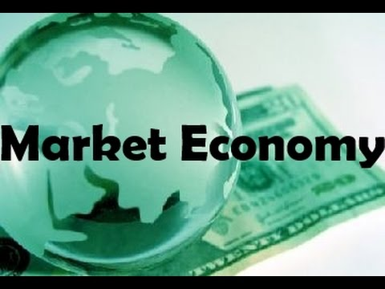
Market
Who decides what to produce? Businesses base decisions on supply and demand and free enterprise (PRICE)
Who decides how to produce goods and services? Businesses decide how to produce goods
Who are the goods and services produced for? consumers

Slide 13
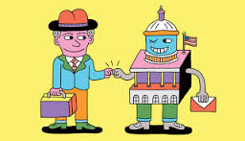
Mixed
Who decides what to produce? businesses
Who decides how to produce goods and services? Businesses, but the government regulates certain industries
Who are the goods and services produced for? consumers

Slide 14
Comparing the UK, Germany, and Russia

Slide 17
 | What to produce? | How to produce? | Form whom to produce?
United Kingdom | Service-based economy (jobs such customer service – cashiers, salespeople, waitress, hair dresser). Agricultural products such as corn, wheat, and soybeans. | Businesses have the freedom to make and sell products and services that consumers want to buy. Businesses are independently-owned (not under government control). Products and services must not be illegal. | Consumers – individuals and business that want to buy the products and services. Consumers can also be international customers (people from other countries).
Germany | Germany produces many goods and services that are exported to other countries. Many factories (manufacturing). | Businesses have the freedom to make and sell products and services that consumers want to buy. Businesses are independently-owned (not under government control). | Consumers – individuals and business that want to buy the products and services. Consumers can also be international customers (people from other countries).
Russia | The Russian government is still very involved with the decisions businesses make. | Manufacturing and factories. | Consumers – individuals and business that want to buy the products and services. Consumers can also be international customers (people from other countries).

Slide 18
United Kingdom Economy:
Economy: Per capita Income: $41,200 (based on a GDP of 2.679 trillion),
15% below poverty level
Natural Resources: Petroleum, natural gas, fish, hydroelectric, metals
Mixed Economy (more so toward Market than Command) Agriculture: 1%, Industry: 15%, Service: 84%
Agriculture products: potatoes, dairy, barley, livestock
Industry: metal working, ship building, paper products, textiles, electric power equipment, automation equipment,, aircraft and motor vehicle parts, fishing
Money: Euro (Finland, Ireland) ($1/1.10), British Pound (UK) ($1/1.22),

Slide 19
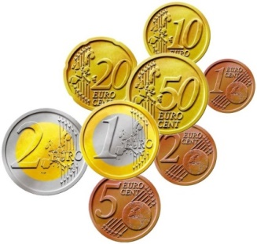
European Union
The European Union is an economic and political union of 28 countries. Each of the countries within the Union are independent but they agree to trade under the agreements made between the nations.
Twenty two of the member states also belong to the Schengen Area, which is comprised of 26 European countries that have abolished passport and border controls at their common borders. Of the countries that are not part of it, Bulgaria, Croatia, Cyprus and Romania all intend to join, while the United Kingdom and Ireland have opted out.
What is the purpose of the EU?
The European Union operates a single market which allows free movement of goods, capital, services and people between member states.
1999 the Euro was created so that all participating countries could have a common currency, thereby making trading easier without having to worry about currency exchange.

Slide 20
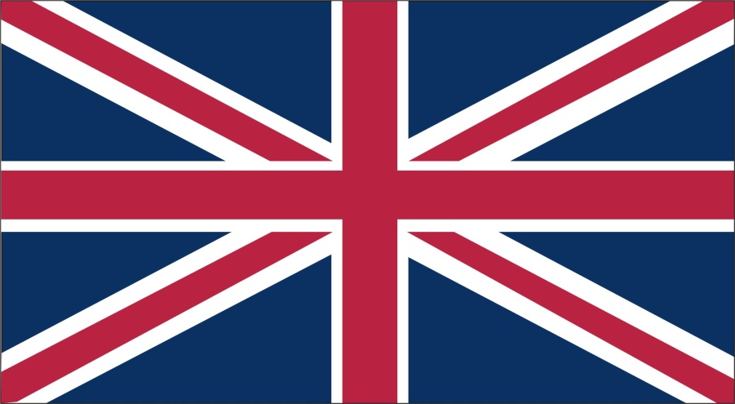
How has the united Kingdom affected the GDP
The UK, a leading trading power and financial center, is the third largest economy in Europe after Germany and France. Agriculture is intensive, highly mechanized, and efficient by European standards, producing about 60% of food needs with less than 2% of the labor force. The UK has large coal, natural gas, and oil resources, but its oil and natural gas reserves are declining; the UK has been a net importer of energy since 2005.

Slide 21
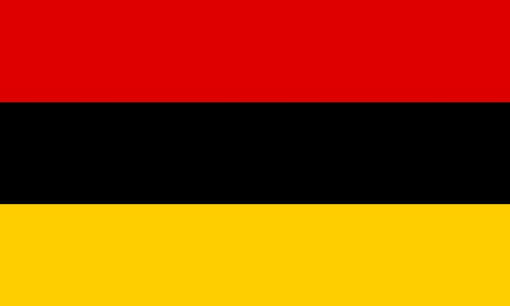
Germany Economy:
Economy: Per capita Income: $46,900 ( based on a GDP of 3.841 trillion)
16% below poverty level
Natural Resources: Petroleum, natural gas, fish, arable land, metals, timber, coal, salt
Agriculture products: potatoes, dairy, barley, livestock, wheat, sugar beets, fruit, cabbage
Industry: among the world’s largest and most technologically advanced producers of iron, steel, coal, cement, chemicals, machinery, vehicles, electronics, textiles, and ship building
Mixed Economy
Agriculture: 2%, Industry: 25%, Service: 74%

Slide 22
How has Germany affected the GDP
The German economy - the fifth largest economy in the world in GDP terms and Europe's largest - is a leading exporter of machinery, vehicles, chemicals, and household equipment and benefits from a highly skilled labor force.
Following the March 2011 Fukushima nuclear disaster, Chancellor Angela MERKEL announced in May 2011 that eight of the country's 17 nuclear reactors would be shut down immediately and the remaining plants would close by 2022. Germany plans to replace nuclear power largely with renewable energy.
How will that affect the air pollution problem?

Slide 23
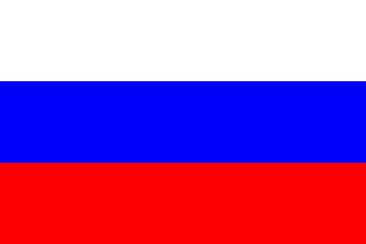
Russian ECONOMY:
Economy: Per capita Income: $25,400 (based on a GDP of 3.718 trillion
11% below poverty level
Natural Resources: Petroleum, natural gas, coal, timber, fish, hydroelectric, metals (much more in Siberia, but too difficult to get)
Mixed Economy:
Agriculture: 9%, Industry: 28%, Service: 63%
Agriculture products: grains, sugar beets, sunflower seeds, vegetables, fruit, beef, dairy
Industry: mining, aircraft and space equipment, defense and military equipment, agriculture equipment, ship building, large vehicle
Money: ruble ($1/.02)

Slide 24
How has Russia affected the GDP
Russia has undergone significant changes since the collapse of the Soviet Union, moving from a centrally planned economy towards a more market-based system. Both economic growth and reform have stalled in recent years, however, and Russia remains an economy with a high concentration of wealth in officials' hands.
The protection of property rights is still weak, and the government continues to interfere in the free operation of the private sector.
Russia is one of the world's leading producers of oil and natural gas, and is also a top exporter of metals such as steel and primary aluminum.
Russia's reliance on commodity exports makes it vulnerable to boom and bust cycles that follow the volatile swings in global prices.

