Slide 1
European History

Slide 2
History of Northern Europe
Scandinavian Countries:
Vikings: 793 – 1066 AD, explored most of Europe and helped settle it. Came from Sweden, Norway, and Denmark. They were a warlike people. (also called Norsemen or Northman), 800 – 1000 raided and conquered with ships, then started settling (farming and trading)
981 Eric the Red discovered Greenland, 1000 Leif Erikson (ERIC’S SON) explored North American coast
Greenland – Generally believed that Eric the Red called it Greenland to trick and attract settlers
Iceland – Was named this because where they landed they basically only saw ice

Slide 3
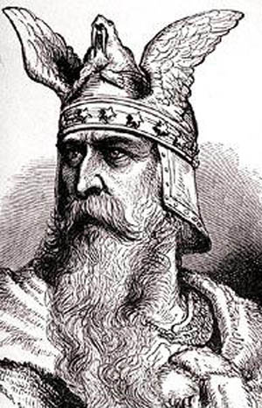
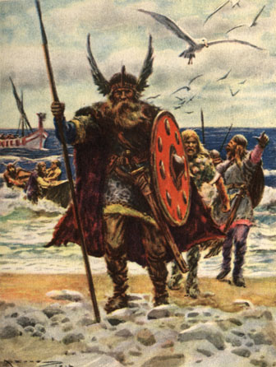
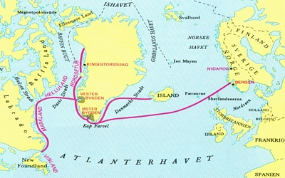
Vikings

Slide 4
United Kingdom
Early name was Britannia
1000-1300 was the Dark Ages (middle ages, Medieval Period)
Feudalism: Kings ruled the kingdoms. They allowed Lords to rule smaller sections of the kingdom. These areas were called Manors.
Manors consisted of a house, a small village (200-300 people), farmland, forest, and water areas
Serfs (peasants) worked the land for protection or to pay off debt
4 days of the crops went to the Lord of the manor and the other 3 were for the serf’s own family
Serfs were attached to the land
As kingdoms grew and greed increased, the need for soldiers increased
Knights became the chief protectors and Manors became castles

Slide 5
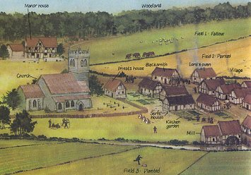

Slide 6
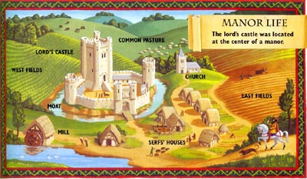

Slide 7
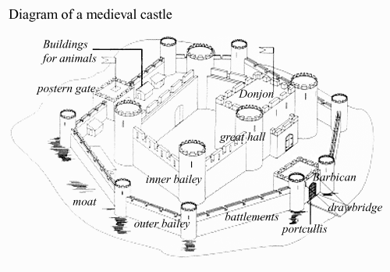

Slide 8
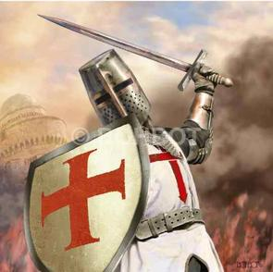
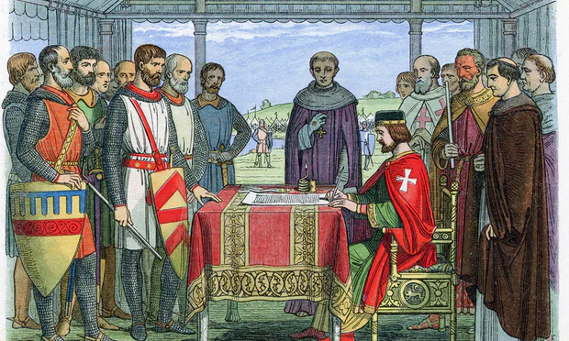
UK continued:
1139 - 1189 King Henry II reigned. This was the time of the crusades (The Crusades were a series of military campaigns against the Muslims of the Middle East to regain Jerusalem) and Robin Hood (the name Robin Hood was given to outlaws, he was just a fictional character)
1215 the people forced King John to sign the Magna Carta (limited the king’s powers of taxation and required trials before punishment) Began constitutional monarchy.
Kings believed in Divine Right. (God gives them the right to rule.)

Slide 9
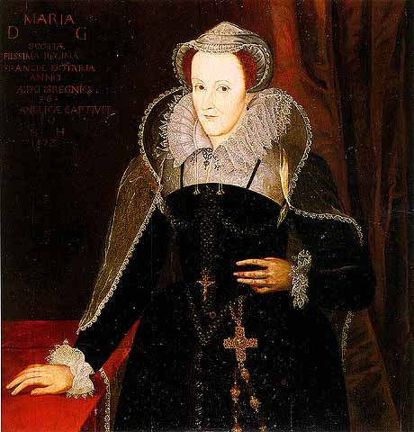
UK continued:
England controlled Scotland (Scottish people were called highlanders) until 1371
2 families (1 Scottish and 1 British) married to unite the area, but each area would have their own monarch
Mary Queen of Scots became queen of Scotland when she was only 1 week old. * Mary’s rule of Scotland was not successful. She was captured, imprisoned and beheaded by her cousin Queen Elizabeth I.

Slide 10
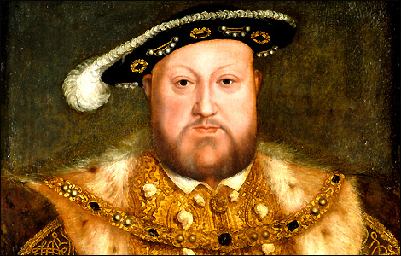
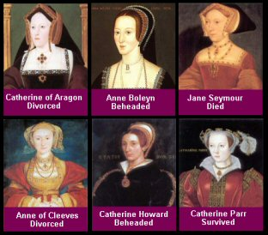
1525 - 1540 Henry VIII married 6 times because he wanted a son. The six wives of King Henry VIII were, in order: Catherine of Aragon (annulled), Anne Boleyn (annulled then beheaded), Jane Seymour (died, childbed fever), Anne of Cleves (annulled), Catherine Howard (annulled then beheaded), and Catherine Parr (survived). Of the six queens, Catherine of Aragon, Anne Boleyn and Jane Seymour each gave Henry one child who survived infancy—two daughters and one son, all three of whom would eventually accede to the throne. They were Queen Mary I, Queen Elizabeth I, and King Edward VI.
After fight with pope (he wanted to get marriage annulled or be divorced) created the Church of England with himself the top person

Slide 11
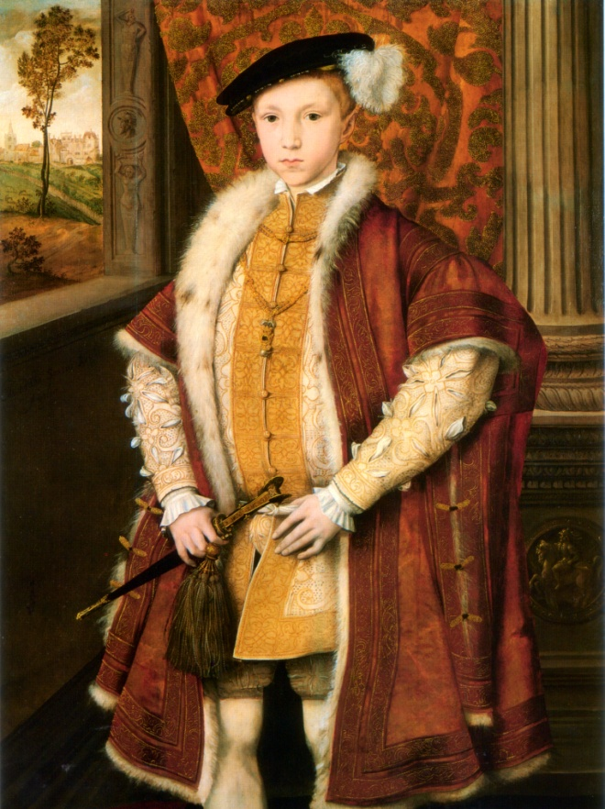
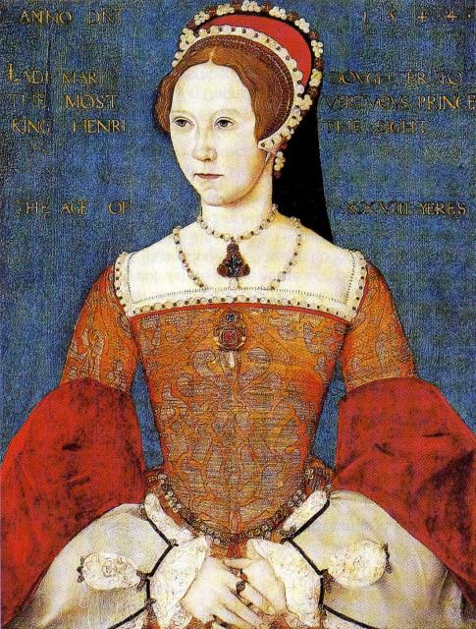
1547 Henry’s son Edward became King at 10 years old after Henry’s death, he died within 6 years, and Mary became Queen of England.
1553 – 1558 Mary wanted England to be Catholic again. She earned her name “Bloody Mary” for having burned at the stake over 300 Protestants for the Roman Catholic faith
Mary died 1558, her sister Elizabeth became queen

Slide 12
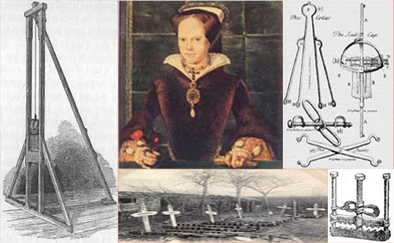
Bloody Mary
Mary, Mary, quite contrary
How does your garden grow?
With silver bells and cockleshells
And pretty maids all in a row.
Queen Mary was a Catholic and the garden referred to is the graveyards which were increasing in size with those who dared to continue to practice the Protestant faith. The silver bells and cockle shells were instruments of torture. The 'maids' were a device to behead people similar to the guillotine.

Slide 13
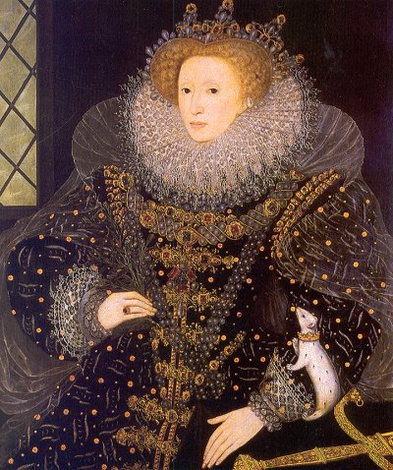
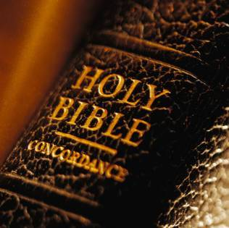
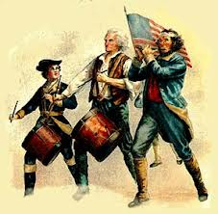
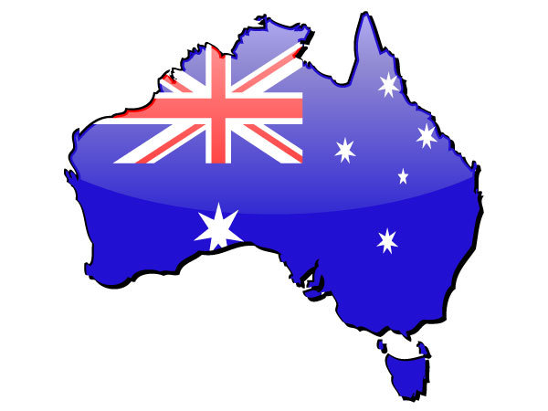
Elizabeth made England Protestant. This was a time of world exploring, colonizing and William Shakespeare.
She died in 1603, her nephew James becomes King of Scotland and England and authorizes the KING JAMES BIBLE
British settled the colonies (1718) in N. America
(1733) Industrial Revolution (see slides)
The French and Indian War (1754–1763) is the war between Britain and France for control of North America. The name refers to the two main enemies of the British: the French and the Native American tribes
Fought the American Revolution War or War of Independence (1775-1783)
(1788) prisons were overflowing in England, convicts/debtors sent to settle Australia

Slide 14
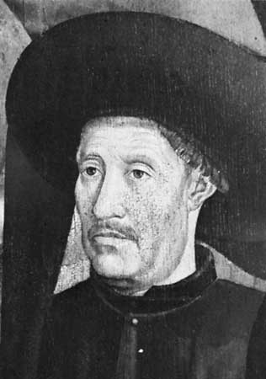
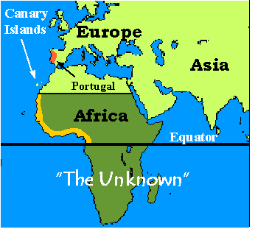
History of Portugal
Prince Henry the Navigator (1394-1460) was a Portuguese royal prince, soldier, and an explorer. Henry sent many sailing expeditions down Africa's west coast, but did not go on them himself.
His expeditions were sent to create maps of the African coast and to spread Christianity.
The main reasons of exploration are:
1) to establish trade routes to Asia while looking for resources
2) to spread Christianity
3) to gain riches

Slide 15
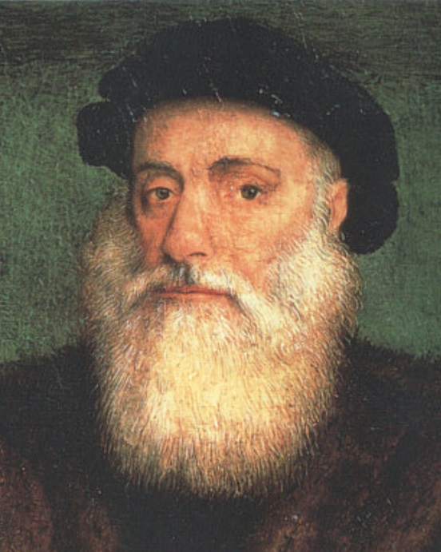
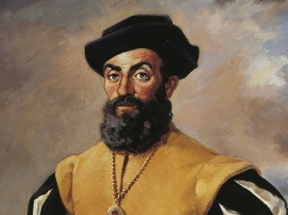
History of Portugal
Vasco De Gama: 1490s first person to sail from Europe to India
Magellan: 1500s Ferdinand Magellan a Portuguese sea captain who led five Spanish ships and 251 men in the first voyage around the World.

Slide 16
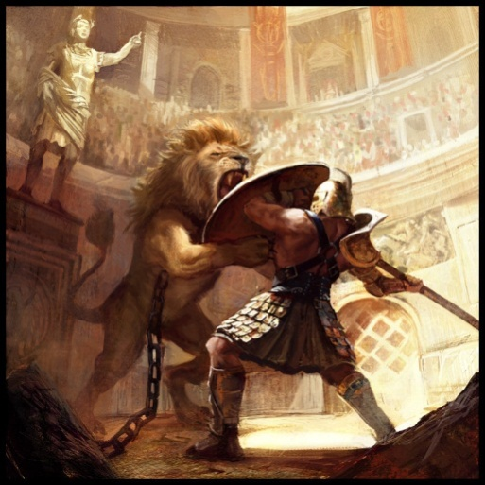
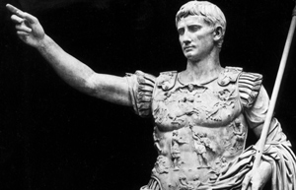
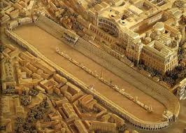
History of Italy
Had many gods and goddesses taken from Greeks
Citizens paid taxes
Military served in army and was paid
Set up Republics
Gladiators in the Colosseum
Chariot Race at the Circus Maximus

Slide 17
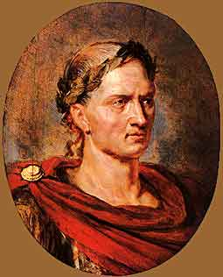
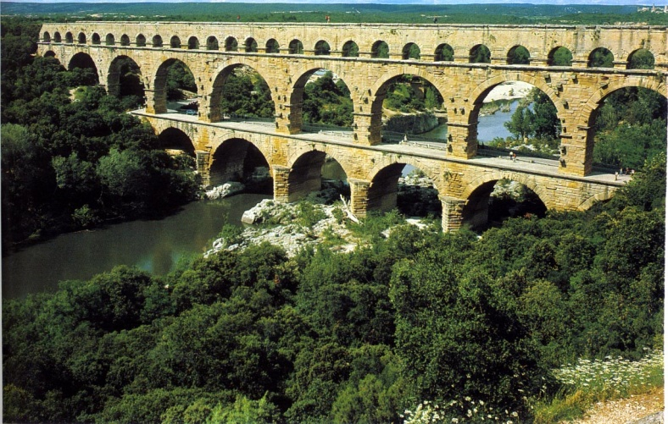
History of Italy
Calendar (10 months 304 days)
Months named for Roman gods or emperors: March (god of war Mars) was the first month: July - Julius Caesar, August - Augusta Caesar, Prefixes determine month
Libraries, Census (population count), Sewers Systems, Public baths, gyms, saunas, hair salons, Concrete, Aqueducts, Code of Laws, Roman Numerals
Roads (sloped, concrete) connected empire
Empire fell because:
it grew too large to protect and control
Citizens became disloyal
became to expensive to maintain
poor leaders and rulers

Slide 18
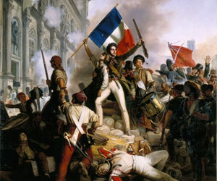
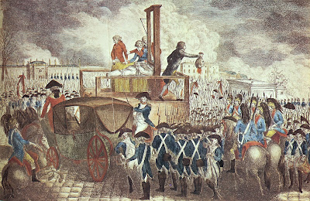
French Revolution
1715 - 1804 Absolute Monarchy French Revolution (Rich vs. Poor) most people were commoners/peasants. People awakened after the American Revolution.
1789, the peasants stormed the Bastille (Prison), where the poor were regularly sent. The Revolution had begun.
1793 captured King Louis XVI and Queen Marie Antoinette as they tried to escape Paris dressed as servants but in the royal carriage. Both were sent to the guillotine .

Slide 19
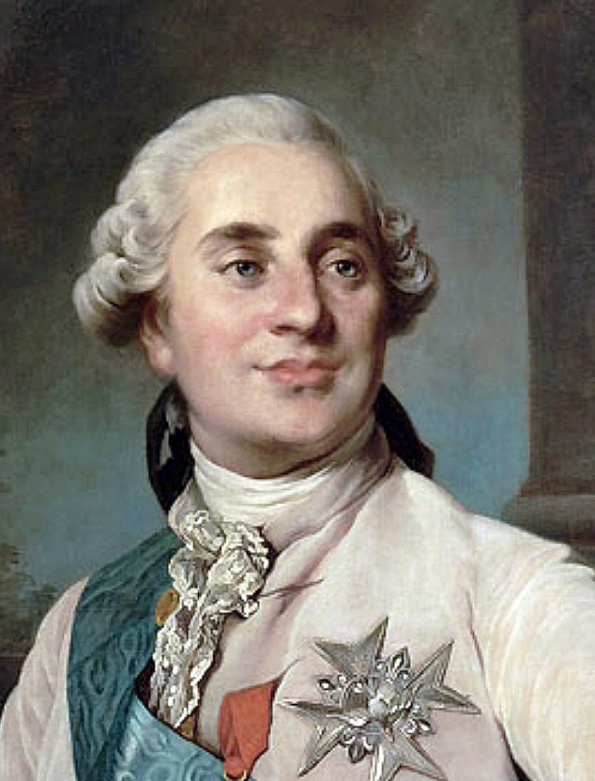
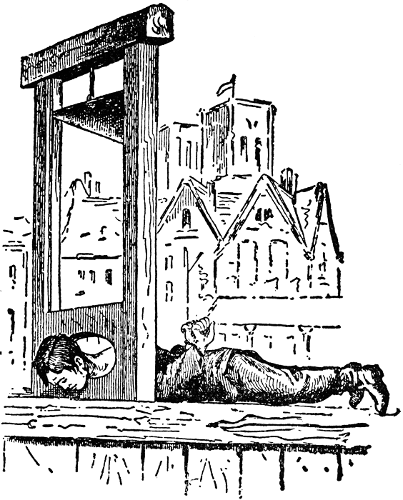
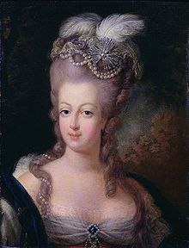
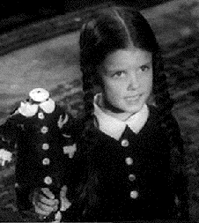
French Revolution

Slide 20
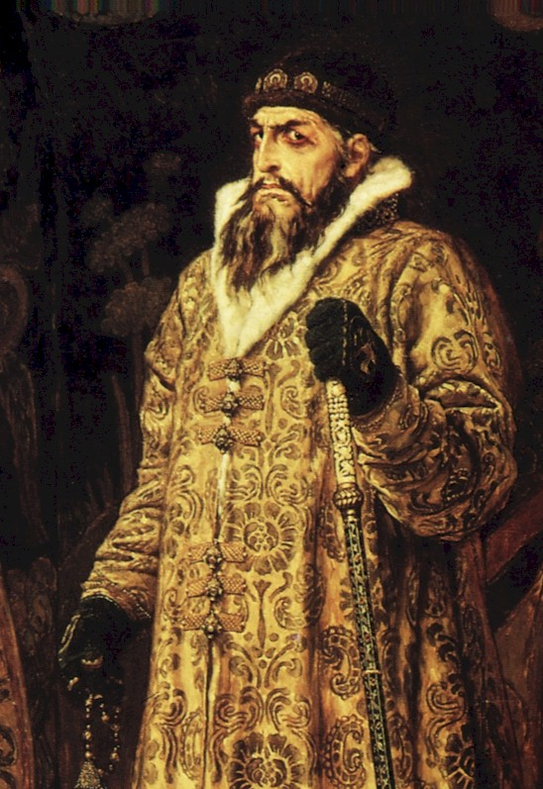
Russian History
800 AD a group of Vikings called Rus came into the area
Ivan’s IV father died when he was 3, mother when he was 8. Because of his age, the aristocracy (rich) took over. He was abused, so he took out his anger on animals. He tore feathers off birds, pierced their eyes and slit open their bodies.
1543 (age 13), he called the “leaders” into a meeting where he had one of them thrown into a pack of hungry hunting dogs. They gave him the power.
1547 (age 17) he took title tsar (czar) means emperor. He expanded the Russian borders through the use of his army.
Ivan earned the nickname “Ivan the Terrible” because he murdered hundreds of landowners, church leaders and his own soldiers who (he felt) opposed him.
In 1581, Ivan beat his pregnant daughter-in-law for wearing immodest clothing, causing a miscarriage. His son, also named Ivan, upon learning of this, engaged in a heated argument with his father, which resulted in Ivan striking his son in the head with his pointed staff, causing his son's death.

Slide 21
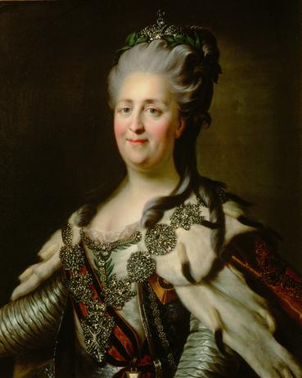
Russian History
1689 Peter the Great “modernized” (schools, the arts, ship building, city layouts, etc) Russia and advanced trade with other countries. He moved the capital from Moscow to the new city he named St. Petersburg. He was nearly 7 feet tall and very broad. He was massively powerful, "loud-mouthed, violent, and ruthless". (1918 Moscow became capital again.)
At first he taxes specific goods such as: salt, vodka, oak trees and tar. That wasn’t enough so he then taxed: bathing, fishing, beekeepng and wearing a beard.
He formed a small army out of his servants and used them in live ammunition firing war games. He convicted his oldest son of treason and executed him.
1762 Catherine the Great, born a German (Prussian), and married Peter the III. He was clueless and she was smarter. She planned and carried out a plot to overthrow and kill her husband. She became ruler. She was a skilled diplomat and very educated. She expanded the lands and the cultures of the Russian people.

Slide 22
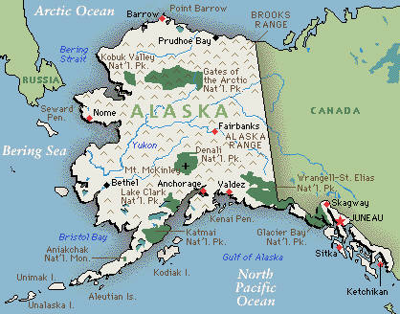
Russian History
In 1867, the United States bought Alaska from Russia for $7,200,000 or about 2 cents an acre for defensive purposes (and gold). (55 miles between Alaska and Russia mainlands)
Late 1800s, Russian Empire power began to decline. Industry grew slowly. Agriculture was the leading method of support. But there were fewer farmers, because people had left the fields to make much more money working in factories. Therefore there were food shortages and economic problems.

Slide 23
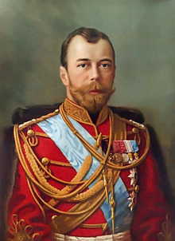
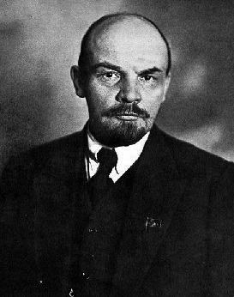
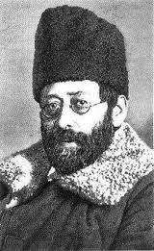
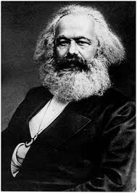
Russian Revolution
1912 the government was split between two groups: the Bolsheviks and the Mensheviks.
Lenin headed the Bolsheviks , who believed that violence was necessary for the revolution to succeed. Lenin gave his group the name "Bolshevik", which means majority-class. RED ARMY
The Mensheviks. (headed by Martov), believed in reform and democracy. "Mensheviks", which means minority-class. WHITE ARMY
1917, Czar Nicholas II (father of Anastasia) abdicated (gave up) his thrown. Lenin (Bolshevik) took control of the government. This ended absolute monarchy in Russia.
1922 the Bolsheviks became the Communist (classless society, equality). They established the USSR (The Union of Soviet Socialist Republic) based on the book (Communist Manifesto) of Karl Marx.

Slide 24
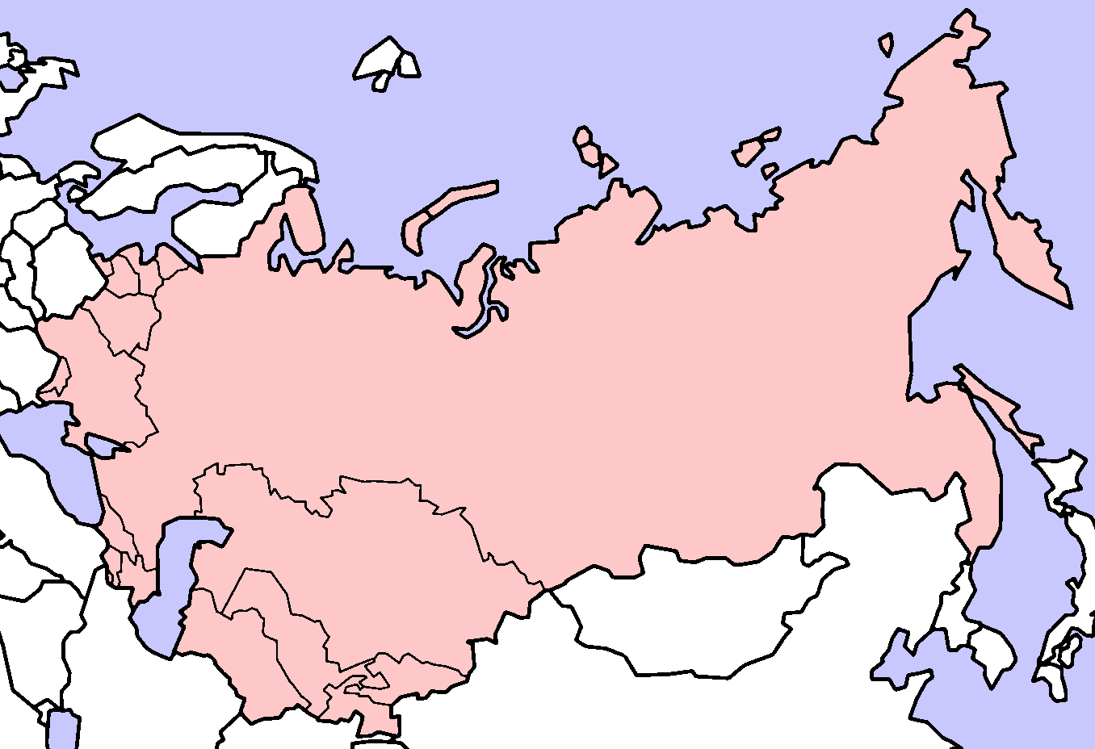
USSR

Slide 25
Pre and Post WWI Europe

Slide 26
WWI
On June 28th 1914, the heir to the Austrian Empire, Archduke Franz Ferdinand and pregnant wife were visiting Serbia and was assassinated.
Austria decided that Serbia must be punished and planned to invade her. Serbia called on Russia to help her. This begins the alliances (union or bond formed for a mutual benefit).
Austria called on Germany for help. The German government agreed to this and their response provoked the French government.
Germans attacked France through Belgium.
Britain went to protect Belgium, so declared war on Germany.
Italy declared war on Germany and Austria
Japan agreed to help Britain
The “Lusitania” was sunk by a German U-boat
Germany helps Lenin gain power in Russia (Russia pulls out of war)
Great Britain intercepts a message from Germany to Mexico (tell them they will help Mexico regain lost lands to USA)
USA declared war on Germany

Slide 27
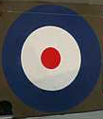
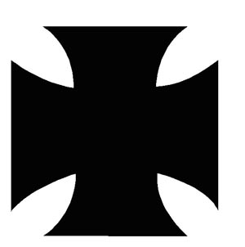
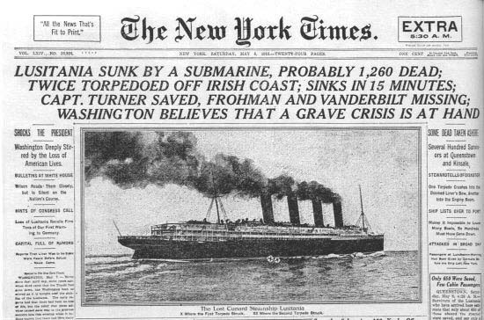
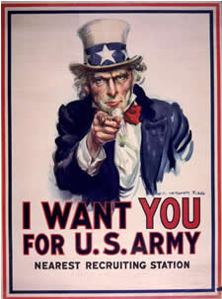
WWI
Allies/*Entente Central Powers
*Britain Germany
*Russia Austria/Hungary
*France Ottoman Empire
Serbia
United States
Italy
Japan
Finland

Slide 28
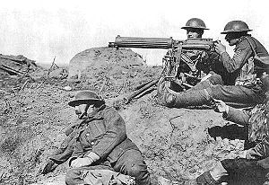
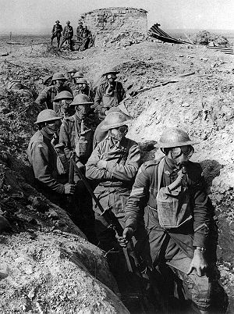
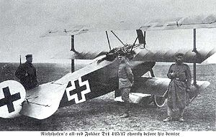
Inventions of WWI
Tank
Submarine
Flamethrower
War planes
Grenades
Mustard Gas
Machine guns

Slide 29
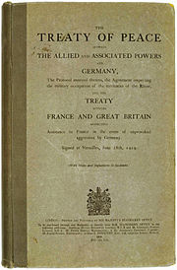
Treaty of Versailles
On the 11th hour on 11/11/1919 The Treaty of Versailles
was signed by the Germans in the French palace of
King Louis XVI, Versailles. Germany was not there for
the negotiations.
Germany lost many previously controlled lands
Germany’s army was reduced to 100,000 men
No tanks or air force
Only 6 naval ships and no submarines
Germany had to pay reparations, most would go to France and Belgium to pay for the damage done to both countries by the war.
Germany had to admit full responsibility for starting the war.
A League of Nations (early form of the UN) was set up to keep world peace.
Japan, Italy and Finland get insulted because they gained nothing from war.

Slide 30
Pre and Post WWI Europe

Slide 31
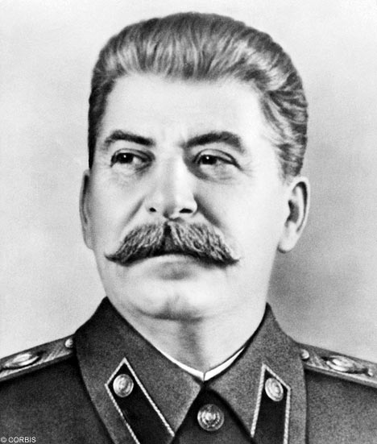
Russian History
1930 Joseph Stalin was in control. He established “true communism”, Soviet Union. He took over all industries and farms. Command Economy
Everything controlled by government.
No Private Ownership.
He created state run farms. Cooperative farming
Industry focused on heavy industry.
Religion was illegal.
Government controlled art, literature, media, etc (no freedom of speech)
One political party. (NO Elections)
No classes, everyone equal
Results:
Quality went down, due to no competition.
Farms failed to produce enough food for the population.
Huge build up of weapons.
Advancements in technology.
Equality? People were poor while the government was wealthy.
Everything distributed equality, so hard work does not produce large individual gains.

Slide 32
Adolph Hitler and the Swastika

Slide 33
WWII
1933 Hitler, an Austrian, becomes chancellor of Germany. He has a strong sense of nationalism.
1934 President Hindenburg dies. Hitler takes over the President's powers. He gives himself the name Fuhrer.
1935 Hitler announces that Germany has an air force. Hitler also passes the Nuremberg Laws oppressing Jews. (Holocaust (genocide)– as a result: 6 million Jews die, they are spread through out the world, genocide becomes a war crime, Israel is established as a home land for Jews 1948.)
1938 Germany invades Austria (he had an alliance with Soviet Union and Italy)
1939 Germany invades Poland, England and France declare war on Germany. (Begins WWII)
1940 Germany invades many European countries, begins the attack on England (Blitzkrieg: Lightning attack) 60% of London is destroyed.
1941 Germany attacks Soviet Union during winter. 1 German soldier dies every 7 seconds.

Slide 34
WWII
Allies Axis
U.S. Germany
U.K. Italy
France Japan
Soviet Union Finland
China

Slide 35
WWII
Japan had been buying all of its oil from USA. USA declares oil embargo on Japan and is sending aid to the Allies in Europe.
Japan attacks Pearl Harbor Navy Base on Oahu, Hawaii
90 minute attack on Sunday, December 7, 1941 at 7:48 am
2400 US people died, 350 planes destroyed, 8 battleships, and 4 destroyers
Japan lost 29 planes

Slide 36
Pearl Harbor before the attack
Pearl Harbor

Slide 37
Attack on Pearl Harbor

Slide 38
Attack on Pearl Harbor

Slide 40
Attack on Pearl Harbor

Slide 41
Kamikaze Pilots

Slide 42
Kamikaze Pilots
USS Columbia hit by kamikaze.

Slide 43
After the attack on Pearl Harbor

Slide 44
After the attack on Pearl Harbor

Slide 45
USS Arizona: the resting place of 1102 of the 1177 who died on the ship

Slide 46
WWII
USA is afraid that USSR will try to take Europe for itself so “allies” with Soviet Union.
In order to surprise Germany, USA creates 100s of balloon tanks, buildings, jeeps, etc to look like an invading army in Dover, England. Germany sends 1 million troops to stop invasion.
1944 D-Day Allies actually land on Normandy, France 250 miles away
1945 Soviet Union invades Germany from the East
Britain and the USA invade from the west
Hitler commits suicide and Germany surrenders (May 8, 1945 VE Day)
August 6, 1945 bombing of Japan (Hiroshima) 80,000 die instantly
August 9 (Nagasaki) 75,000 instantly
Japan surrenders, WWII over

Slide 47
The Atomic Bomb and Japan

Slide 48
The Atomic Bombs Little Boy – Hiroshima Fat Man - Nagasaki
 | Name: Little Boy Type: Uranium gun-type fission Weight: 9,700lb (4400 kg) Length: 10 ft, 6 in (3.2m) Diameter: 29 in (0.737m) Explosive Yield: 15,000 tons of TNT
 | Name: Fat Man Type: Plutonium fission Weight: 10,000lb (4535 kg) Length: 10 ft, 8 in (3.25 m) Diameter: 5 ft (1.52 m) Explosive Yield: 21,000 tons of TNT

Slide 49
Hiroshima before the Bomb

Slide 50
Hiroshima after the Bomb

Slide 51
The explosion created a supersonic shock wave which was responsible for destroying most of the buildings in the blast zone. Fully half of the bomb's released energy was released in the form of this wind, which spread out at 1000 miles/hr. It not only knocked things down, it also filled the air with debris. The section of concrete wall below has numerous glass shards embedded in it, even though it was 1 ½ miles from the blast center.

Slide 52
The heat of the blast, estimated at 5500 to 7000 degrees Fahrenheit, immediately below the explosion, was sufficient to melt glass bottles such as these, which were ½ mile away.

Slide 53
The photograph on the right shows the dark portion of the pattern of the clothing imprinted on the skin by the powerful heat rays. This is also called secondary burns, in which the skin under the clothing received burns through the clothes scorched by the heat rays.

Slide 54
Leaders of WWII
J. Stalin
F. D. Roosevelt
B. Mussolini
A. Hitler
W. Churchill
H. Tojo
H. S. Truman

Slide 55
What happened to them?
Roosevelt while at Warm Springs, Georgia, died at 63 years old of a stroke.
Stalin died at 73 years old of a stroke.
Churchill died at 90 years old of a stroke.
Truman died at 88 years old of heart failure.
Mussolini (Il Duce) executed by firing squad, body was then hung upside down on meat hooks at a gas station and stoned age 61.
Hitler (de Fuhrer) committed suicide in bunker with wife and had bodies burned. He was 55 and she was 33.
Tojo (the Razor) attempted suicide by shooting himself four times, however the shots missed vital arteries and his heart and so, he pleaded guilty to war crimes. He underwent emergency surgery and was moved to prison. Once he had recovered he was sentenced to death and hanged at age 63.

Slide 56
IRON CURTAIN/eastern bloc
Soviet Union became a world power.
1961 Built the Berlin Wall (creating 2 Germanys), creating the IRON CURTAIN.
Soviet Union become leader of the Eastern Bloc (Warsaw Pact: the Communist version of NATO)
Cold War began between Soviet Union and USA (Superpowers).
1970s two leaders (Khrushchev and Brezhnev) tried to expand cultural, domestic, and foreign policies. Unfortunately it did not work. Russia spent most of their money on defense and weapons. Russia was going broke competing with the US.

Slide 57
Berlin Wall
1949 West Germany and East Germany are created.
1961 Communists build the Berlin Wall
12 feet tall, 4 feet wide, 96 miles long
1989 The Berlin Wall falls (end of the Soviet Union)
Germany reunified

Slide 58
Russian History
1985 Mikhail Gorbachev started glasnost (openness). He opened up diplomacy and gave people individual rights to speak.
1989 first public election since 1917.
1991 USSR was ended when the Berlin wall came down. Many countries declared their independence (15 countries). The Russian Federation was created.
Some want to be communist again: Life for most Russians has not improved. The great majority still struggles to survive, sometimes below the poverty level.

