Slide 1
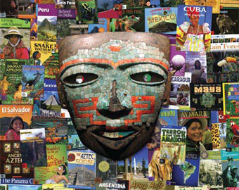
Geography of Latin America

Slide 2
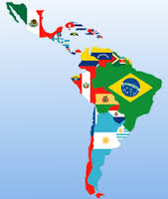
What is Latin America?
Latin America are the countries in the Americas south of the United States that have a Romance language (a language derived from Latin) such as: Spanish, Portuguese, French and the Creole.

Slide 3
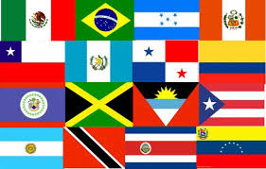
Political Map of Latin America

Slide 4
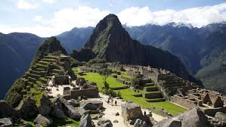
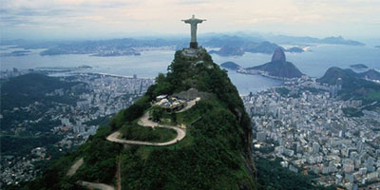
Physical Map of Latin America

Slide 5
Facts of Latin America
2 continents: North America and South America
Central America is not a continent
Mexico and Central America: is an isthmus (small piece of land that connects two larger pieces of land)
The Caribbean is an Archipelago: a group of islands
The Andes: World's longest and second highest mountain range
The Amazon River: Largest river in the world. 
The Atacama Desert: World's driest desert. 
The Amazon Rainforest: World's largest rainforest, and is the world's greatest storehouse of species (plant and animals, largest single area concentration on oxygen)
Angel Falls in Venezuela: 3723ft of uninterrupted waterfall, making it the world's highest

Slide 6
Climate of Latin America
 Most of Latin America is located in the tropics
Land located between the Tropic of Cancer (23.5 N) and the Tropic of Capricorn (23.5 S)
In the tropics there is not much seasonal variation in temperature; temperature averages 64 ° to 81°F. It has no real winter.
Desert (arid): a barren area of land where little precipitation occurs, few plants and animals live there
Savanna: a grassland scattered with shrubs and isolated trees, which can be found between a tropical rainforest and a desert. Not enough rain falls on a savanna to support full forests.
Tropical Rain Forest: is a forest of tall trees in a region of year-round warmth. An average of 50 to 260 inches of rain falls yearly.

Slide 7
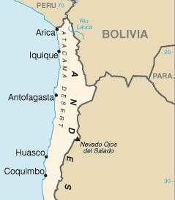
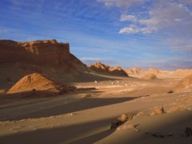
Atacama Desert
Atacama Desert of northern Chile is the world's second driest region. The Atacama lies in the rain shadow of Chile's Coast Range. The desert is completely barren and while most areas only receive moisture from an occasional fog or a shower every few decades, the rain gauges in some areas have never recorded any measurable precipitation. The Atacama is a high (most elevations are over 8000 feet) and cold desert, average temperatures range from 32° to 75° F.

Slide 8
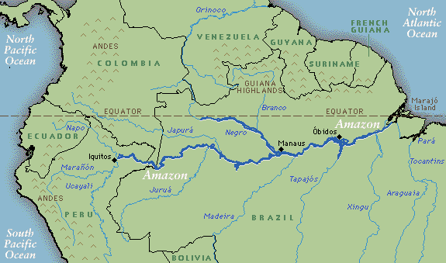
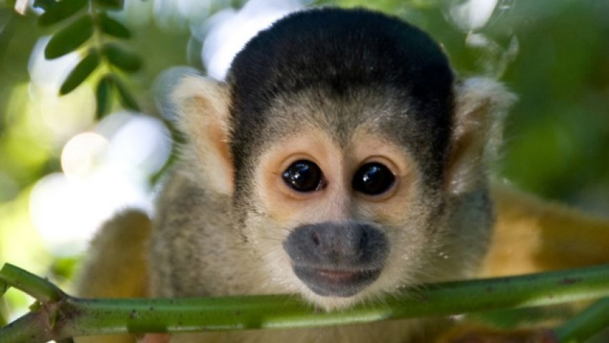
Amazon River
The same mountain range that causes the driest area also causes the wettest area, “The Amazon River Basin” (a basin is a region surrounded by mountains or other higher land).
Amazon River- is drained by the 2nd longest river in the world
The Amazon River is about 4,195 miles long.
Carries more water than any other river. Over 20% of the earth’s water flows down the Amazon.

Slide 9
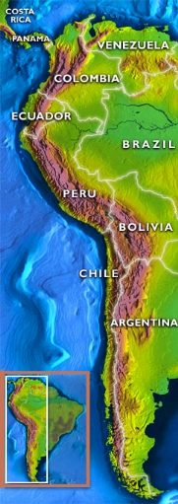
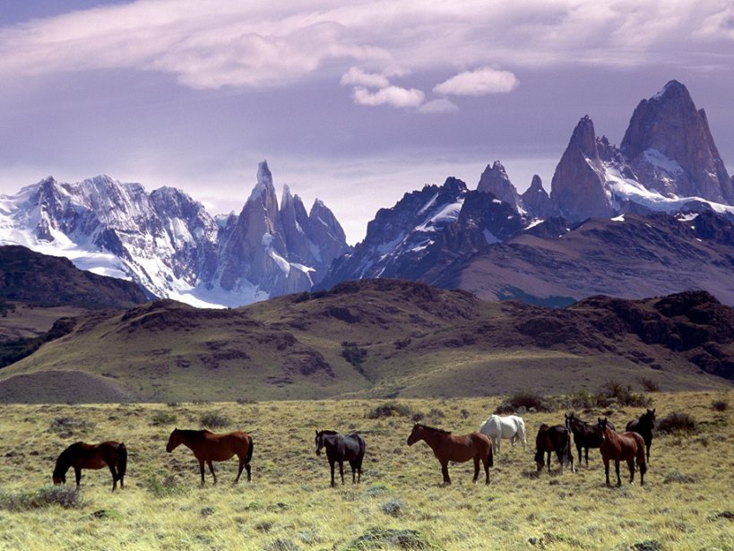
The Andes
The Andes are the longest mountain range in the world, running north to south 4,200 miles.
The Andes are the second highest mountain range in the world (18,000 ft.) .
Andes Mountains provides most of the water to the Amazon River
The Andes mountains are a natural trade barrier. They have led to more settlements on the western coast due to height.

Slide 10
Partner Work
How does climate, resources, and location affect where the population live?

Slide 11
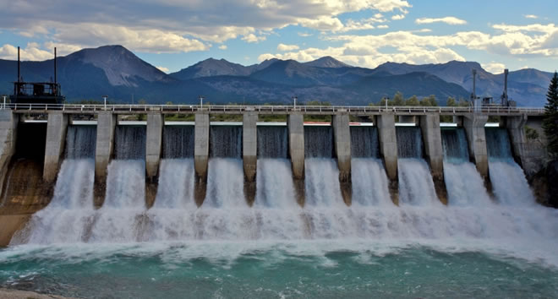
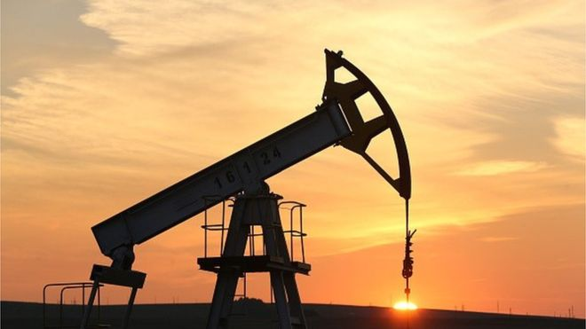
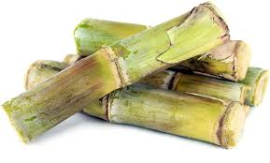
Land Use
Mexico and South America: oil, natural gas, silver, gold, copper, iron, coal (More mining, drilling, industry)
Central America and Caribbean: coffee, cotton, sugar cane, bananas, cacao trees (More agriculture)
Hydroelectricity: using energy of flowing water to produce power

Slide 12
Human/Environment Interaction
78% urban (Mexico City has a population of 21,200,000)
raw sewage and industrial materials polluting rivers in urban areas
natural fresh water resources scarce and polluted
Mexico City is listed as one of the most polluted places on the planet. Its pollution was thought to cause 1,000 deaths and 35,000 hospitalizations per year. Things have improved.
Air pollution (Many cars don’t have the anti-pollution equipment. The city is surrounded by mountains, so wind does not push pollutants away.)
Farming and industries are causing deforestation and desertification

Slide 13
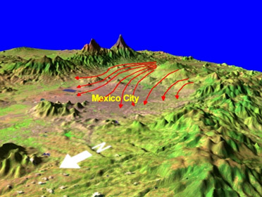
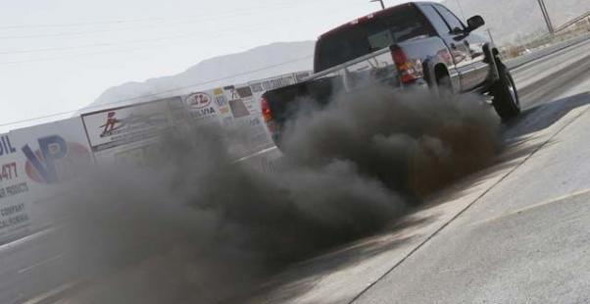
Causes of Mexico City’s Air pollution
The huge population means there are a lot of cars (the emissions cause air pollution).
Many cars are older (less expensive)they run on regular gas (unleaded is cleaner) or they do not have the anti-pollution equipment
The Sierra Madre mountains surround city & trap in polluted air.

Slide 14
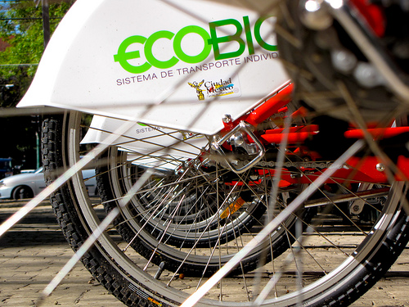
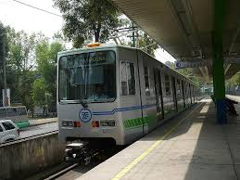
Solutions
To reduce air pollution, the city promotes public transportation (buses, subway, bikes, etc.).
The city is also testing buses that run on cleaner burning fuels.
There are new restrictions on car use. They are limited days that certain cars can be driven.
The government also holds workshops to teach people about the environment.

Slide 15
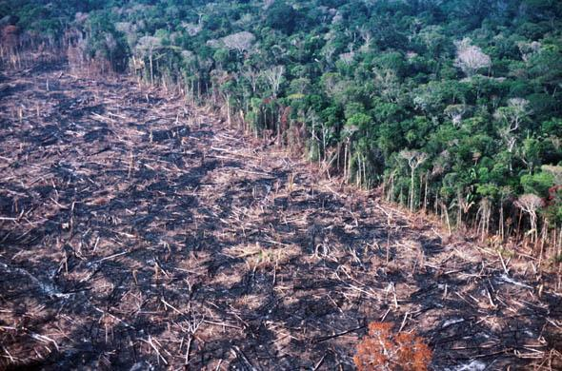
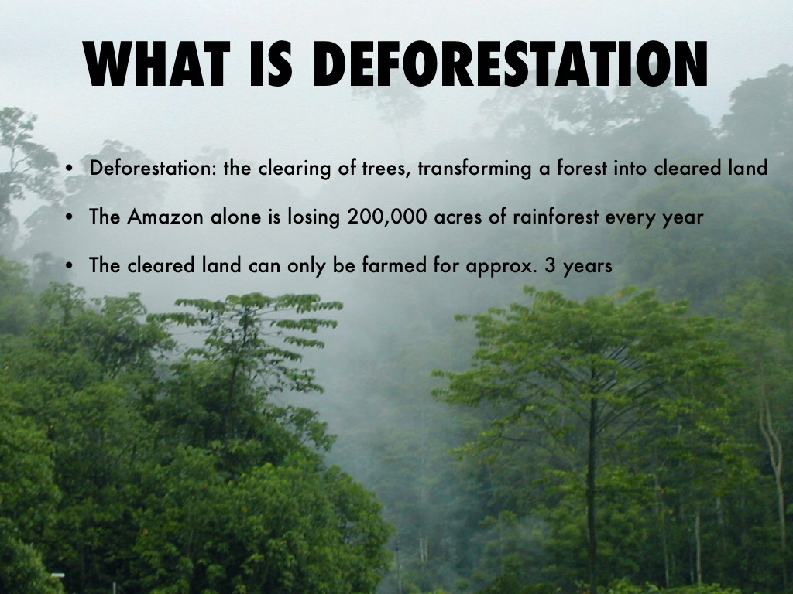
Deforestation of the
Amazon Rain Forest
One and one-half acres of rainforest are lost every second due to deforestation.
Experts estimates that we are losing 137 plant, animal and insect species every single day. That equates to 50,000 species a year.
As the rainforest species disappear, so do many possible cures for life-threatening diseases. Currently, 121 prescription drugs sold worldwide come from rainforest plants.
The Amazon Rainforest has been described as the "Lungs of our Planet" because it provides the continuously recycling carbon dioxide into oxygen. More than 20 percent of the world oxygen is produced in the Amazon Rainforest.

Slide 16
Causes and solutions
Causes:
In the 1950s, the Brazilian government began building a major highway system. This opened the rain forest to loggers.
Also, Brazil’s population has increased, and huge parts of the rain forest are being cut down to create farms.
People are raiding the rainforest for profit (animals and plants)
Solution:
The government is working to fix the deforestation problem by passing laws on cutting down too many trees, as well as creating reforestation projects.

Slide 17
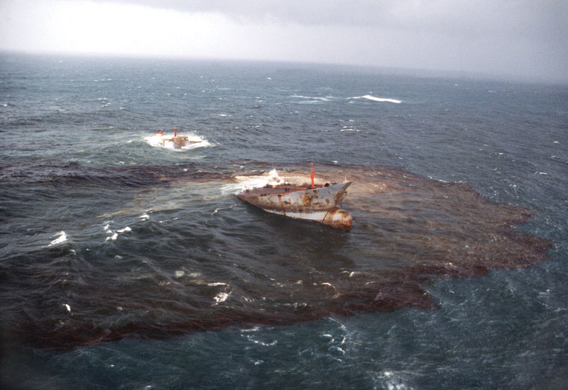
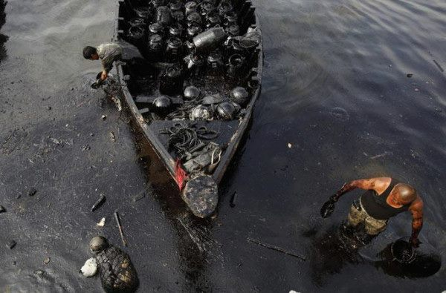
Venezuela Oil Pollution
It’s one of the world’s leading producers of oil. It has been producing oil for about 100 years. Oil production has boosted the economy. It’s the main source of income for many people.
Oil production results in toxic wastes, air pollution, & oil spills.
Money from selling oil is the country’s main source of income. Venezuelans are motivated to keep producing, selling, and burning oil--and polluting— because it boosts their economy.

Slide 18
Causes and solutions
Causes:
Oil spills have damaged the environment. It also hurts the ability of fishermen to earn a living.
Venezuela leads South America in the production of carbon dioxide, which is a by- product of burning fossil fuels like natural gas & oil. This can cause breathing problems for children & elderly. It also contributes to global warming.
Oil businesses have damaged Lake Maracaibo (largest lake in South America). Large amounts of oil have been removed from the area so the land is changing. The eastern shore of the lake is dropping about three inches a year. The government is having to take precautions to keep water from flooding into nearby towns.
Solutions:
Groups are calling for renewable energy sources and the clean-up and prevention of pollution.

