Slide 1
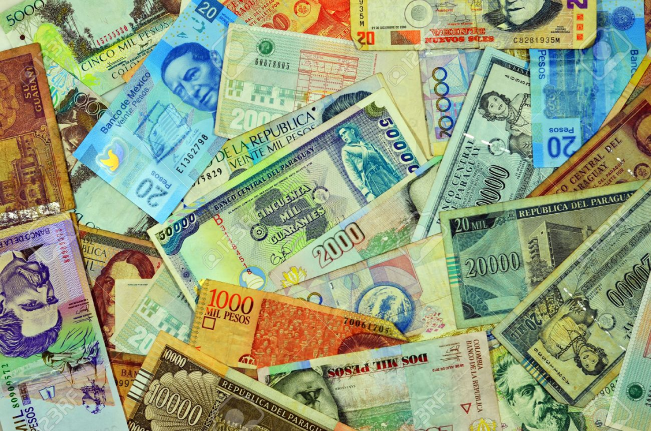
Government and Economy of Latin America

Slide 2
Mexico:
Government Type: Presidential Democracy
Economy: Per capita Income: $16,100
52% below poverty
Mixed economy (some areas are traditional)
member of NAFTA (North American Free Trade Agreement) (78% of trade is with USA) This agreement removed most barriers to trade and investment among the United States, Canada, and Mexico.
Agriculture: 4%, Industry: 37%, Service: 60%
Agriculture products: corn, wheat, rice, beans, cotton, coffee, fruit, tomatoes, beef, poultry, (cash crops, commercial farming), cooperative farming most often, many practice subsistence farming

Slide 3
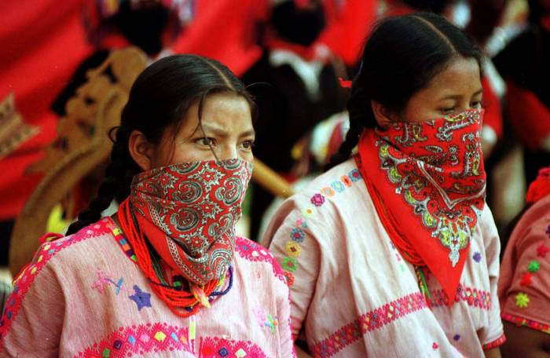
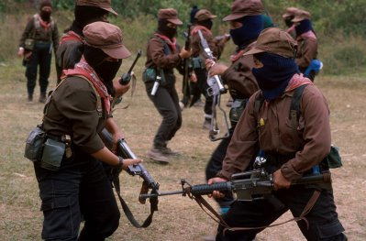
Zapatista
Some native people of Mexico do not agree with NAFTA. They think it would allow cheap goods to come into Mexico from the United States. The Zapatistas fight for the rights of the native Mexicans and to force all foreigners out. They have tried to use force to convince the Mexican government to end NAFTA.

Slide 4
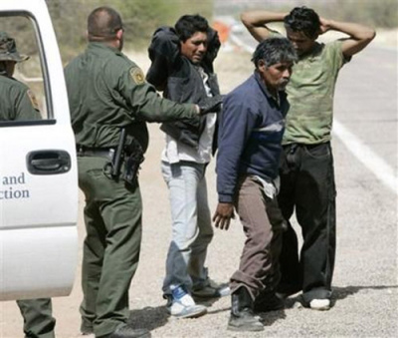
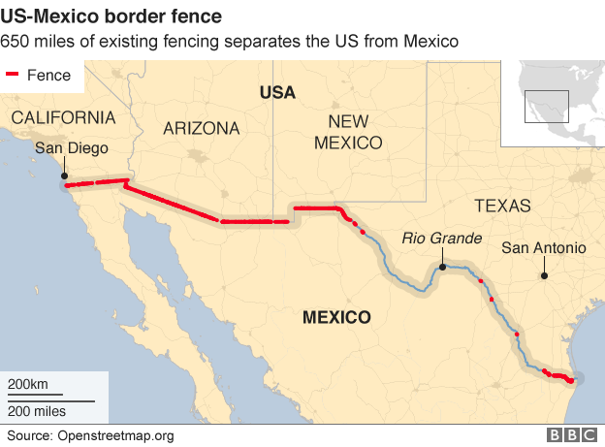
For many generations Mexicans have illegally crossed the border into the United States. Many individuals come from poverty-stricken towns in Mexico and desire to come to the United States to achieve the "American dream." For many, just gaining employment at a low wage job in the United States provides a much higher standard of living than in their home country.
There is 700 miles of the 1950 miles with fence. It is located in the areas with the largest illegal migration.
Estimated 12 million illegals in US
Trump’s wall would cost an estimated 25 billion.

Slide 5
Central America
Government Type: Democracy: presidential and parliamentary, * Belize is commonwealth of England
Economy: Per capita Income: $7900
Largest: Panama ($14,300) Smallest: Nicaragua ($3200) 42% below poverty level: Best: Costa Rica (24%) Worst: Honduras (60%)
Mixed economy (some areas are traditional)
Agriculture: 25%, Industry: 19%, Service: 56%
Tourism and the canal are largest industry and service

Slide 6
 | El Salvador | Belize | Nicaragua | Honduras | Panama | Costa Rica | Guatemala
Literacy Rate % | 81 | 68 | 68 | 80 | 92 | 95 | 69
Life Expectancy | 73 | 77 | 72 | 71 | 78 | 78 | 71
Per capita Income | $7,600 | $8,400 | $3,200 | $4,400 | $14,300 | $12,000 | $5,100
Agriculture % | 19 | 10 | 29 | 39 | 15 | 14 | 50
Industry % | 23 | 18 | 19 | 21 | 18 | 22 | 15
Service % | 58 | 72 | 52 | 40 | 67 | 64 | 35
Poverty % | 38 | 43 | 46 | 60 | 29 | 24 | 54

Slide 7
Caribbean
Government Type: Cuba is communist, Democracy: presidential and parliamentary, * Jamaica and the Bahamas are a commonwealth of England, Puerto Rico is a commonwealth of the US,
Economy: Per capita Income: $17,000
Largest: Puerto Rico ($37,700) Smallest: Haiti ($1800)
Mixed economy (some areas are traditional)
Agriculture: 7%, Industry: 26%, Service: 67%
Countries that are commonwealths are better economically
Puerto Rico’s industry is 50% of its economy due to pharmaceuticals, electronics, apparel, food products, tourism

Slide 8
 | Haiti | Dominican Republic | Jamaica | Puerto Rico | Cuba | Bahamas
Literacy Rate % | 61 | 92 | 89 | 93 | 99.8 | unknown
Life Expectancy | 64 | 78 | 74 | 79 | 79 | 72
Per capita Income | $1,800 | $15,900 | $9,000 | $37,700 | $11,600 | $24,600
Agriculture % | 22 | 5 | 7 | 1 | 4 | 2
Industry % | 20 | 33 | 21 | 50 | 23 | 8
Service % | 58 | 62 | 72 | 49 | 72 | 90
Poverty % | 59 | 41 | 17 | unknown | unknown | 9

Slide 9
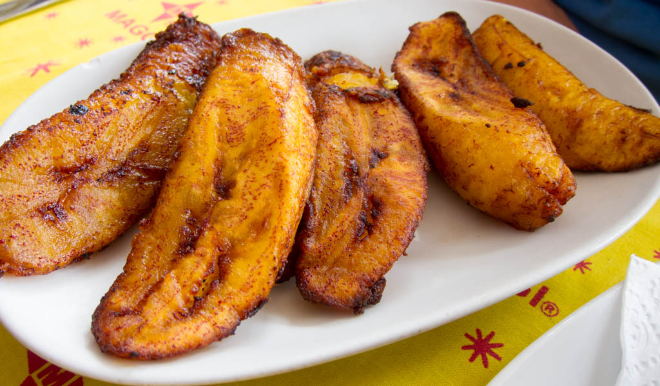
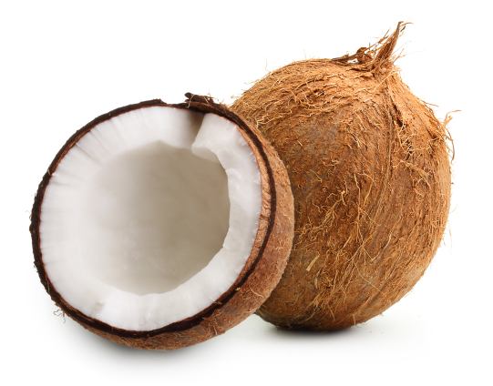
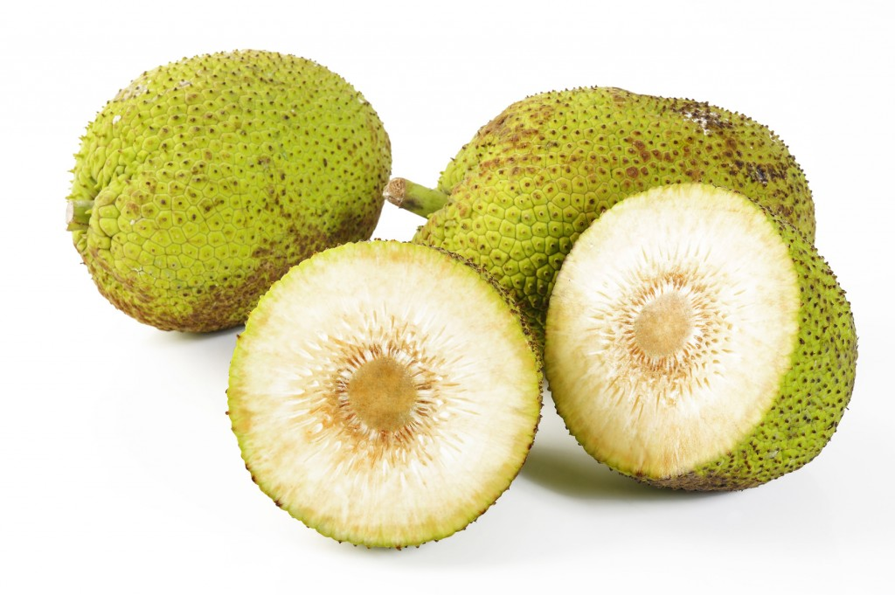
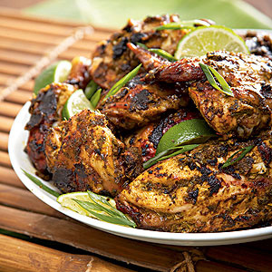
Foods of the Caribbean

Slide 10
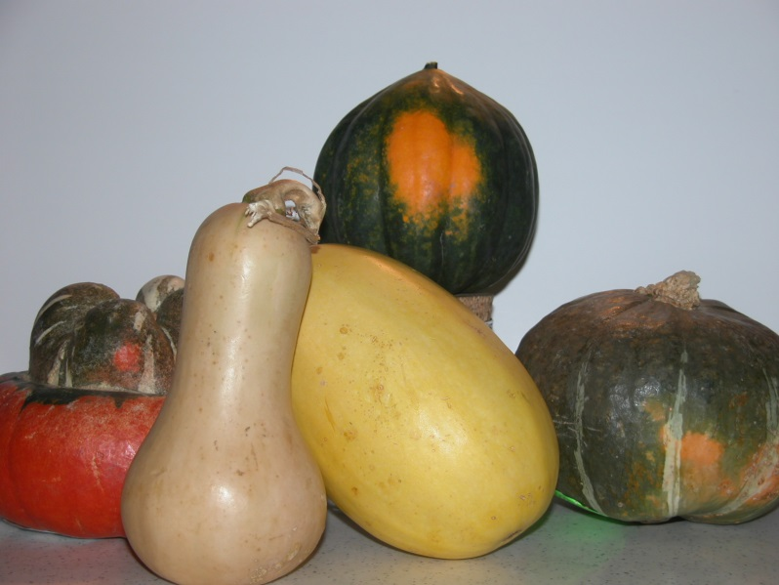
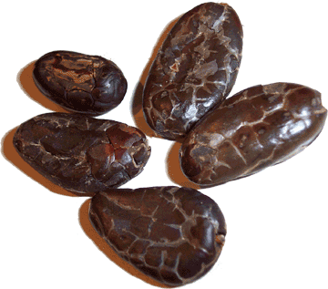
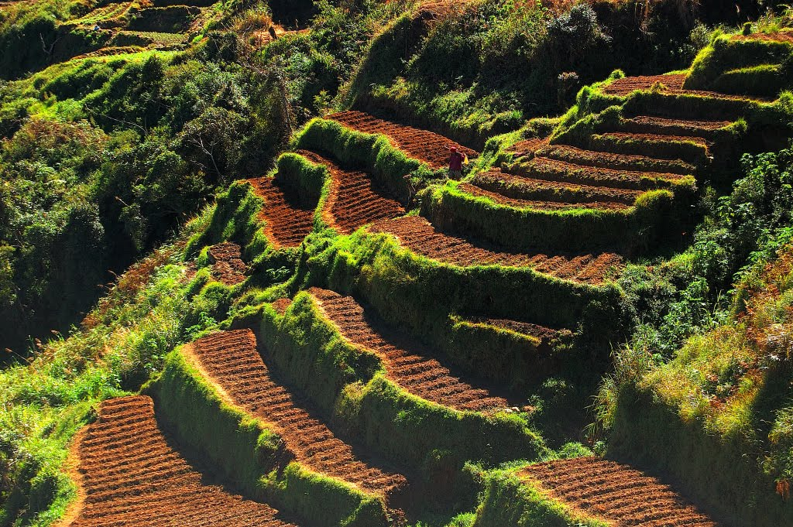
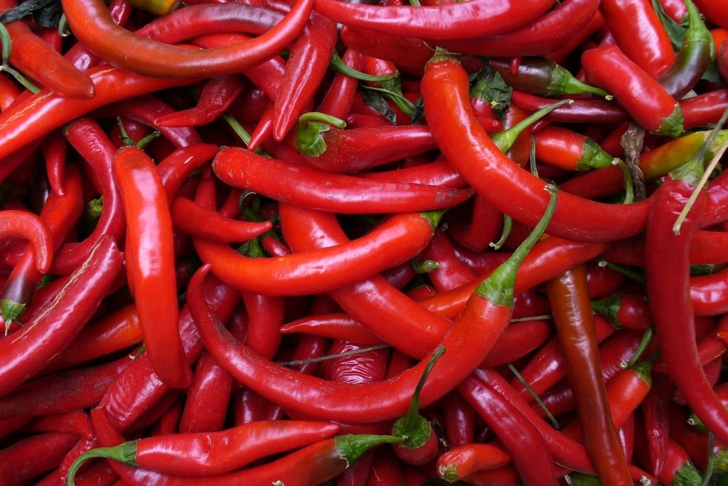

Slide 11
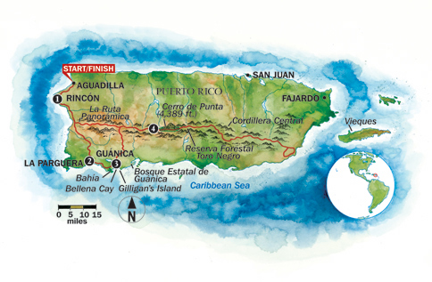
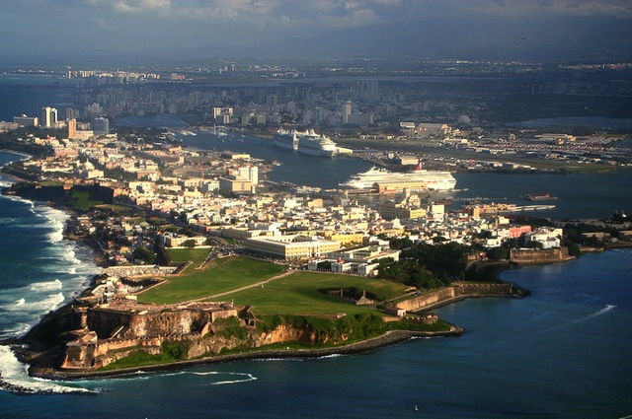
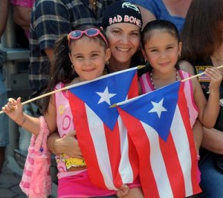
Puerto Rico Got name from “Rich Port” due to the amount of gold found there

Slide 12
South America
Government Type: Democracy: all are presidential except Guyana which parliamentary and French Guiana which is a is a commonwealth of France
, Economy: Per capita Income: $14,500
Largest: Chile($24,000) Smallest: Bolivia ($7200)
Agriculture: 9%, Industry: 33%, Service: 58%
Unlike the Caribbean, the commonwealth, French Guiana has he worst literacy rate and depends on agriculture the most in the region
Suriname has the worst poverty rate at 70% but has the highest industry amount at 50% due to mining

Slide 13
 | Columbia | Venezuela | Brazil | Argentina | Peru | Bolivia | Chile
Literacy Rate % | 95 | 96 | 93 | 98 | 94 | 96 | 98
Life Expectancy | 76 | 76 | 74 | 77 | 74 | 69 | 79
Per capita Income | $14,200 | $15,100 | $15,200 | $20,200 | $13,000 | $7,200 | $24,000
Agriculture % | 7 | 4 | 6 | 11 | 7 | 13 | 4
Industry % | 34 | 36 | 22 | 30 | 34 | 37 | 32
Service % | 59 | 60 | 72 | 58 | 59 | 54 | 64
Poverty % | 28 | 32 | 21 | 30 | 26 | 45 | 14

