Slide 1
What is a government?

Slide 2
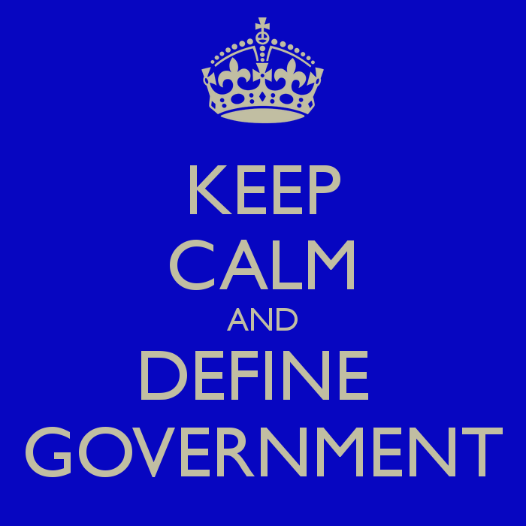
Definition
Government: a system of people, laws, and officials that define and control a nation, state or community.
How would you define government?

Slide 3
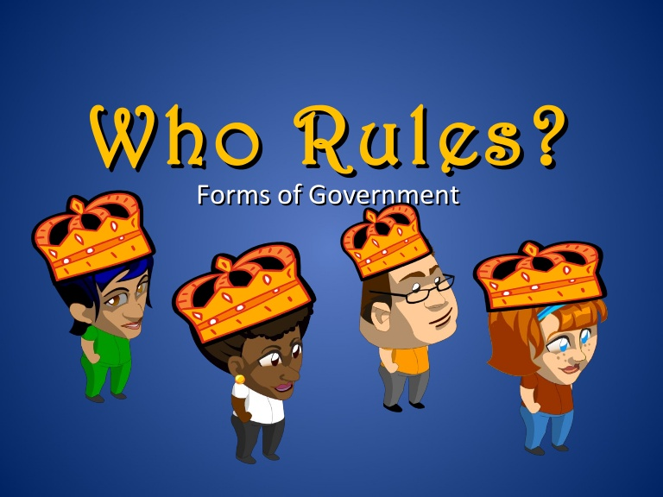
Governments or Political Systems

Slide 4
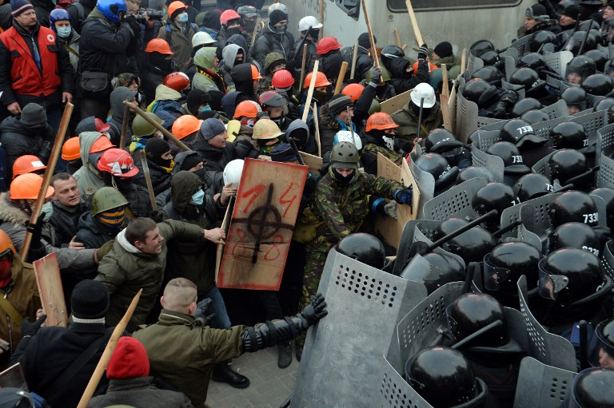
Anarchy
No One Rules

Slide 5
Unitary
Actual definition: a political system with a central supreme government which holds the authority over and makes the decisions for subordinate local governments.
Your definition:

Slide 6
Unitary
Local Government
Local Government
Central Government
Local Government
Local Government

Slide 7
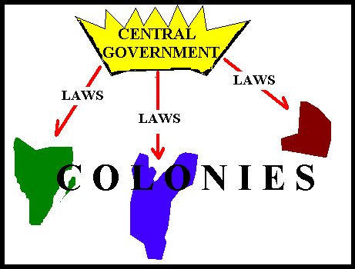
Unitary
Strengths
Weaknesses
The central government is in complete control.
There is more unity because the government makes all decisions.
“Big” Decisions made quicker.
The central government will do what is best for itself.
Citizens have little say!

Slide 8
Examples
Totalitarianism
a political system that permits no individual freedom, absolute control

Slide 9
Examples
Autocracy
One person possesses unlimited power.
The citizens have no role or say in government.
This is the oldest and most common form of government.
Oligarchy
One family or group possesses unlimited power.
A few special citizens have a say in decisions. The majority do not.

Slide 10
Forms of Autocratic Governments
Dictatorship
Single Leader
Leader controls everything
Control usually through threat of violence
Absolute Monarchy
King, queen, or emperor is the supreme power of government
Position is usually inherited
Notes:
Remy, Richard C., United States Government- Democracy in Action (Columbus, OH: Glencoe, McGraw-Hill, 2006)

Slide 11
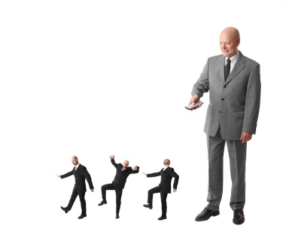
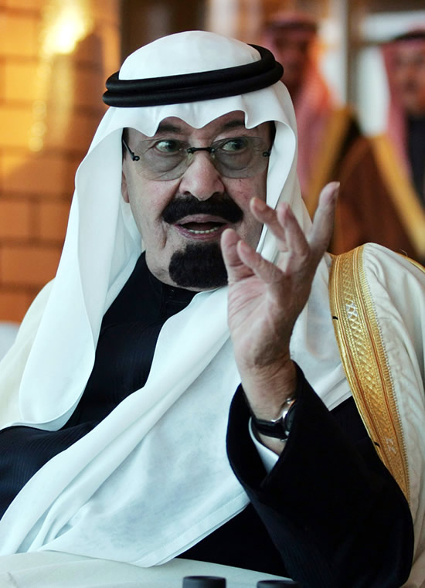
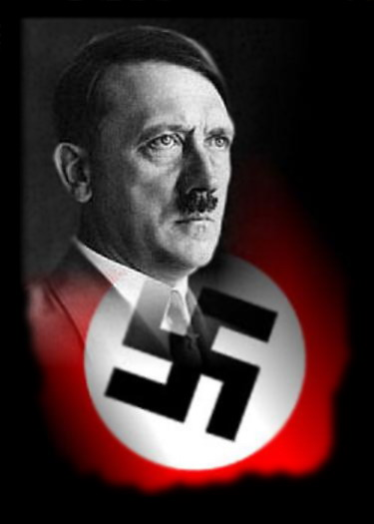
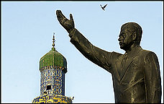
Autocracy
Government by ONE

Slide 12
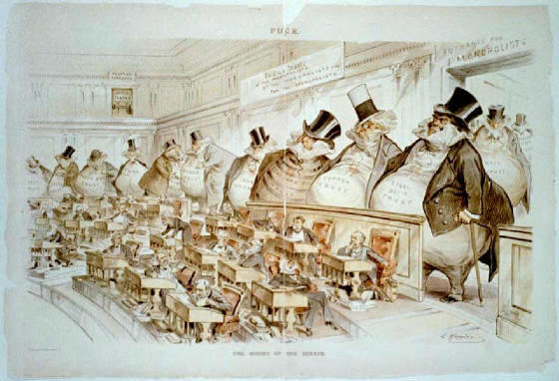
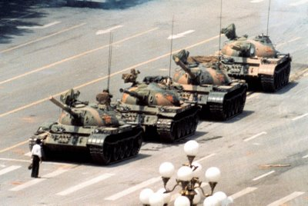
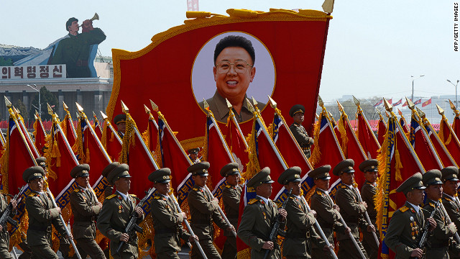
Oligarchy
Government by a GROUP
Tiananmen Square 1989

Slide 13
Federal
Actual definition: a system that divides up power between a strong national government and smaller local governments.
Your definition:

Slide 14
Federal
Local Government
Local Government
Central Government
Local Government
Local Government

Slide 15
Federal
Power is divided “equally” between one central government and local governments.
Local governments retain certain individual powers and are unified under a central government.
One central government has the final say.

Slide 16
Federal
Strengths
Weaknesses
Neither the central nor local governments make decisions alone.
Citizens have say usually through voting.
Local governments handle local problems.
Central government can devote more time and energy to national and international problems.
It is difficult to be equal to everyone.
It may take longer to make decisions, due to the large size of government.

Slide 17
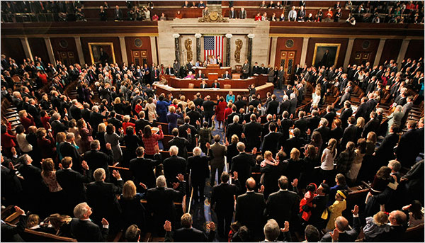
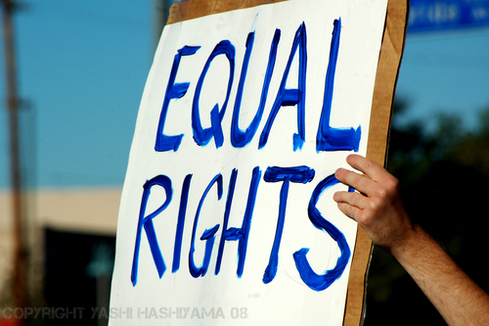
Democracy
Government by the People

Slide 18
Forms of Democracies
Direct democracy: doesn’t exist. All citizens would vote on everything. Majority would always win.
Republic: government based on law. Voters choose representatives to vote for them.
Constitutional Monarchy is a monarchy but their decisions are limited based on citizen’s rights. (MAGNA CARTA)

Slide 19
Forms of Democracies
Parliamentary Democracy
No clear separation between the Executive and Legislative branch.
The People elect representatives to the legislature.
The Legislature selects the Executive Leader.
The executive leader is called a Prime Minister.
Example: Canada, Australia, Great Britain
Notes:
Remy, Richard C., United States Government- Democracy in Action (Columbus, OH: Glencoe, McGraw-Hill, 2006)

Slide 20
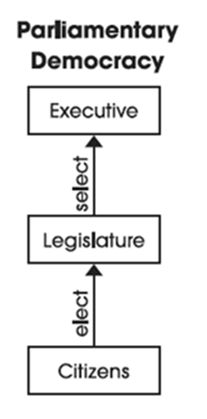
Parliamentary Democracy

Slide 21
Advantages/Disadvantages of Parliamentary Systems
Strengths:
Always unified government
No one to overrule decisions (Veto)
Clear lines of responsibility –voters know who to blame/reward
Weakness:
Divided government may be a good thing to make sure everything “fair” (Checks and Balances)
Minority groups have very little rights

Slide 22
Forms of Democracies
Presidential Democracy
A system of government in which the executive is separate of the legislature.
The People elect the legislature.
The People elect the Executive Leader.
The executive leader is called the President.
Example: United States, Mexico
Notes:
Remy, Richard C., United States Government- Democracy in Action (Columbus, OH: Glencoe, McGraw-Hill, 2006)

Slide 23
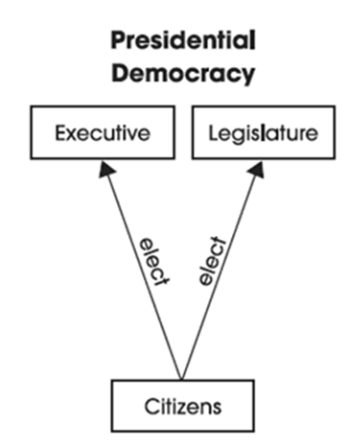
Presidential Democracy

Slide 24
Advantages/Disadvantages of Presidential Systems
Strengths:
The key distinction is the Separation of Powers
The executive and the legislative can veto each other
Minority groups have more rights
Weakness:
Divided government may not be a good thing
Decisions can take longer if executive and legislative do not agree.
No Clear lines of responsibility –voters do not know who to blame/reward

Slide 25
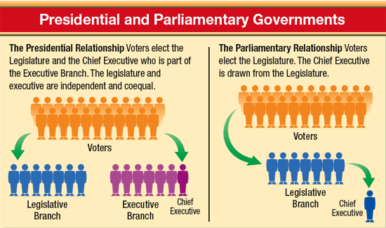

Slide 26
Confederation
Actual definition: A group of nations or states in which the individual states retain considerable independence.
Your definition:

Slide 27
Government System Exception
Confederation
Local Government
Local Government
Central Government
Local Government
Local Government

Slide 28
Confederation
Strengths
Weaknesses
Local governments (alliances) are stronger when working together
A confederation often is short term or only for a specific purpose.
The central government is limited to handling only what the local governments allow.
Confederation doesn’t truly exist (in a government form).
Many countries participate in organizations that run like a confederation such as: NATO, United Nations, NAFTA, and the European Union

