Slide 1
History of Latin America

Slide 2
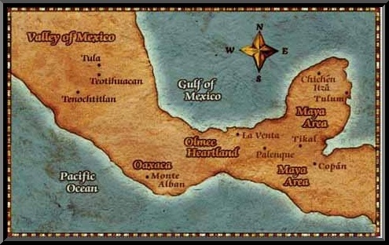
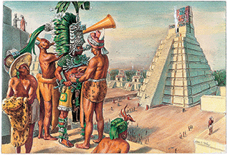
History: Mayans (1500 BC – 900 AD)
Inhabited the Yucatan Peninsula
Lived near natural water for survival and trade
Farmers of maize, beans, squash, cotton cacao, and chili peppers
Terrace farming and created canals for irrigation
Built pyramids for religious sacrifices
Play Pok-ta-Pok
Starvation, natural disasters, diseases, or invasion by outsiders is believed to have led to their disappearance (but not known for sure). After 900 AD, the Mayans disappeared from area, but reappeared in Belize and Guatemala.

Slide 3
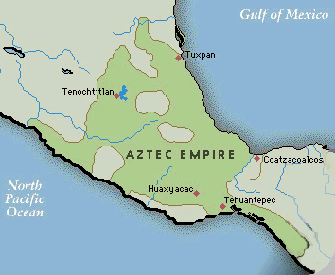
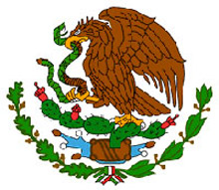
History: Aztecs (1200 BC – 1521 AD)
Located in Central Mexico
They believed they were the chosen people of the sun and war god (religion called Mexica)
They were told that the place they would live would be marked for them. It would be marked by a bird eating a snake while sitting in a tree. They wandered the area until one day they came upon an eagle perched on a cactus eating a snake. They built their city there.
The Aztec founded the city of Tenochtitlan (Tay-nawch-teet-lahn) on an island in Lake Texcoco, which is now Mexico City.
It became a major city with trading, markets, temples, different classes of people: (priest, tax collectors, warriors, and merchants).

Slide 4
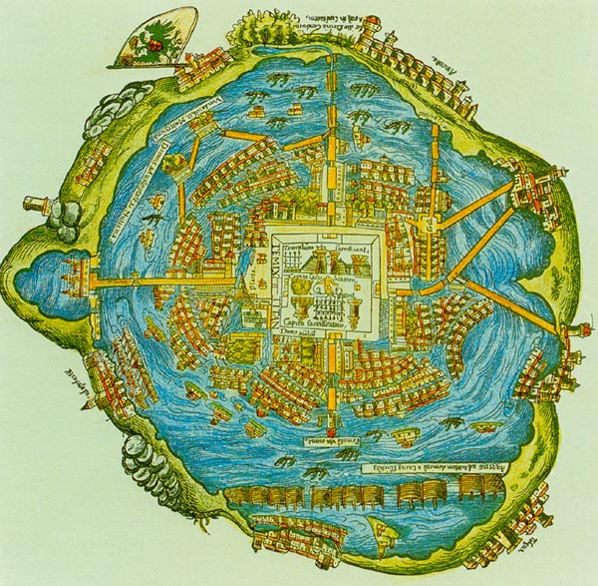
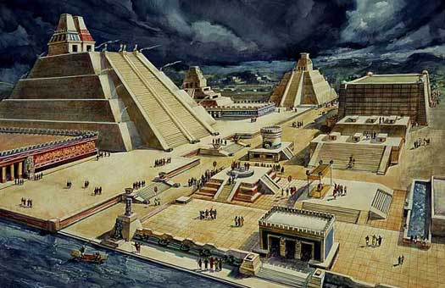
Tenochtitlan

Slide 5
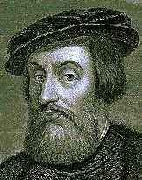
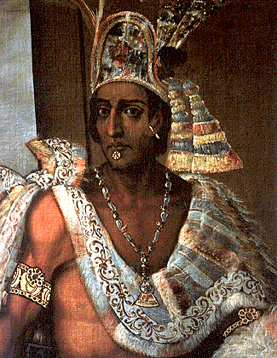
History: Mexico
1519 Spanish Conquistador (Spanish adventurer), Cortes arrived on the Yucatan Peninsula with about 600 men and 16 horses. The soldiers had muskets. The Aztecs had never seen a white person, nor had they ever seen a horse.
The legend stated that Quetzalcoatl would return one day as a white man with a white beard. Cortes was a white man with a beard.
The Aztec ruler, Montezuma II, thought that Quetzalcoatl had returned. So he welcomed Cortes and brought him many things including GOLD.
Montezuma convinced the people that Cortes was the reincarnation of Quetzalcoatl.
Cortes learned enough of the Aztec language, Cortes kidnapped Montezuma until he could get all of the Aztec gold.
The Aztec people rebelled. Cortes tried to stop the rebellion by persuading Montezuma to get on the roof and ask for peace.
The people responded by insulting him, stoning him and shooting him with arrows. Eventually killing him.
Cortes escaped, but returned in about 6 months. He found many of the Aztecs dead. Cortes eventually defeated the Aztecs by using his soldiers and weapons and killing them with diseases (small pox) that he didn’t know he brought.
He called the newly conquered land NEW SPAIN.

Slide 6
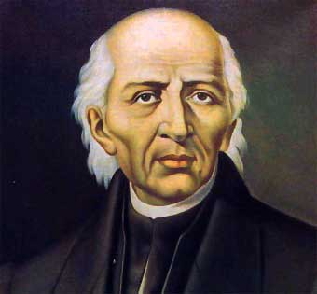
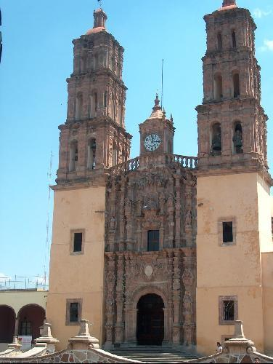
History: Mexico
Roman Catholic missionaries were in New Spain trying to convert the natives to Christianity. In 1810, a native priest, Father Miguel Hidalgo, began a revolt against Spanish rule. He was killed in 1811. This turned the population against the Spanish. They revolted against the Spanish until they won their independence in 1821.

Slide 7
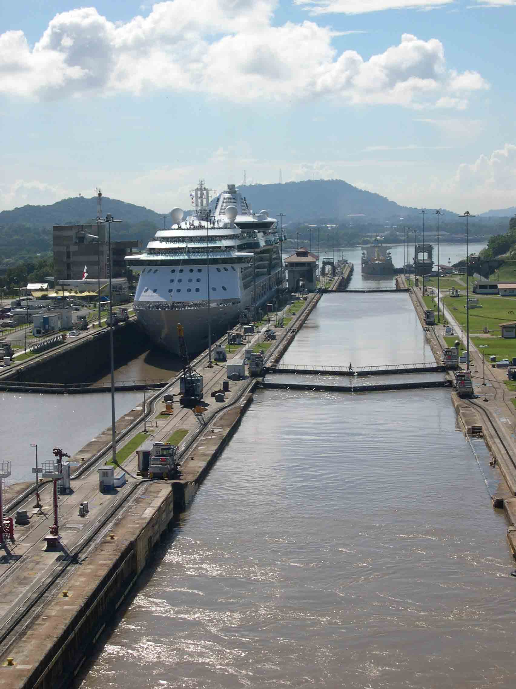
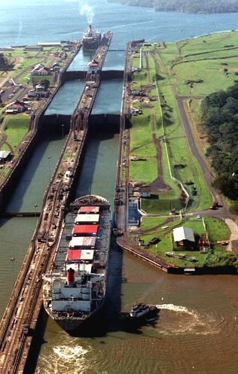
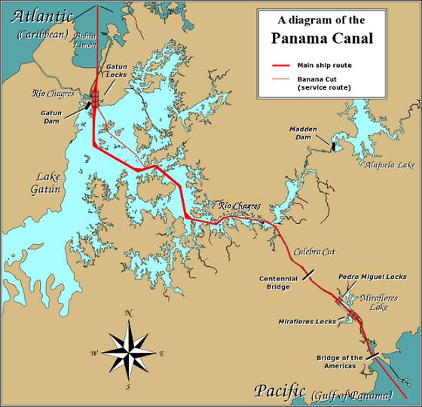
The Panama Canal
Operation

Slide 8
Panama Canal
US President Theodore Roosevelt started project through a treaty that gave the US control over a strip of land 10 miles wide and 50 miles long on either side of the Panama Canal Zone. In the zone, the US would build a canal, administer it, fortify it, and defend it for 99 years.
It was built by the US Army Corps of Engineers between 1904 and 1914.
The canal is made up of locks. These locks raise and lower the water level by gravity for the ships.
It is located at the narrowest passage of the isthmus
It connects the Caribbean Sea (Atlantic Ocean) and the Pacific Ocean
The 50 miles takes 8-10 hours to pass through
Cost is $800-$3200 depending on size of ship/boat
35-40 vessels per day

Slide 9
The Panama Canal
The builders dealt with tremendous rain, heat, diseases, landslides and mudslides.
During the construction over 25,000 died due to disease.
The cost was $375,000,000 (at the time the most expensive project ever) (roughly equivalent to $8,600,000,000 now)
The canal saved ships traveling from the Atlantic coast to the Pacific coast 7,872 miles
The Canal provides approximately $1 billion dollars a year in revenue
Work force is approximately 9,000 a day and operates 24 hours, 365 days year
Only certain sizes of ships can pass, many ships are too large to pass
President Jimmy Carter gave the control to Panama in 1977 (15 years before the time was up).
2016, the canal opened a new lane for larger ships

Slide 10
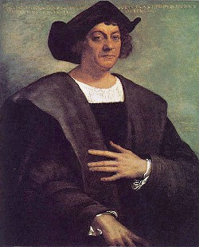
History: Caribbean
Christopher Columbus was the first European explorer to travel to the Americas, but soon both Portuguese and Spanish ships began claiming pieces of Central and South America.
He came searching for a shorter trade route to India by going west. He named the area West Indies, thinking he had landed in India. The name stayed even when people realized the mistake.
During the first voyage of Columbus, contact was made with the natives in the Bahamas and Cuba, and a few of the native people were taken back to Spain. The Spanish enslaved the native population and rapidly drove them to near-extinction. The need for workers led to labor, the importing of African slaves.

Slide 11
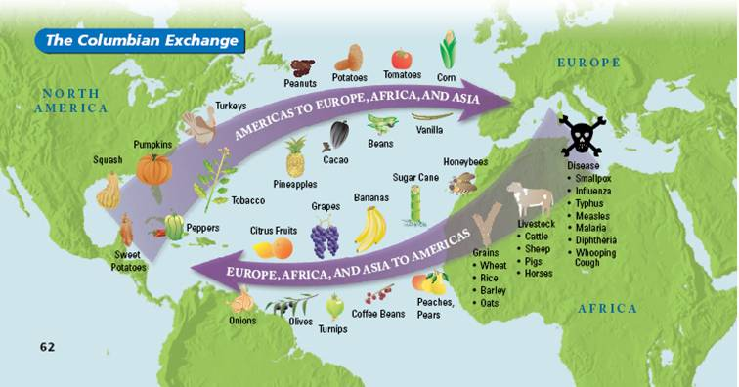
Columbian Exchange
The Columbian Exchange was a widespread exchange of the animals, plants,
foods, culture and human populations, diseases, and ideas between the Old World
and New World. The horse and pig was introduced to the new world.

Slide 12
Slave Trade – Triangle of Trade
Slavery started because:
Natives of Americas were dying due to: over worked and diseases brought by the Europeans
Need for workers from same climate and uneducated
The Triangle of Trade:
Left from Europe to Africa carrying manufactured goods, weapons, livestock, etc.
Went from Africa to the Americas or Caribbean with slaves or new products
From the Americas or Caribbean to Europe with sugar, tobacco, rum, rice, cotton, etc.

Slide 13
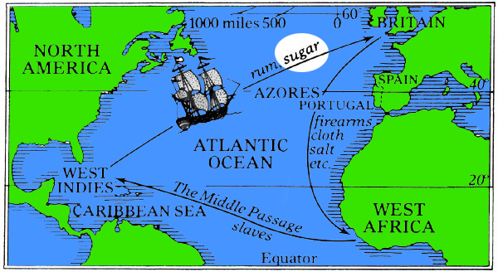
Slave Trade – Triangle of Trade

Slide 14
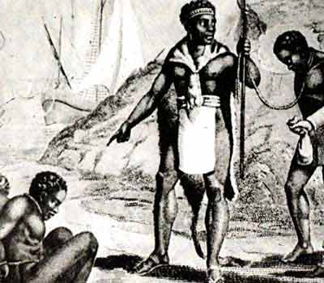
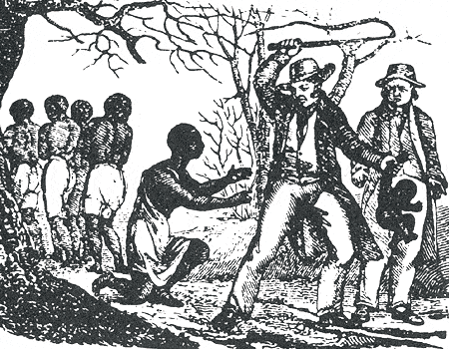
Slave Trade – Triangle of Trade
Mighty African kings sold their captives to European slave traders for such things as: metal cookware, livestock, and weapons (that they could use to fight other tribes and gain more captives).

Slide 15
Slave Trade – Triangle of Trade
British ships dominated the market for slaves in the Americas and supplied African captives to Dutch, French, Portuguese and Spanish colonies.
The slaves were traded for or captured by raiding parties, imprisoned at coastal forts and forced to endure a horrific voyage as human freight. At its height British ships carried some 40,000 chained men, women and children across the Atlantic each year. Many died while being captured.
The “standard space per slave” laid down by the Royal Africa Company was 5 foot long, 11 inches wide and 23 inches high – for a voyage lasting at least 2 months.
Around 1 in 6 of the slaves died on the journey (12- 13%). Those who survived were sold at auction into a life of brutal labor on plantations.
26% were children
In the West Indies, on average, a slave mother gave birth to 18-20 children. So many bought the slave women first.

Slide 16
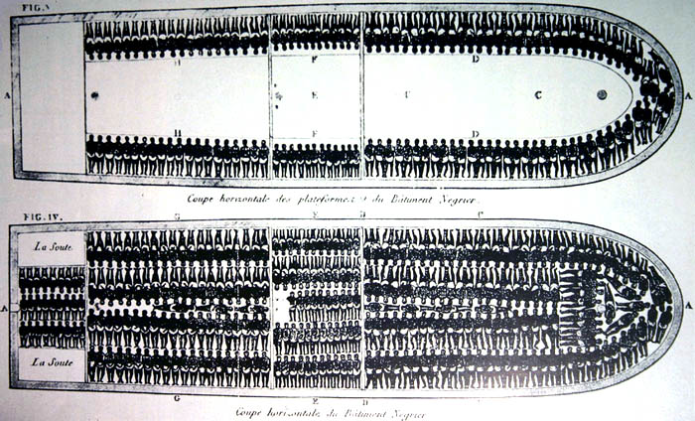
Slave Trade – Triangle of Trade

Slide 17
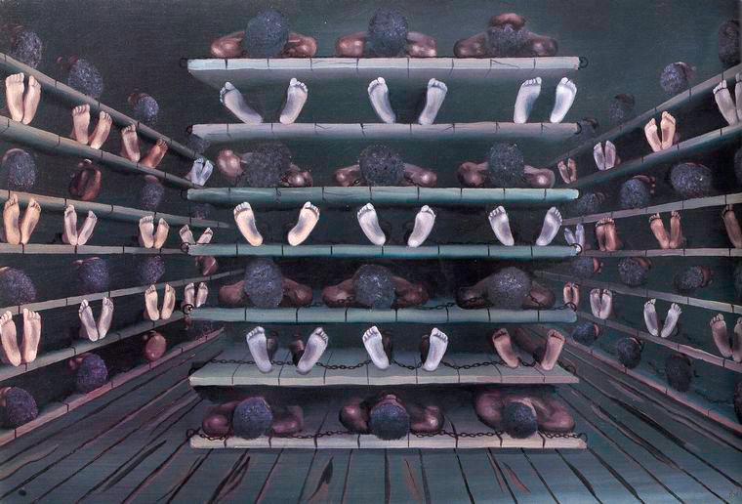
Slave Trade – Triangle of Trade

Slide 18
Slave Trade – Triangle of Trade
As a warning to others, those who would not eat or who physically rebelled, faced a variety of tortures designed to kill them slowly. Slaves were frequently whipped “until they could let out not even a whimper” and then left tied to the deck through the sun and rain for days.
There were even cases of entire shiploads of slaves being thrown overboard to their death so that the ship’s owners could claim them as a “loss” against their insurance policies.
Slaves who chose to reject their masters by running away could expect the lash, and, at times, the iron collar and a straitjacket. Eventually most owners took to branding their slaves with a red-hot iron that carried the mark of their owner.
Estimates on the number of Africans who lost their lives due to slavery vary between 10 and 30 million.
Slavery official ended in the 1800s. That last continent to outlaw slavery was Africa.

Slide 19
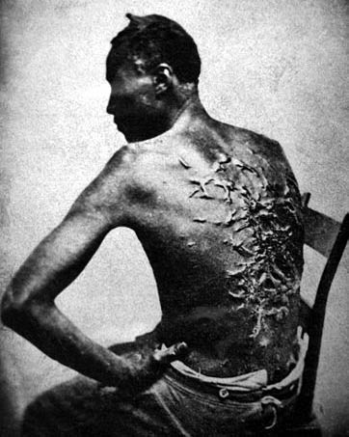
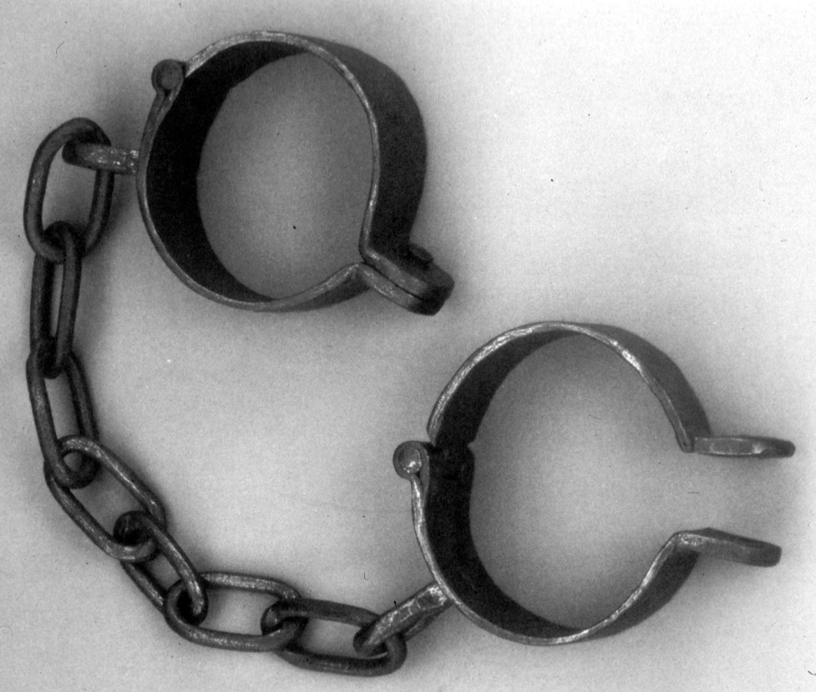
Slave Trade – Triangle of Trade

Slide 20
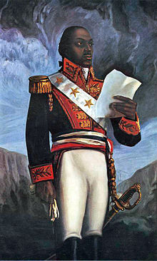
History Continued
At the end of the French Revolution, the new French government granted freedom to all blacks and mulattoes. The plantation owners in the Caribbean were furious, so the government changed its mind. Toussaint L’Ouverture led a slave army and defeated the French troops.
Toussaint L’Ouverture was invited to France to discuss a peace treaty. He was captured and died in prison. Within 2 years, St. Domingo declared their independence and renamed itself Haiti.
Haiti was the first Caribbean nation to gain independence from European powers. Haiti became the world's oldest black republic.

Slide 21
History: Cuban
Spain controlled Cuba for four centuries starting in the 1400s.
Cuba's independence came when the United States won the Spanish American War in 1898 and granted Cuba independence in 1902.
The new Cuban constitution is established in 1940. The communist party is created.
On March 1952, General Batista overthrew the president of Cuba, and canceled all elections. This angered the young lawyer Fidel Castro, and for the next seven years he attempted to overthrow Batista’s government (CUBAN REVOLUTION). He began using guerrilla tactics to fight Batista’s armed forces, and with the aid of other rebels throughout Cuba and the United States, he forced Batista to resign and flee the country on January 1, 1959.

Slide 22
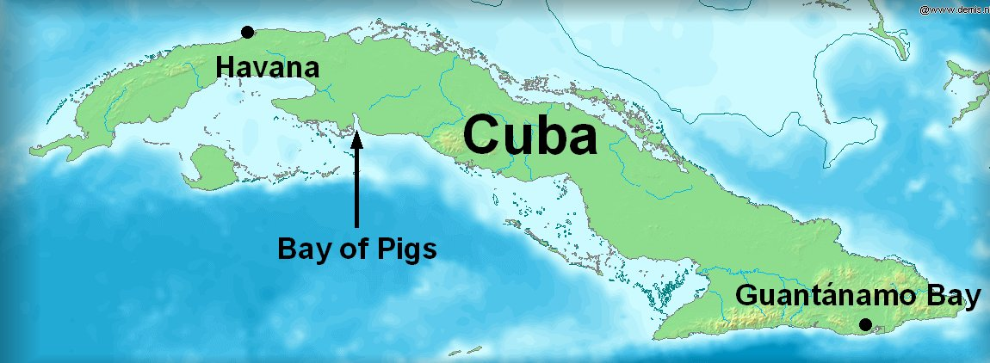
History: Cuban
Castro became the Prime Minister of Cuba in February and had about 550 of Batista’s associates executed. He soon suspended all elections and named himself "President for Life", jailing or executing all who opposed him. He established a communist government with himself as a dictator and began relations with the Soviet Union.
Once Castro embraced communism, the U.S. attempted to overthrow him. Cuban exiles, armed and trained by Americans, formed an army of 1320 and invaded Cuba’s Bay of Pigs on April 1961. The army was crushed by Castro’s army (235,000) after President Kennedy refused to directly involve the U.S. armed forces, and 1200 of the invaders were captured (120 died). The United States was forced to give $53 million worth of food and supplies to Cuba for the release of the captives.

Slide 23
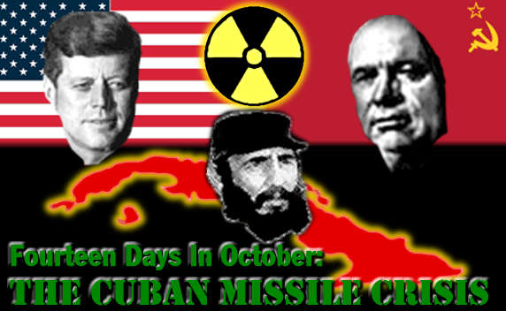
At the time the US had missiles in Turkey since the end of WWII. USSR felt threatened. Due to US involvement in the Bay of Pigs invasion, Soviet leader Nikita Khrushchev, felt that the US would do little to resist Soviet Expansion. So, in July 1962, Khrushchev began installing missile sites in Cuba. When this was discovered, Kennedy completely blockaded Cuba and threatened to invade or fire on USSR directly. The USSR promised to withdraw from Cuba if the US promised to never invade Cuba and if the US would remove missiles from Turkey. The conflict known as the Cuban Missile Crisis was resolved.

Slide 24
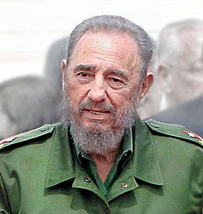
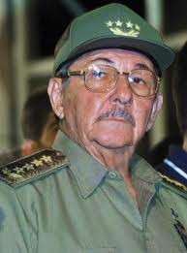
History: Cuban
Soviet aid represented 75% of Cuba’s economy. The United States had issued a trade embargo around Cuba, so when the Soviet Union collapsed in 1991, so did Cuba’s economy.
The Cuban people have lost all personal freedom, lost all personal property and now occupy government-owned, rotting, worn-out buildings that are crumbling around them.
In October 2006, it was officially declared that the political power of Cuba was transferred to Castro's brother, Raul, on account of Castro's health.
Ex-President Obama has eased the embargo on Cuba, making it easier for trade. The relationship between the two countries is currently changing.

Slide 25
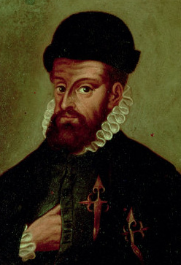
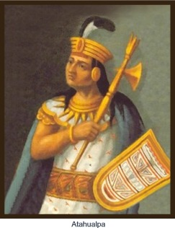
The INCAS
They arose from the highlands of Peru from 1438 to 1533
In 1521, Herman Cortés conquered the Aztecs; this conquest inspired Francisco Pizarro to invade the Incas in 1531. He only had two hundred soldiers. However, he convinced the ruler of the Incas, Atahualpa, to come to a meeting. When Atahualpa arrived, Pizarro kidnapped him and killed several hundred of his family and followers. Atahualpa tried to ransom himself, but Pizarro tried to use him as a puppet ruler. When that failed, Pizarro simply executed him in 1533.
Over the next thirty years the Spanish struggled against various up risings, but, with the help of native allies and diseases, they finally gained control of the Inca empire in the 1560's.

Slide 26
Inca Achievements:
They built roads through the mountains from Ecuador to Chile with tunnels and rope bridges.
They also built aqueducts to their cities as the Romans had.
The Inca made many discoveries in medicine. They performed successful skull surgery, which involved cutting holes in the skull to release pressure from head wounds.
Coca (ingredient of cocaine) leaves were used to lessen hunger and pain. Messengers chewed coca leaves for extra energy to carry on their tasks as runners delivering messages throughout the empire.
The Inca also practiced cranial deformation. They achieved this by wrapping tight cloth straps around the heads of newborns in order to alter the shape of their still-soft skulls. These deformations did not result in brain damage.

Slide 27
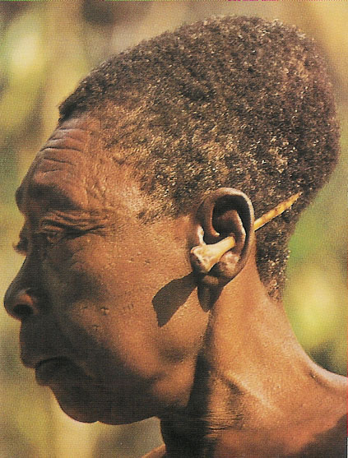
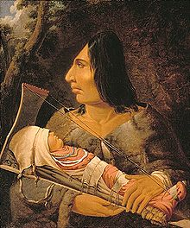
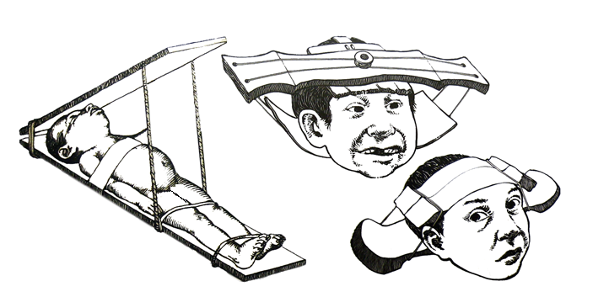

Slide 28
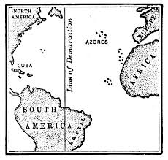
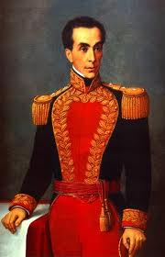
History: South America
After Columbus came into the area other countries followed. Spain and Portugal fought over the entire area.
Pope Alexander VI divided South America between the two countries. (Line of Demarcation)
Simon Bolivar (a Venezuelan) was known as the LIBERATOR. He fought the Spanish to win the independence of Venezuela, Colombia, Ecuador, Peru, and Bolivia.
Almost all of the colonies had gained their independence by the 19th century. Europe still has involvement with many of the countries.

