Slide 1
Personal Finance

Slide 2
Key Terms
Barter Entrepreneur Profit
Budget Income Sales Tax
Consumer Interest Savings
Credit Invest Specialization
Currency Loan Taxes
Debt Occupation

Slide 3
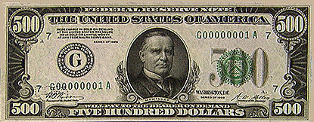
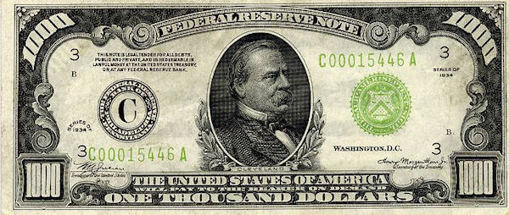
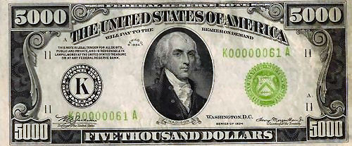
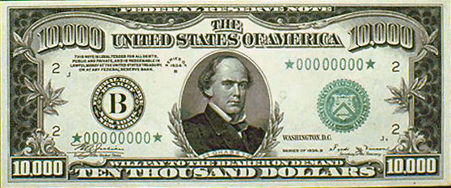
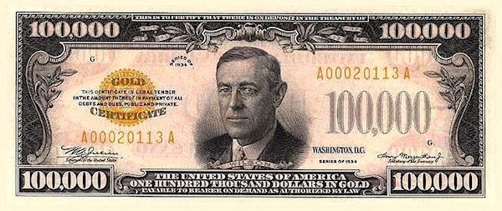
Forms of currency
Cash
Debit Card
Credit Card
Check
Food Stamps

Slide 4
Denominations

Slide 5
Denominations

Slide 6
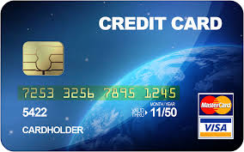
Cards
Debit cards draw money directly from your checking account. This is NOT a loan.
Credit Cards draw money from the bank. This IS a loan.

Slide 7
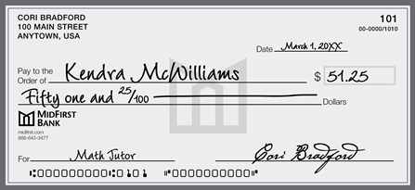
Check
Checks are the same as debit cards. The money comes from your checking account. This is NOT a loan.
It is very important that you keep up with your account balance, so that you do not spend more than you actually have.

Slide 8
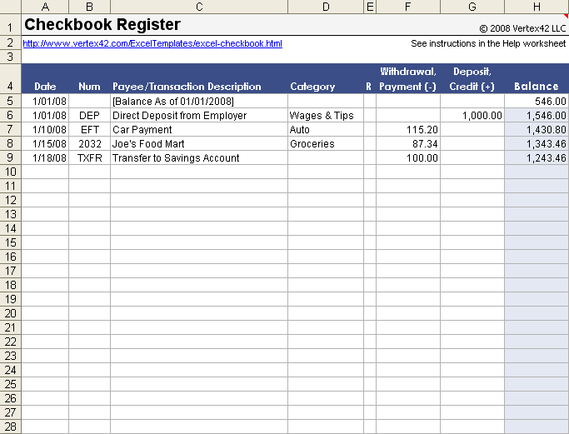
Ledger
What are you expenses?
What is your income?
What can you afford (budget)? Life Skills Sheet

Slide 9
What is the best way to get paid?
Straight Hourly
Pros: Get a definite hourly rate, can get overtime pay, You have a “work day”
Cons: Don’t work, don’t get paid, less or no benefits
Hourly and Tips
Pros: Can make more money due to tips
Cons: Hourly is less due to addition of tips, to get the best tips, you usually have to work unfavorable hours
Straight Salary
Pros: Get a definite pay check, Usually make more money, get more benefits
Cons: You may not have a actual “work day”, Hourly might get paid more (when you include overtime)
Salary and Commission
Pros: You can make a lot of money, if you are willing to work hard
Cons: Salary is less due to commission, If you don’t work hard, you get paid as much

Slide 10
How does a bank work?

Slide 11
Starting and running a business
Have an idea (entrepreneur, specialization)
Get financing (borrow money from bank and/or get investors)
Set up the business (purchase equipment, merchandise, find building, hire employees, etc)
Set a prices (income - debt = profit)
Debit: cost of materials, cost of employees, cost of facilities, taxes, etc
Income: money coming in from customers, sells, etc

Slide 12
Job Project
You will take a career exploration survey. www.gafutures.org
You will choose two careers/occupations from the list and research (using the graphic organizer).
www.gafutures.org
www.mynextmove.org
You will create a visual to present to the class for each of the careers.

Slide 13
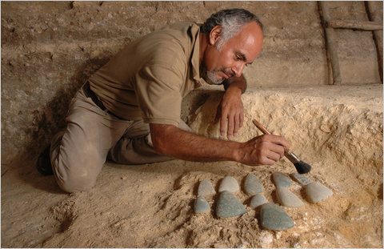
Archeologist
a person who studies human history and prehistory through the excavation of sites and the analysis of artifacts and other physical remains.

Slide 14
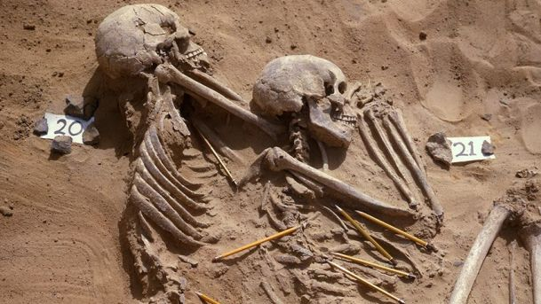
Typical day
What they do:
Conduct research to reconstruct record of past human life and culture from human remains, artifacts, architectural features, and structures recovered through excavation, underwater recovery, or other means of discovery.
On the job, you would:
Study objects and structures recovered by excavation to identify, date, and authenticate them and to interpret their significance.
Research, survey, or assess sites of past societies and cultures in search of answers to specific research questions.
Write, present, and publish reports that record site history, methodology, and artifact analysis results, along with recommendations for conserving and interpreting findings.

Slide 15
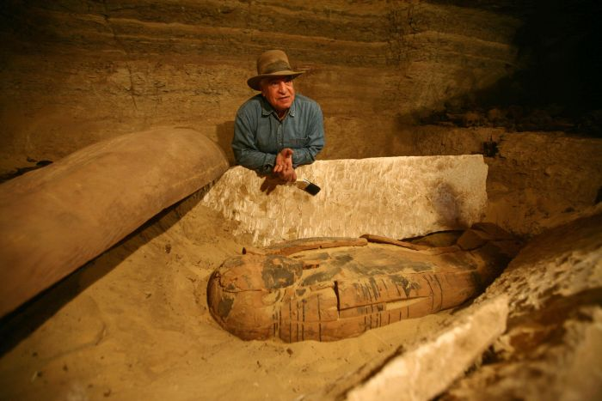
Facts:
Pay: $61,000
Possibilities for advancement: Not good
Skills required: good with a computer, good verbal and written skills, good at listening, good at problem solving, good at seeing beyond
College or technical school needed: 10 colleges in Georgia (Ga Southern, GA State, UGA) all 4 plus years
Other requirements:
Attention to Detail
Analytical Thinking
Integrity
Persistence
Cooperation
Dependability
Be willing to travel

Slide 16
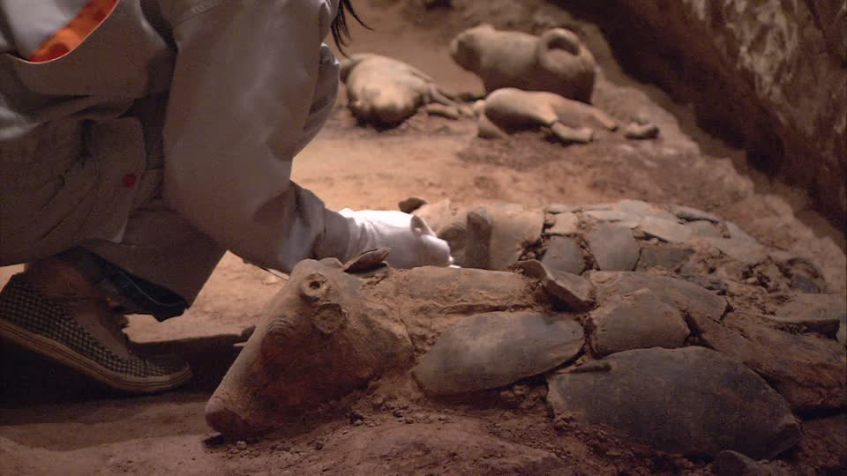
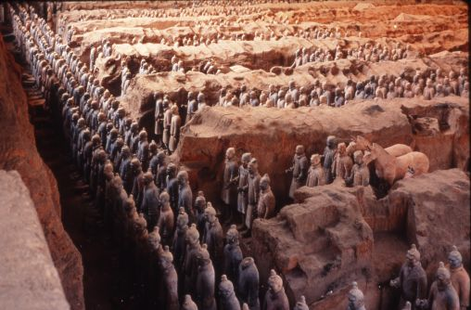
Why Archeologist
What do I like?
History
Finding things
What do I dislike?
Many times you find nothing
A lot of hours
You can’t be quick!
Why I would be good?
I am dependable
I like to travel
I am honest
I like other cultures

