Slide 1
The Governments of Europe

Slide 2
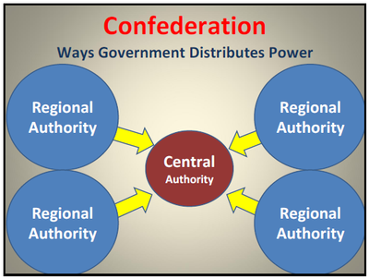
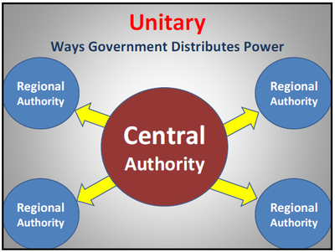
Government Systems

Slide 3
How do citizens participate in government?

Slide 4
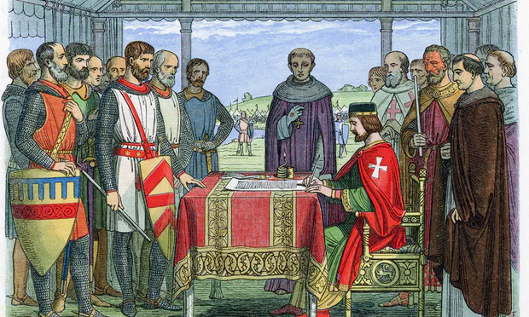
Monarchy
1215 the people forced King John to sign the Magna Carta (limited the king’s powers of taxation and required trials before punishment) Began constitutional monarchy.
Kings believed in Divine Right. (God gives them the right to rule.)

Slide 5
Europe is a federal system with a Presidential or Parliamentary Democracy
Government Type: Federal Republics and
Parliamentary Democracy with Prime Minister or Chancellor (Portugal, Spain, Germany, United Kingdom) many are also a constitutional monarchy.
Presidential Democracy with a President (Italy, France, Russia)

Slide 6
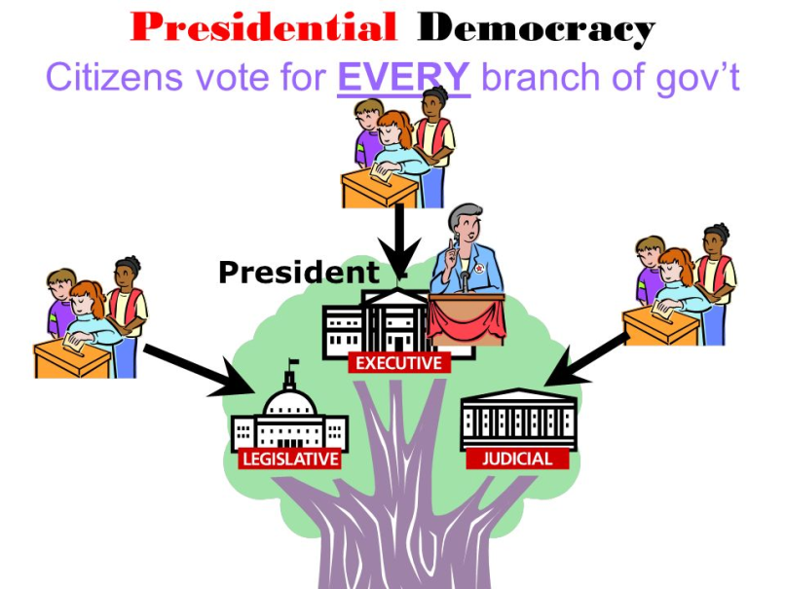
Presidential
A presidential system is a system of government where a head of government is also head of state and leads an executive branch that is separate from the legislative branch.

Slide 7
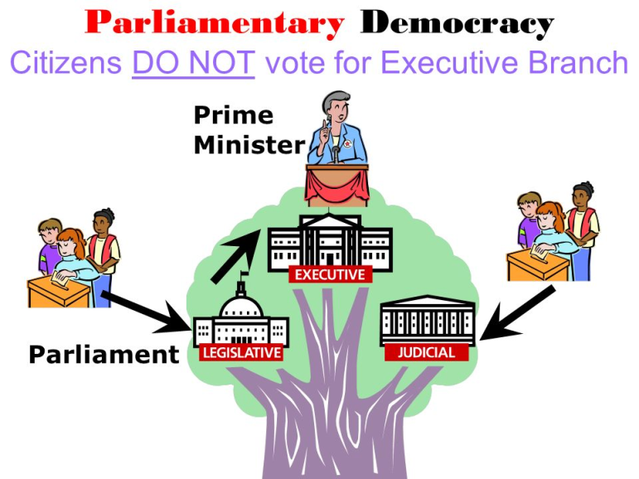
Parliamentary
Parliamentary democracy, democratic form of government in which the party with the greatest representation in the parliament (legislature) forms the government, its leader becoming prime minister or chancellor.

Slide 8
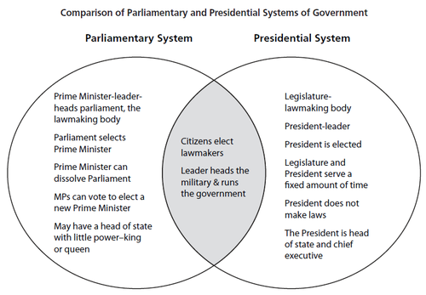

Slide 9
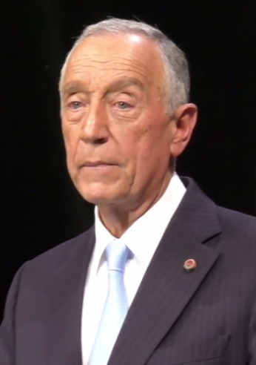
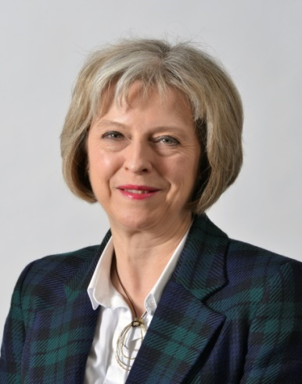
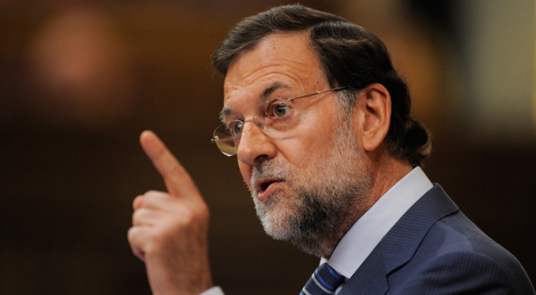
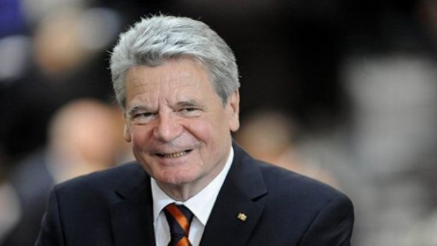
United Kingdom : Theresa May
Parliamentary
Portugal : Marcelo Rebelo de Sousa
Spain : Mariano Rajoy

Slide 10
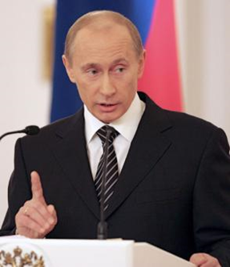
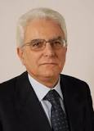
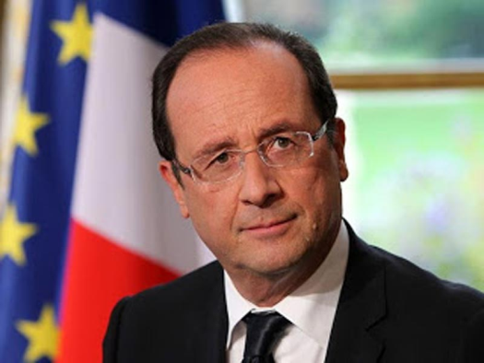
Presidential
Russia : Vladimir Putin
Italy : Sergio Mattarella
France : François Hollande

Slide 11
United Kingdom
The United Kingdom is a Parliamentary Democracy with a Constitutional Monarchy
How is power distributed? How do citizens participate?
Notes:
Instructional Approach(s): The teacher should present the information on the slide while the students record the important information on their notes. The teacher may want to ask the class to answer the two questions based on their previous knowledge from earlier lessons.

Slide 12
Structure of Government: United Kingdom
A parliamentary system in which the power in the United Kingdom’s government lies with the Parliament (legislature).
Notes:
Instructional Approach(s): The teacher should present the information on the slide while the students record the important information on their notes.

Slide 13
Form of Leadership: United Kingdom
Prime Minister is the chief executive with the MOST power
Leader of the British Parliament, works with legislative branch
Runs the government
The monarch is the official head of state (a symbol for the country)
Duties are mostly ceremonial
role is restricted by the constitution of the United Kingdom
Notes:
Instructional Approach(s): The teacher should present the information on the slide while the students record the important information on their notes.

Slide 14
Form of Leadership: United Kingdom
The monarch is inherited.
Following legislative elections by the people, the leader of the majority party is usually the prime minister.
The UK legislature has two houses. One house is elected by popular vote.
Notes:
Instructional Approach(s): The teacher should present the information on the slide while the students record the important information on their notes. The teacher may want to start by asking students what hereditary means.

Slide 15
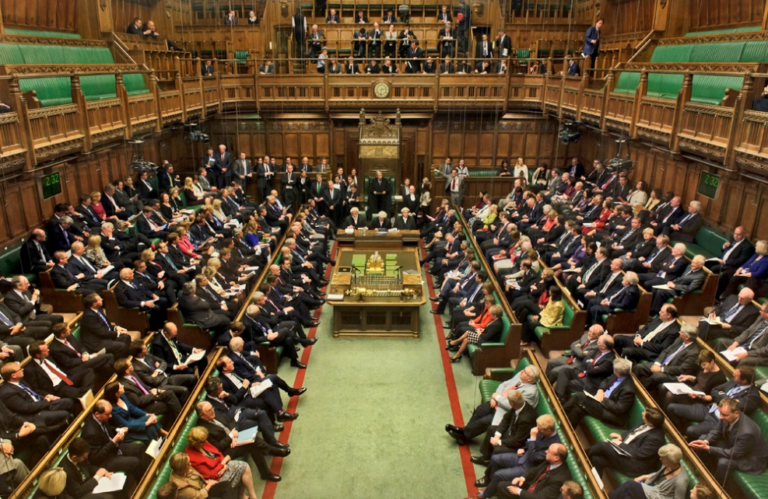
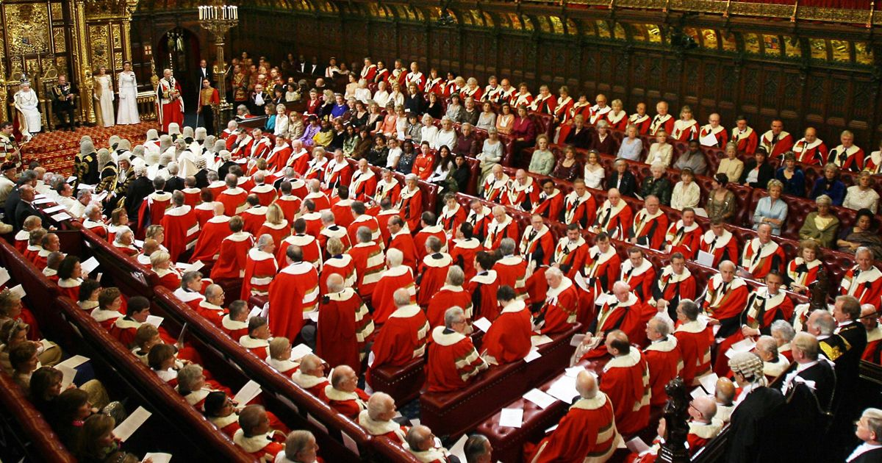
Form of Leadership: United Kingdom
The business of Parliament takes place in two Houses:
1. House of Commons
2. House of Lords

Slide 16
Form of Leadership: United Kingdom
The House of Commons is responsible for making laws for the country.
Citizens elect members of the House of Commons
The political party with the most votes chooses the Prime Minister.

Slide 17
Form of Leadership: United Kingdom
The House of Lords plays an important part in revising legislation and keeping a check on government
It has little power.
Most members of the House of Lords are nobles who have inherited their titles.

Slide 18
Role of the Citizen: United Kingdom
Citizens are granted basic rights and personal freedoms like the right to vote and freedom of speech, press, religion, and assembly.
Notes:
Instructional Approach(s): The teacher should present the information on the slide while the students record the important information on their notes.

Slide 19
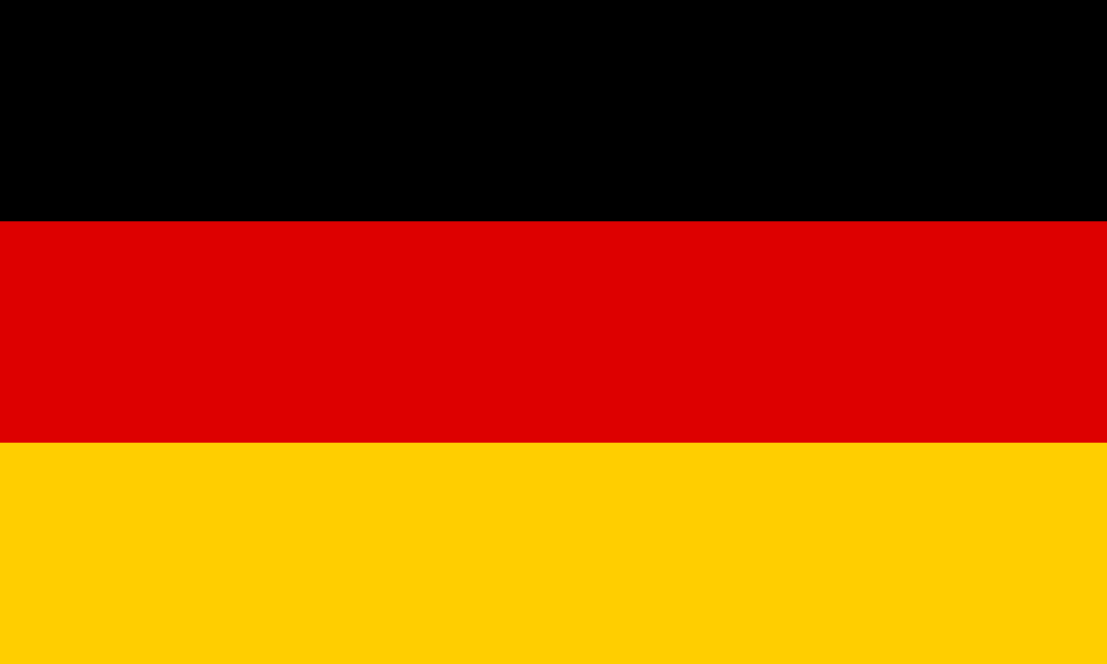
Germany
Germany is a Federal Parliamentary Republic
How is power distributed? How do citizens participate?
Notes:
Instructional Approach(s): The teacher should present the information on the slide while the students record the important information on their notes. The teacher may want to ask the class to answer the two questions based on their previous knowledge from earlier lessons.

Slide 20
Structure of Government: Germany
A federal system of government in which power is shared between a central government and state governments
Ultimate power rests with the people who elect their government representatives
Notes:
Instructional Approach(s): The teacher should present the information on the slide while the students record the important information on their notes.

Slide 21
Form of Leadership: Germany
Chancellor is the chief executive
Runs the government
Elected by the Bundestag (legislature)
The president is the official head of state
a symbol for the country
Duties are mostly ceremonial
Representatives of the legislature and representatives of the states choose the president

Slide 22
Form of Leadership: Germany
Bundestag has the most power
Citizens of each German state elect its members
Members of this house elect the Chancellor (chief executive of Germany)
Bundesrat represents the interests of the state governments
Each state government selects representatives for this house
Mainly concerned with laws that affect states, such as education and local government issues

Slide 23
Role of the Citizen: Germany
Germany’s constitution guarantees basic rights and personal freedoms, such as the right to vote, equal rights, and freedom of speech, religion, and press.
Notes:
Instructional Approach(s): The teacher should present the information on the slide while the students record the important information on their notes.

Slide 24
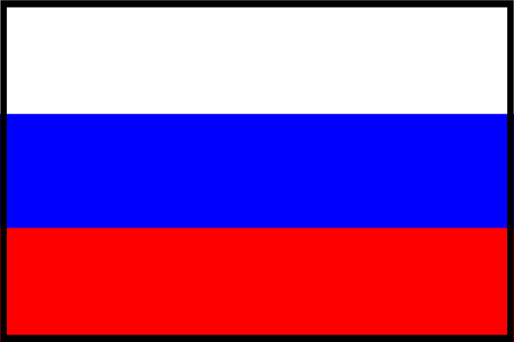
Russia
Russia is a Federation with a President
How is power distributed? How do citizens participate?
Notes:
Instructional Approach(s): The teacher should present the information on the slide while the students record the important information on their notes. The teacher may want to ask the class to answer the two questions based on their previous knowledge from earlier lessons.

Slide 25
Structure of Government: Russia
In a federation (federal), power is divided between a central authority and a number of districts.
The central government exerts influence directly upon people as well as upon the districts.
Notes:
Instructional Approach(s): The teacher should present the information on the slide while the students record the important information on their notes.

Slide 26
Form of Leadership: Russia
The president is the head (chief) of state and the head of government and is elected by popular vote
The Prime Minister is appointed by the President
The legislature consists of a lower house (State Duma) which is elected and an upper house (Federation Council) which is appointed.
Notes:
Instructional Approach(s): The teacher should present the information on the slide while the students record the important information on their notes.

Slide 27
Form of Leadership: Russia
The legislative branch is far weaker than the executive branch.
The President can pass decrees without consent from the legislature.
How is this different than the United States?
Notes:
Instructional Approach(s): The teacher should present the information on the slide while the students record the important information on their notes.

Slide 28
Role of the Citizen: Russia
The constitution provides for basic rights and personal freedoms, such as the right to vote, equal rights, freedom of religion, freedom of speech and of the press; however, in practice government pressure on the media persists, resulting in numerous violations of these rights.
The government uses its influence to restrict access to information deemed “sensitive”.
Notes:
Instructional Approach(s): The teacher should present the information on the slide while the students record the important information on their notes. The teacher may want to ask the students what type of information might the government deem as “sensitive”. Opposition movements or political parties are often restricted. Additionally, ask the students if there have been any recent events in which the government might have controlled the type and amount of information its citizens received (the situation with Ukraine).

